Slide 1
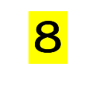
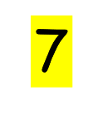

Slide 3
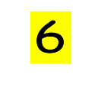

Slide 5
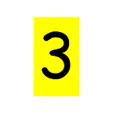

Slide 8
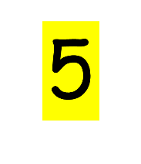

Slide 9
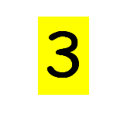

Slide 10
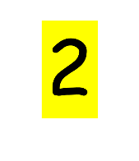

Slide 11
5
3
2
0

Slide 12
5
3
2
0

Slide 13
9
8
7
6
5
10

Slide 18
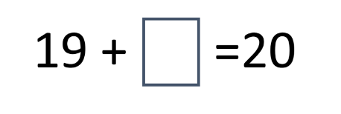
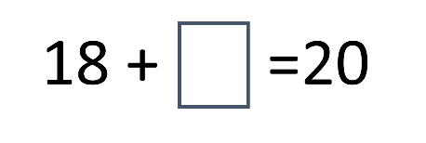
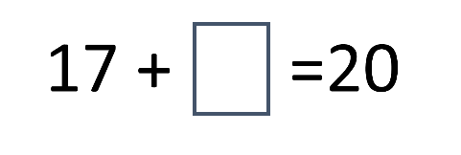
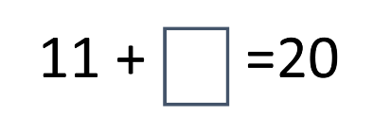

Slide 20
19 +
18 +

Slide 21
17 +
16 +

Slide 22
15 +
14 +

Slide 23
13 +
12 +

Slide 24
11 +
10 +

Slide 27
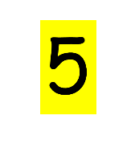
+

Slide 28
+

Slide 29
+

Slide 30
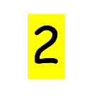
+

Slide 31
+

Slide 32
+

Slide 40
9 + =10

Slide 41
8 + =10

Slide 42
7 + =10

Slide 43
6 + =10

Slide 44
5 + =10

Slide 45
4 + =10

Slide 46
3 + =10

Slide 47
2 + =10

Slide 48
1 + =10

Slide 49
0 + =10

