Slide 1
Teacher’s Notes
The objective here is to provide a little introduction into Morris Dancing with a number of slides which can be presented alone or incorporated into other powerpoints by the individual teacher. There are words such as “fusion” , “evolution”, “amplification” “parody” and “tradition” which may need explanation but are well worth adding to a child’s vocabulary. It should keep introduction down below 10 minutes.
There is minimal writing on slides from 5 onward. The intention is to be a visual addition to the teacher’s introduction rather than subject the children to “death by powerpoint” and slides 3 & 4 can be skimmed over or omitted entirely. Most teachers will no doubt edit the powerpoint to their own tastes.
The examples shown are by no means definitive or exhaustive and leave children with scope for much research.
I have deliberately not put maps in as many KS1 & 2 children will have little knowledge to relate it to and I do not think spoon feeding them will be helpful. This could, however open up an area for a geographical investigation by the children themselves offering a discovery learning experience. The other thing is that, in an age when we have Irish dancers in Hong Kong and Chinese restaurants in Dublin, the majority of Morris dancing in all styles now takes place far away from the area which gives it its name.
Staff thinking about introducing Morris dancing will usually find their own local Morris teams helpful with information, speakers and, perhaps, equipment loans.
There are three umbrella Morris organisations, The Morris Federation http://morrisfed.org.uk Open Morris http://www.open-morris.org and the (all male) Morris Ring http://www.themorrisring.org which usually work closely.
You can find further teacher friendly information, including practical ideas, resources, history and use within the curriculum, on sites such as www.morrisminors.wordpress.com or http://www.backtothequarry.net . The former organisation can supply a free video of good amateur quality showing adult teams performing many different types of Morris.
One organisation notable for work with children in the East Midlands is http://www.hallamtrads.co.uk/Education.html . The Great Caper http://www.thegreatcaper.co.uk is a Bristol based collective promoting Morris among young people in the South and South West of England.
The main port of call for anyone investigating English folk activity is The English Folk Dance and Song Society http://www.efdss.org/ .
There are thousands of video clips on You Tube of groups performing the various styles, although I can understand the reluctance of schools to use this resource.
Any teachers wishing to “try before they teach” will usually find their local Morris team welcoming and there are many weekend events such as “Freaks in the Peaks” http://www.freaksinthepeaks.com which have a nominal cost and welcome beginners.

Slide 2
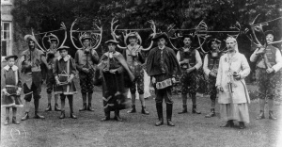
Morris Dancing
Morris Dance: One of a family of group formation folk dances from a defined location within England normally, but not exclusively, danced by men.

Slide 3
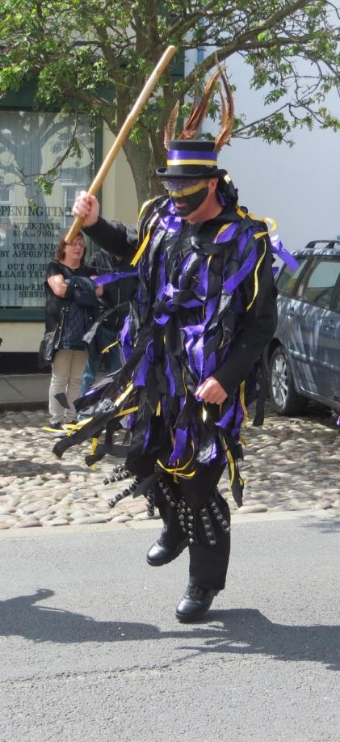
The definition on the first slide is immediately contentious!
A major problem is that there is no clear definition of ”Morris Dancing”. Some say it should be restricted to the Cotswold variety or certainly no further than Border Morris, others include all group display dances, which throw it as wide as Longsword and Rapper dancing or even Appalachian Tap. The origins and purpose of all Morris styles may vary considerably. The term Morris Dancing has also, more recently, been applied to a modern cheerleading discipline.
While there are still many men only (and women only) teams, there is probably a 50/50 male/female split generally.
While most dances are still danced in their place of origin, many of the dances have been exported far from their roots.
There are examples of Welsh dances.
There are some solo and duet dances, particularly in the Cotswold tradition.

Slide 4
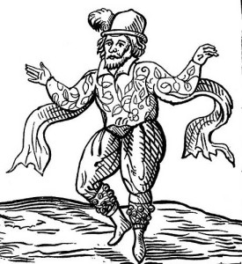
How Old Is Morris Dancing?
The truth is that this is lost in time. I would caution you to treat any history of the Morris dance, especially this one, with a large pinch of salt. One problem is that the doings of common folk were of little interest to diarists and chroniclers, another is the variety of dances described as “Morris” which probably came into being independently at different times.
Mentions of Morris in contemporary documents go back to the middle ages and it was already an old and established dance form in 1600 when William Kempe (shown here) performed his “nine day wonder”, dancing from London to Norwich.
Some say the dances came up through the Morriscos of Spain, others that it comes from a group of dances performed in the Balkans under the term “little mill”. It is possible that the origin of some dances, such as the Abbotts Bromley Horned Dance, are more local and may pre date the use of the term “Morris”. The truth is that the Morris known to Kempe and the Morris we know today is the result of fusion and evolution which has gone on throughout history and that there is no real answer as to where it came from.
My humble and personal opinion is that those looking for a “big bang” point at which Morris burst forth, fully formed and uniquely distinguishable, are doomed to labour in vain.
The fusion and evolution aspect can be noted in the adoption by many traditional troupes of Irish and Scottish tunes or 19th century polkas. Recently French and Iberian tunes have also crept in.

Slide 5
The costumes and tunes used in Morris Dancing vary considerably. We will look at examples of Morris costumes from around England. These are not all. There are many, many more.

Slide 6
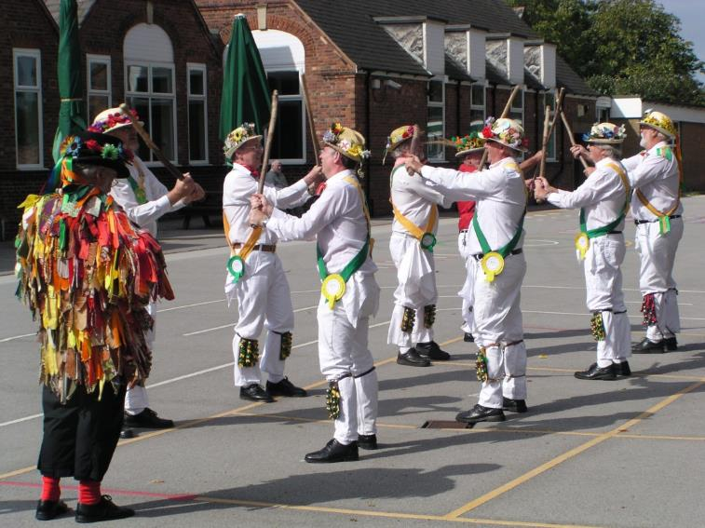
Cotswold Morris
Mention Morris Dancing and the Cotswold style immediately springs to mind, probably because it is the most parodied for popular entertainment in the mass media.
The clue is in the name as it originates mostly, but not exclusively, from the Cotswold and Thames Valley areas.
The dancers wear bells and baldrics or sashes. Costume may vary but white usually predominates.
Dancers may carry sticks or waivers (hankies) and the style is usually noted for complex footwork.
Here they have borrowed a melodeon player from a “Border” Morris team.

Slide 7
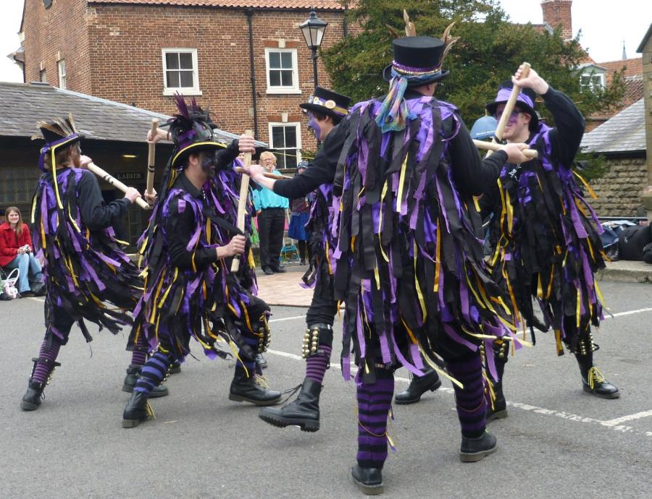
Border Morris
Characterised by the flowing tassels on the “Tatter Jackets”, Border Morris, from the borders of England and Wales, has an aggressive edge and tends to have more aggressive music.
It usually relies on formation body movement rather than complex stepping routines.
Blacking up of the face, “The poor man’s mask”, has been traditional but is now often abandoned to reflect modern sensitivities.

Slide 8
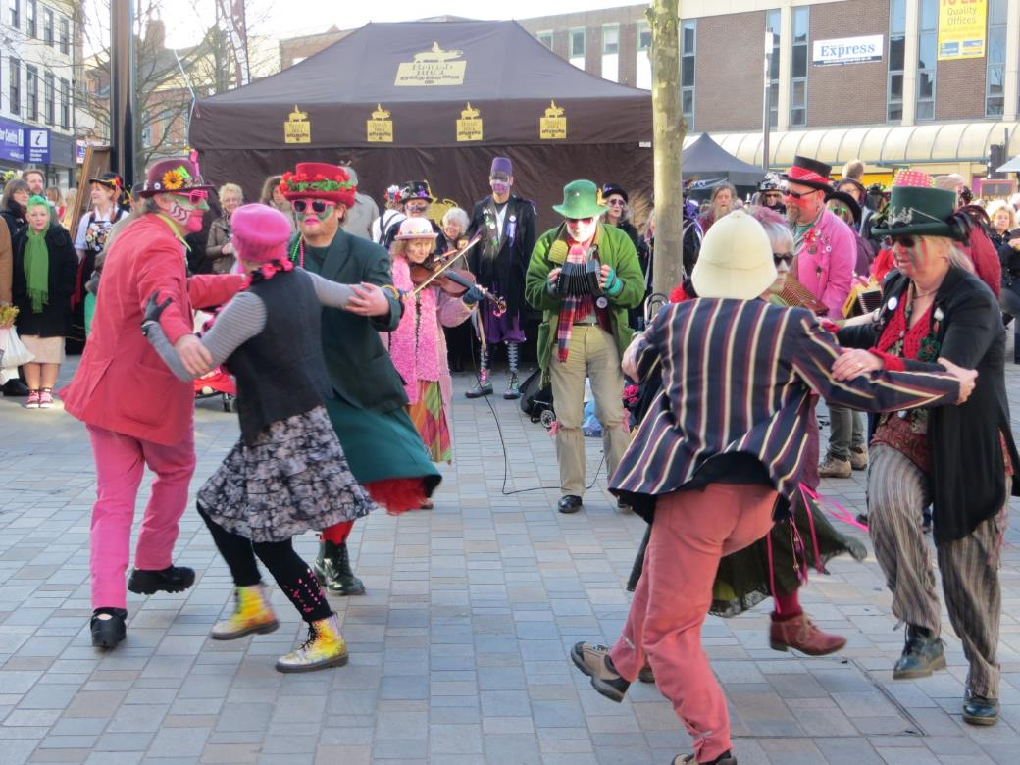
Mollie Dancing
Mollie Dancing originates from the fens and East Anglia. No sticks or waivers are normally used and there is a tradition of cross dressing in a comical or grotesque form. The music tends to be light and bouncy.

Slide 9
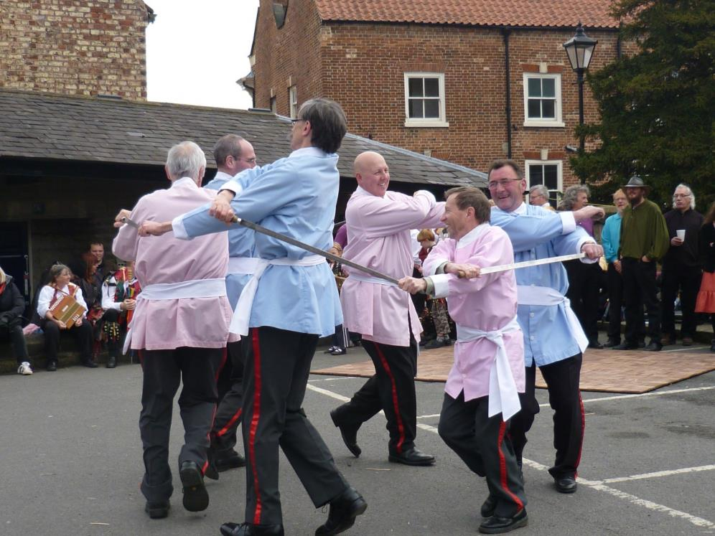
Yorkshire Longsword
Totally different to styles such as Cotswold and Border.
The team shown here are the Goathland Plough Stotts from North Yorkshire although the tradition exists in all three Ridings.
Some suggest it has military origins and could go back as far as Viking times, although this is not provable.

Slide 10
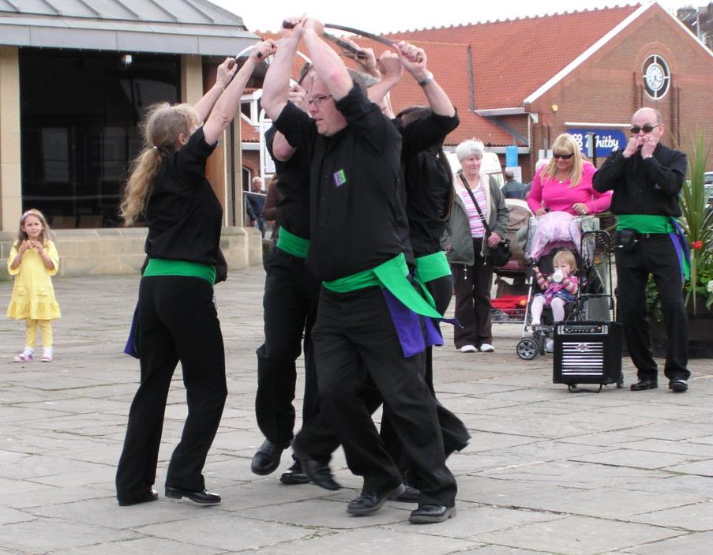
Short Sword or Rapper
Rapper dancing is associated with the pits of County Durham and South Tyneside.
The dancers may wear clogs and use “swords” with a handle at each end.
Movement is much faster than in Longsword dancing, especially the footwork.
Note the music here, unusually electronically amplified, is from a single harmonica player.

Slide 11
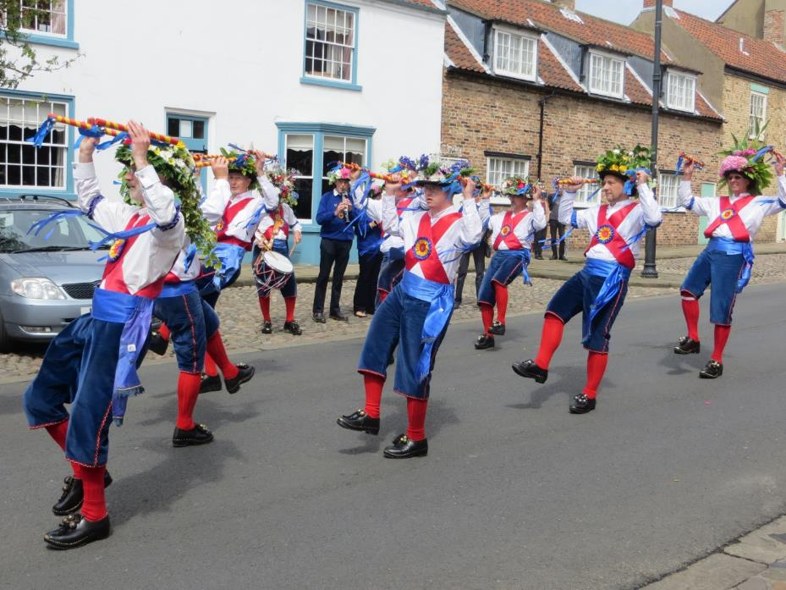
North West Morris
The North West tradition comes from North Cheshire, Lancashire and West Yorkshire and tends to be associated with industry rather than agriculture. Many teams dance in clogs.
All male or female teams are usual although there are some mixed teams.
Here the Ripon Morris Men dance out in Bridlington’s old town.

Slide 12
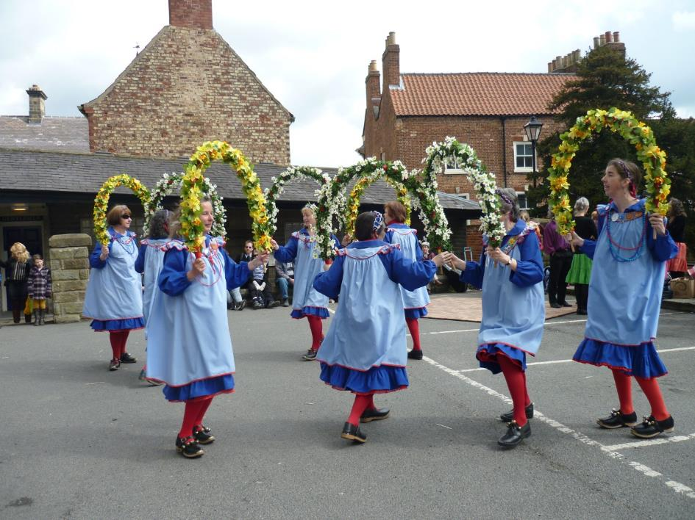
Garland Dancing
Garland Dancing in Britain tends to go with the North West Tradition (from North Cheshire, Lancashire and West Yorkshire) but there are other examples.
Here Beverley Garland are dancing out at the Malton and Norton Folk Festival.
Note the wearing of clogs with bells on them.

