Slide 1
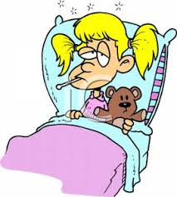
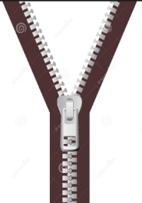
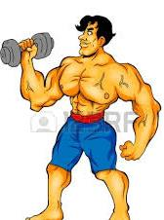
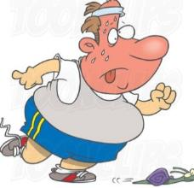
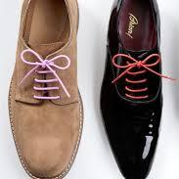
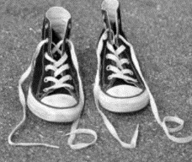
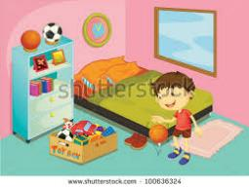
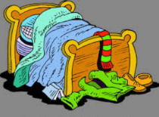
WALT: understand how ‘un’, changes the meaning of a word.
well
well | tidy | zip
happy | tie | fit
HA

Slide 2
WALT: understand how ‘un’, changes the meaning of a word.
well
tie
happy
tidy
unwell | untidy | unzip | zip
unhappy | unfit | untie | fit

