Slide 1
a e

Slide 2

cake

Slide 3

ape

Slide 4
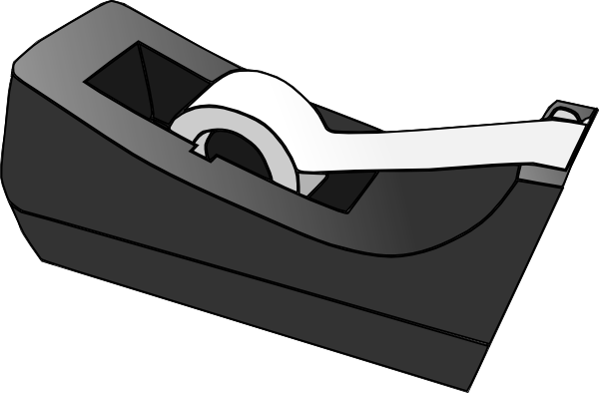
tape

Slide 5
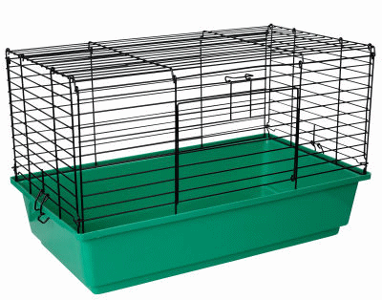
cage

Slide 6

face

Slide 7

shape

Slide 8

grape

Slide 9
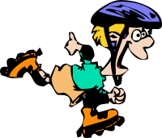
skate

