Slide 1
WALT:
Write descriptively
about a setting

Slide 2
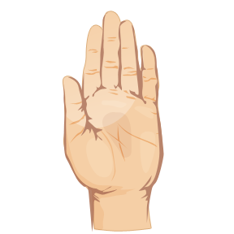
Use your senses to
build up a fantastic
description!
sight
touch
hearing
smell
taste

Slide 3
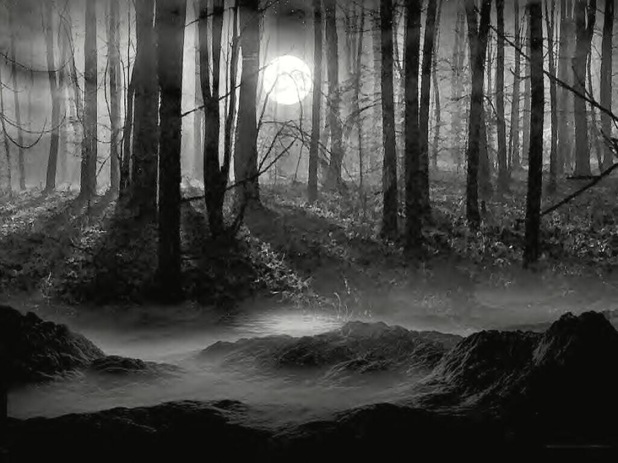
What can you touch?
What can you smell?
What can you hear?
What can you see?
What can you taste?

Slide 4
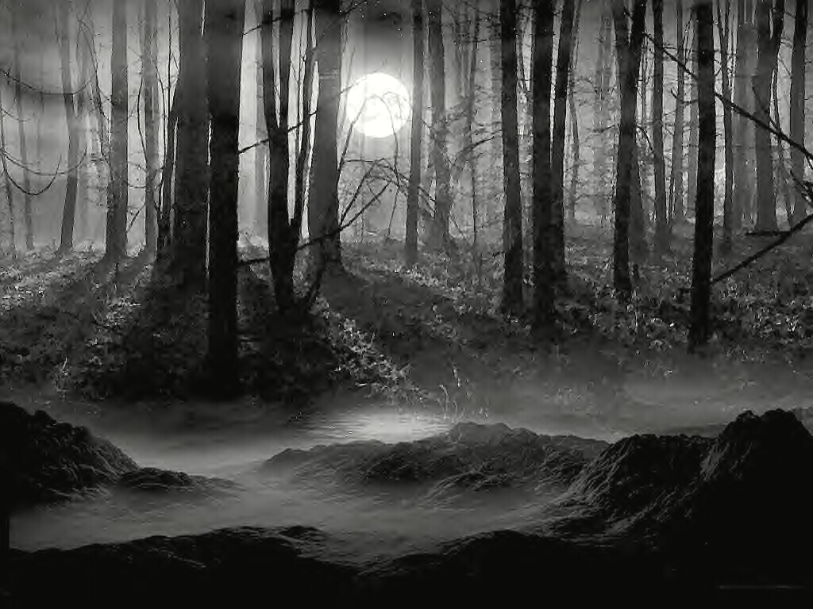
Task: Make a mind map to show what you can see, hear, smell, touch and taste.
Hear
See
Forest
Feel
Smell
Taste

Slide 5
Don’t forget to use adjectives!
twisted
dark
tree
lifeless
gnarled
bare
old

Slide 6
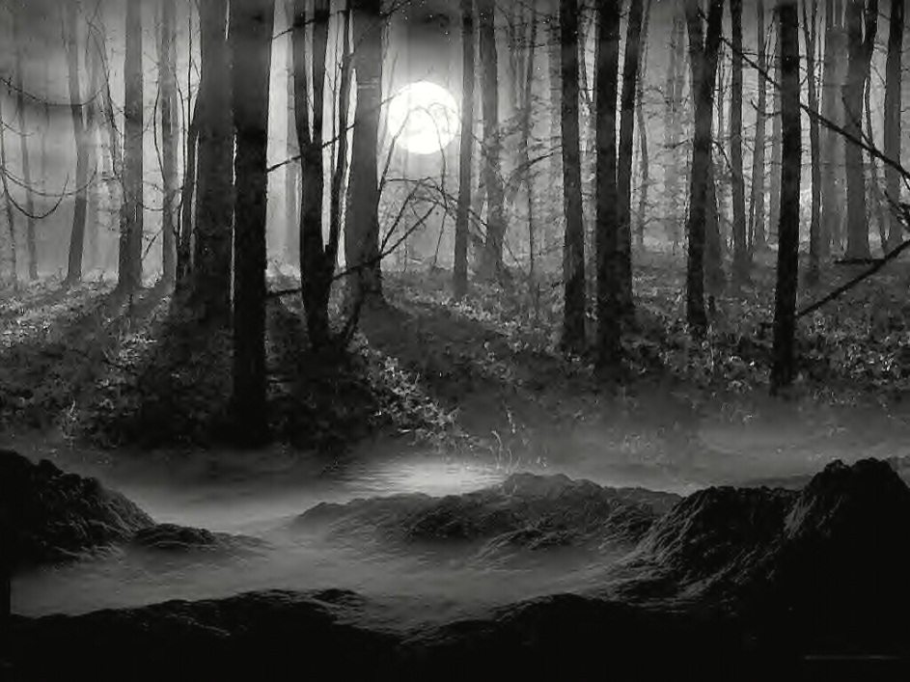
Now you are ready to write your description!
As I made my way into the forest I could see dark, twisted trees and a layer of soft, white mist covered the path. In the distance I could hear a lone wolf howling at the bright moon and the dry twigs cracked and rustled beneath my feet as I crept along. The icy wind swept across my face, stinging my cheeks. The smell of rotting leaves filled my nostrils but I pushed myself further into the darkness.

Slide 7




Now you can write descriptively about any setting!

