Slide 1
Determiners
determiners

Slide 2
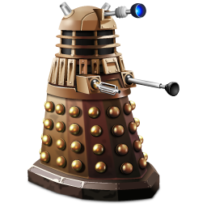
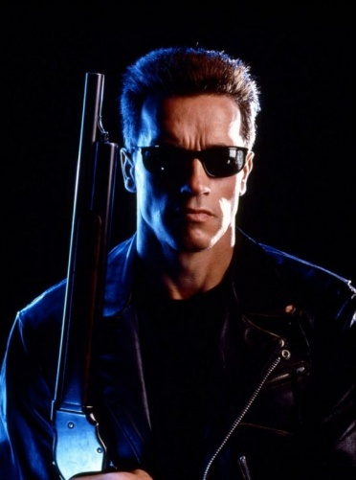
the
a
five
my
that
both
You will be determinated!
What are determiners?
determiners

Slide 3
What are determiners?
Determiners are words which introduce a noun.
One or more determiners can be found before a noun.
They do not have comparatives or superlatives.
big bigger biggest adjective
the - - determiner
that - - determiner
my - - determiner
five - - determiner
determiners

Slide 4
Types of determiners
Articles
Demonstratives
Possessives
Quantifiers
determiners

Slide 5
1. Articles
There are two kinds of articles: the definite article (the) and the indefinite article (a or an)
Nouns can be found with or without articles.
Dogs need to be walked every day.
The dogs need to be walked every day.
A dog needs to be walked every day.
determiners

Slide 6
2. Demonstratives
There are four demonstratives: this, that, these and those.
For these words to act as demonstratives, they must be in front of a noun.
That porridge was delicious. (That is a determiner)
That was delicious. (That is a pronoun)
Those people were so rude! (Those is a determiner)
Those were awful. (Those is a pronoun)
determiners

Slide 7
Can you identify the demonstrative determiners in the sentences below?
I prefer this cheese to that Cheddar.
These grapes came out of that box.
I haven’t been doing much – just a bit of this and that.
Those chocolates are just asking to be eaten.
That’s an enormous spot on your face!
These are much tastier than those apples.
determiners

Slide 8
Demonstrative determiners in red
I prefer this cheese to that Cheddar.
These grapes came out of that box.
I haven’t been doing much – just a bit of this and that.
Those chocolates are just asking to be eaten.
That’s an enormous spot on your face!
These are much tastier than those apples.
determiners

Slide 9
3. Possessive determiners
My, your, his, her, its, our and their, before a noun, will be possessive determiners.
Mine, yours, his, hers, its, ours and theirs, on their own, are pronouns not determiners.
My writing is neater than yours.
The dog ate its food quickly.
His class are so lazy.
Her singing was more tuneful than his.
Their team beat ours.
It’s not their fault her coat got lost.
determiners

Slide 10
Can you identify the possessive determiners in the sentences below?
She polished his shoes then hers.
It’s a shame that its saddle is so small.
Her feet were smellier than his.
His cakes were sold whereas our biscuits weren’t.
Our job is to make sure their cars are cleaned properly.
Ours is not an easy task.
It was my word against his.
Your bedtime should be after hers.
determiners

Slide 11
Possessive determiners in red
She polished his shoes then hers.
It’s a shame that its saddle is so small.
Her feet were smellier than his.
His cakes were sold whereas our biscuits weren’t.
Our job is to make sure their cars are cleaned properly.
Ours is not an easy task.
It was my word against his.
Your bedtime should be after hers.
determiners

Slide 12
4. Quantifier determiners – how many or how much of something.
Numbers before a noun are quantifier determiners.
I ate six biscuits.
The flat’s on the sixth floor.
I saw 2000 ants.
determiners

Slide 13
Some, many, more, less, no, little, both, each, all, enough, half, whole, every, any, much, few, several, plenty, lots, a lot and ample are all examples of quantifier determiners.
They must be before a noun otherwise they act as pronouns.
Several dogs wandered off. (determiner)
Several wandered off. (pronoun)
Most children support Norwich. (determiner)
Most support Norwich. (pronoun)
determiners

Slide 14
Some nouns are countable, others are not. You can use some quantifiers with both sorts.
Did you have lots of fun on your holiday?
There is still some dirt on the table.
There are some people who couldn’t care less.
We found many spiders in the bath.
There was no laughter in that house.
Which of the nouns (fun, dirt, people, spiders and laughter) are countable?
determiners

Slide 15
Sometimes determiners use the word ‘of’ before the noun.
Most of the crowd thought it was a goal.
He ate some of the chocolate.
Many of the adverts were rubbish.
Half of the bread was mouldy.
He’s had plenty of time to finish it.
She wasted all of the money.
Some of the geese had flown.
determiners

Slide 16
Can you identify the quantifier determiners in the sentences below?
He keeps six beetles in a jar under his bed.
If you spent less time on your Xbox, you would get more homework done.
She scored more with her second dive than her first.
In no time, he had plenty of apples in his basket.
Several lions had escaped from the first cage.
Each child had enough to last a whole month.
Both had spent all their money before the 3rd week in August.
determiners

Slide 17
Quantifier determiners in red
He keeps six beetles in a jar under his bed.
If you spent less time on your Xbox, you would get more homework done.
She scored more with her second dive than her first.
In no time, he had plenty of apples in his basket.
Several lions had escaped from the first cage.
Each child had enough to last a whole month.
Both had spent all their money before the 3rd week in August.
determiners

Slide 18
Determiners with pronouns
In some cases determiners can be used with pronouns.
All of them were wrong.
I would like that one.
I will eat lots of those.
She squashed five of these.
The one I really wanted was lost.
determiners

Slide 19
Can you identify all the determiners below?
The heavy rain flattened their sunflowers.
Those four boys need to eat theirs now.
An apple a day keeps the doctor away.
There is no time like the present.
A stitch in time saves nine.
Her new clothes were more expensive than his.
Some people like these red apples but I prefer those.
Mr Smith kept his cool and gave Jake his fourth warning.
Can I have one of those please?
determiners

Slide 20
Determiners in red.
The heavy rain flattened their sunflowers.
Those four boys need to eat theirs now.
An apple a day keeps the doctor away.
There is no time like the present.
A stitch in time saves nine.
Her new clothes were more expensive than his.
Some people like these red apples but I prefer those.
Mr Smith kept his cool and gave Jake his fourth warning.
Can I have one of those please?
determiners

Slide 21
Can you identify all the determiners below?
A first glance told her that her suspicions were justified – her evil brother had left his usual dirt on her brand new soap. Furthermore when she counted her Lush bath bombs in their box, there were seven. This morning ten bombs had filled the box. These smellies were one of her many luxuries.
This was not the first time Ben had made her angry. Yesterday Ben had sprayed half her perfume as air freshener and then tossed two bath bombs down their loo. When confronted, he had retorted, “My need is greater than yours.”
determiners

Slide 22
Determiners in red.
A first glance told her that her suspicions were justified – her evil brother had left his usual dirt on her brand new soap. Furthermore when she counted her Lush bath bombs in their box, there were seven. This morning ten bombs had filled the box. These smellies were one of her many luxuries.
This was not the first time Ben had made her angry. Yesterday Ben had sprayed half her perfume as air freshener and then tossed two bath bombs down their loo. When confronted, he had retorted, “My need is greater than yours.”
determiners

