Slide 1
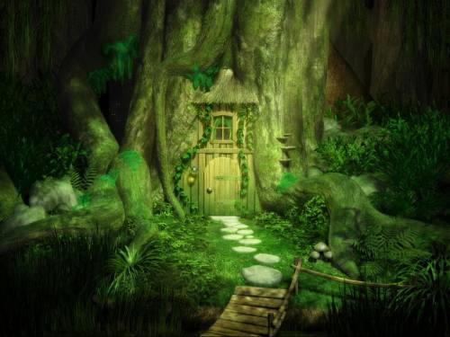

Slide 2
The Mystery Door
Imagine you are looking at the door at the bottom of a tree. What thoughts are going through your head? You are about to open the door and go inside. Use your senses to describe what you see, hear, feel, smell and taste – yes you can ‘taste’ the damp air, the fear in your mouth etc.
Create a mind map of ideas and vocabulary to help with your planning.

Slide 3
The Mystery door
Five bums on a Rugby Post
What lies behind the Mystery door?
When is this happening; what time of day?
Who lives there?
Why is it mysterious?
Where is it?

Slide 4
Questions to ask …
Who lives here?
Where is it?
Is the inside how you expect it or something different?
What can you see (eg the bridge leading into the house?

Slide 5
Possible story openers …
Breathing heavily, Marty began to creep towards the narrow bridge which would lead him to the mysterious door.
Shaking, trembling, quaking, he stood in front of the tiny door, wondering what to do next.
Marty tripped on a tree root. When he lifted his head there, in front of him, was a most peculiar sight.

Slide 6
Was it only yesterday that Marty had felt the holidays were going to be boring? He reached out and slowly opened the door …
Marty crouched down behind the tree. He could hear Ella counting; 97… 98 … 99 … He looked down and there it was – a tiny, green door. What a brilliant place to hide, he thought to himself and turned the handle.
Marty’s heart was pounding. He was sure he had seen the doorknob turn.

Slide 7
Success Criteria
Have I checked my punctuation? Do I have full stops, followed by a capital letter?
Have I written in paragraphs?
Have I included lots of detail and description?
Have I used ‘empty’ words to create suspense?
Have I used BOYS connectives?
(But, Or, Yet, So)

