Slide 1
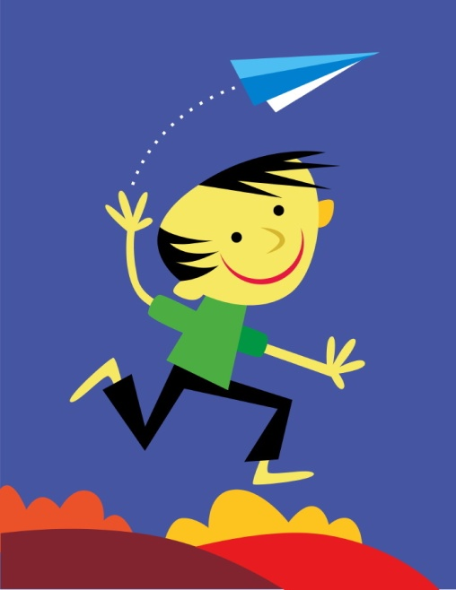
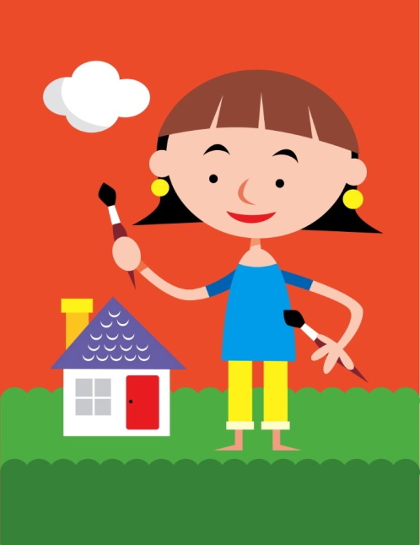
Pronouns
mine
I
me
you
he
she
it
they
your
we
us
our
my

Slide 2
Personal Pronouns
We use personal pronouns in place of the person or people that we are talking about.
My mother’s name is Felly. She is a nurse.

Slide 3
Possessive Pronouns
We use possessive pronouns to refer to a specific person/people or thing/things belonging to a person/people.
Look at our hair. Mine are longer than yours.

Slide 4
Reflexive Pronouns
We use a reflexive pronoun when we want to refer back to the subject of the sentence or clause. Reflexive pronouns end in "-self" (singular) or "-selves" (plural).
“You will sow the rest of the seeds yourself.” Mum told Tanya.

