Slide 1
Proverbs

Slide 2
Each proverb has two slides.
In the first slide you get a picture clue – can you guess the proverb?
In the second slide three possible meanings are given – can you guess the correct one?
Use the mouse, not the keyboard, to navigate through this PowerPoint.
Authors of photos are attributed in the notes of the relevant slide.

Slide 3
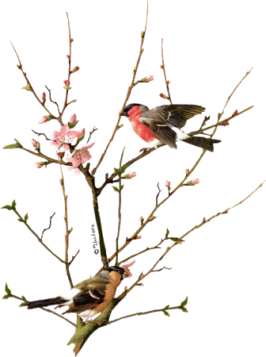
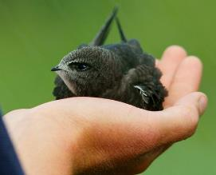
1
=
Click here
A bird in the hand is worth two in the bush.
Answer
Notes:
http://www.g
http://i476.photobucket.com/albums/rr125/ChuckLentine/Love%20Special%20Someone/LoveBirds.gifeograph.org.uk/photo/2504010

Slide 4
1
Click on one ?
A bird is going to be warmer in the hand than out in the garden.
?
Something you have for certain is more
valuable than something you might get.
?
A pet bird is better than two wild ones.
?

Slide 5
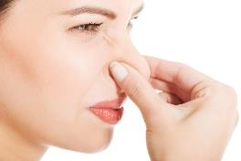
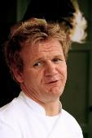
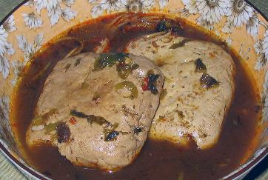
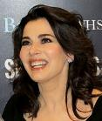
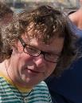
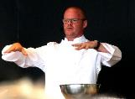
2
Too many cooks spoil the broth.
Answer
Notes:
http://www.flickr.com/photos/paultomlin/3578194790/
© Glenn Francis, www.PacificProDigital.com (Email: glennfrancispacificprodigital.com)
http://www.mynewsdesk.com/uk/scandic_hotels/images/jamie-oliver-192908
By Brian Minkoff- London Pixels (Own work) [CC BY-SA 3.0 (http://creativecommons.org/licenses/by-sa/3.0)], via Wikimedia Commons
https://www.flickr.com/photos/aquamech-utah/24445365953
By Brian Minkoff- London Pixels (Own work) [CC BY-SA 3.0 (http://creativecommons.org/licenses/by-sa/3.0)], via Wikimedia Commons

Slide 6
2
?
Too many on the same job can spoil the result.
An overcrowded kitchen produces bad food.
?
?
Top chefs never agree on ingredients.

Slide 7
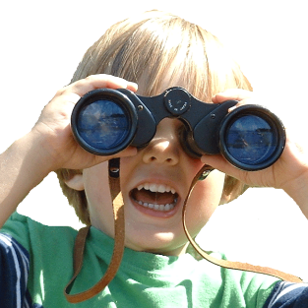
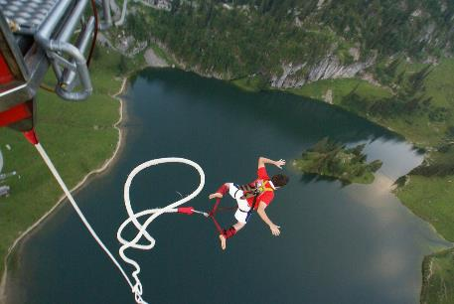
3
Step 1
Step 2
Look before you leap.
Answer
Notes:
By No machine-readable author provided. Jrod2~commonswiki assumed (based on copyright claims). [GFDL (http://www.gnu.org/copyleft/fdl.html) or CC BY-SA 3.0 (http://creativecommons.org/licenses/by-sa/3.0)], via Wikimedia Commons
https://www.flickr.com/photos/carla777/1039697905

Slide 8
3
Keep your eyes open when jumping.
?
?
Check your shoes before jumping.
?
Think of the consequences before you act.

Slide 9
4
≠
Two wrongs don’t make a right.
Answer

Slide 10
4
Kisses don’t always make things better.
?
It is not acceptable to wrong someone even if they have wronged you first.
?
Two wrong turnings may send you left.
?

Slide 11
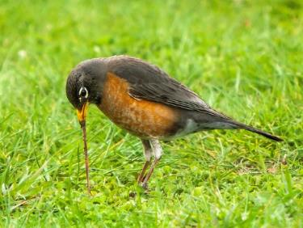
5
5:02am
The early bird catches the worm.
Answer
Notes:
Sheila Sund - https://www.flickr.com/photos/sheila_sund/8636326715

Slide 12
5
You get an advantage by doing something soon or first.
?
Worms are plentiful early in the day.
?
Hunting is good around dawn.
?

Slide 13
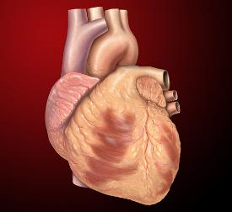
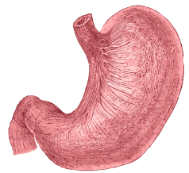
6
The way to a man’s heart is through his stomach.
Answer
Notes:
By Patrick J. Lynch, medical illustrator - Patrick J. Lynch, medical illustrator, CC BY 2.5, https://commons.wikimedia.org/w/index.php?curid=1492978

Slide 14
6
?
Heartburn is caused by eating the wrong things.
When operating, go through the stomach.
?
A man’s love can be earned by giving him tasty food.
?

Slide 15
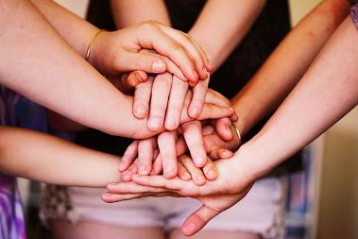
7
work
Many hands make light work.
Answer
Notes:
By Sharon & Nikki McCutcheon from We currently live in the United States, we are paying it forward and spreading love worldwide! (Many Hands) [CC BY 2.0 (http://creativecommons.org/licenses/by/2.0)], via Wikimedia Commons
https://commons.wikimedia.org/wiki/File%3AMany_Hands_(16859686419).jpg
By Shadster (Own work) [CC BY-SA 3.0 (http://creativecommons.org/licenses/by-sa/3.0)], via Wikimedia Commons
https://commons.wikimedia.org/wiki/File%3AOstrich_feather.jpg

Slide 16
7
Weights seem lighter if supported by several hands.
?
If many help, jobs get done quickly.
?
Many people at the power station keep the lights on.
?

Slide 17
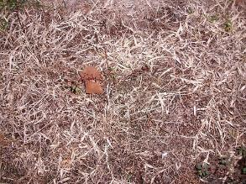
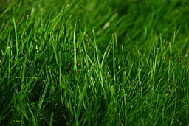
8
This side
Answer
The grass is greener on the other side.
Notes:
By MarcusObal (Own work) [GFDL (http://www.gnu.org/copyleft/fdl.html) or CC BY-SA 4.0-3.0-2.5-2.0-1.0 (http://creativecommons.org/licenses/by-sa/4.0-3.0-2.5-2.0-1.0)], via Wikimedia Commons
https://commons.wikimedia.org/wiki/File%3AGreen_Grass.JPG
By John Harvey [Public domain], via Wikimedia Commons

Slide 18
8
A new situation looks better – although it may not be.
?
Next door take better care of their lawn.
?
Some things improve if looked at from a different angle.
?

Slide 19
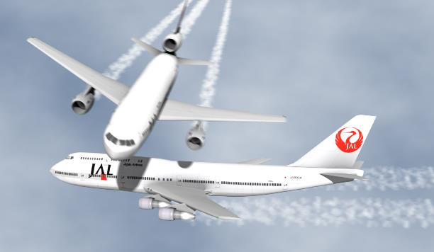
9
= 1760 yards
A miss is as good as a mile.
Answer

Slide 20
9
It is worth travelling to visit an unmarried woman.
?
Missing a target by a small margin has just the same result as missing it by a lot.
?
If you miss the bus, you may have to walk a mile.
?

Slide 21
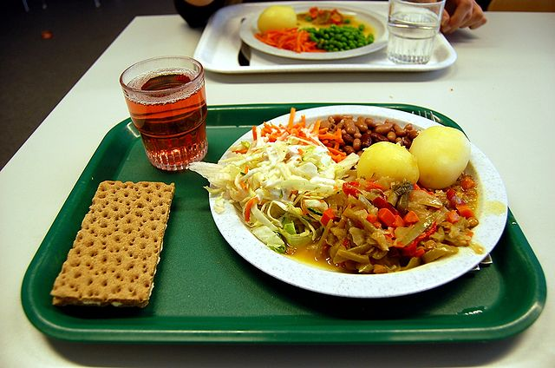
10
Price: £0
There’s no such thing as a free lunch.
Answer
Notes:
<a title="By Casey Lehman from Häljarp, Sweden (Lunch i Skolan: Overall) [CC BY-SA 2.0 (http://creativecommons.org/licenses/by-sa/2.0)], via Wikimedia Commons" href="https://commons.wikimedia.org/wiki/File%3ASchool_lunch.jpg"><img width="512" alt="School lunch" src="https://upload.wikimedia.org/wikipedia/commons/thumb/c/c7/School_lunch.jpg/512px-School_lunch.jpg"/></a>

Slide 22
10
You can’t get something for nothing.
?
Food costs money.
?
Don’t eat if you can’t pay.
?

Slide 23
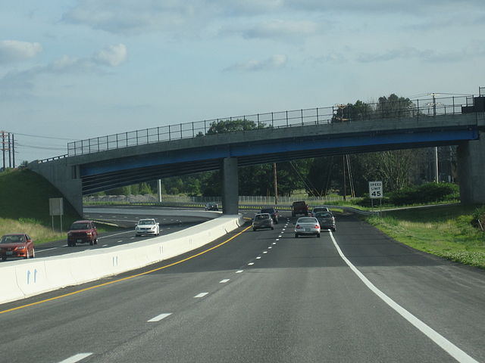
11
Don’t:
Don’t cross a bridge till you come to it.
Answer
Notes:
By Raime - Own work, CC BY-SA 3.0, https://commons.wikimedia.org/w/index.php?curid=7273277

Slide 24
11
Tick the bridges off as you cross them.
?
Deal with a situation when it happens, not before.
?
Don’t speed to reach a crossing.
?

Slide 25
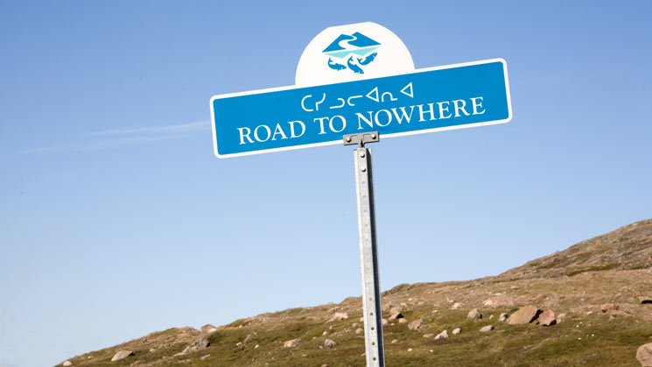
12
I wish I was like you.
You’re much better though.
You’re the best teacher in the world
If only everyone was like you
Did you make this? Amazing!
Oh boss, you look stunning!
Flattery will get you nowhere.
Answer
Notes:
http://wp.patheos.com.s3.amazonaws.com/blogs/yearwithoutgod/files/2014/07/road-to-nowhere.jpg

Slide 26
12
The earth is round.
?
?
You need ups and downs in your life.
You won’t get an advantage by paying people unearned compliments.
?

Slide 27
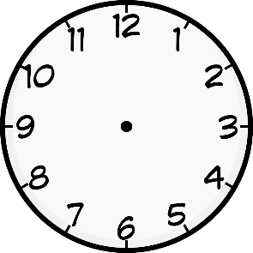
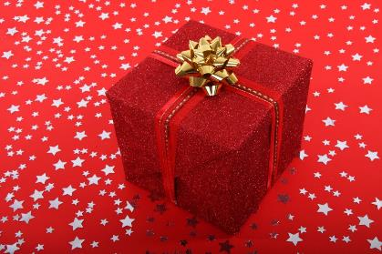
13
=
There’s not time like the present.
Answer

Slide 28
13
It’s best to get on with things at once.
?
Clocks make good gifts.
?
Don’t wait to give a gift.
?

Slide 29
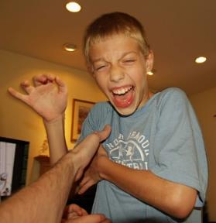
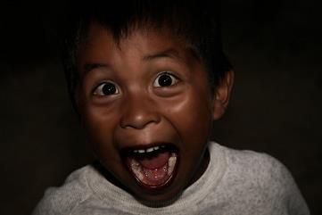
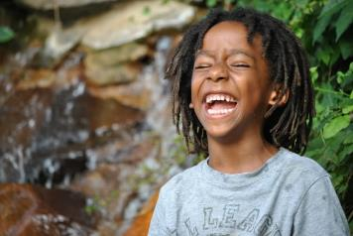
14
He who laughs last laughs longest.
Answer
Notes:
http://www.freesfx.co.uk
By David Shankbone - David Shankbone, CC BY-SA 3.0, https://commons.wikimedia.org/w/index.php?curid=2126268
By Josh Giovo from USA (Little Bugger) [CC BY 2.0 (http://creativecommons.org/licenses/by/2.0)], via Wikimedia Commons
https://www.flickr.com/photos/cheriejphotos/6019067180
Recorded by Mike Koenig http://soundbible.com/1119-Kid-Laughing-Short.html

Slide 30
14
If it takes you a long time to get a joke, you will appreciate it more.
?
?
The last contestant often wins the competition.
The person with an advantage at the end is the winner.
?

Slide 31
15
Sometimes
< = >
Sometimes less is more.
Answer

Slide 32
15
?
You sometimes get a better effect with less.
It’s opposites day.
?
Maths doesn’t always add up.
?

Slide 33
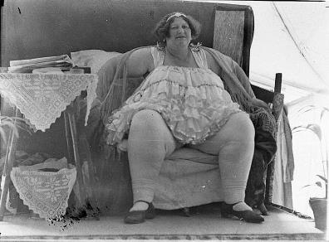
16
It
Under
It’s not over till the fat lady sings.
Answer
Notes:
credit to ABIGAILIA. Lyrics & Melody Copyright ABIGAILIA

Slide 34
16
Ladies last.
?
Traditionally an opera ends with a female vocalist.
?
?
Nothing is certain until the event finishes.

Slide 35
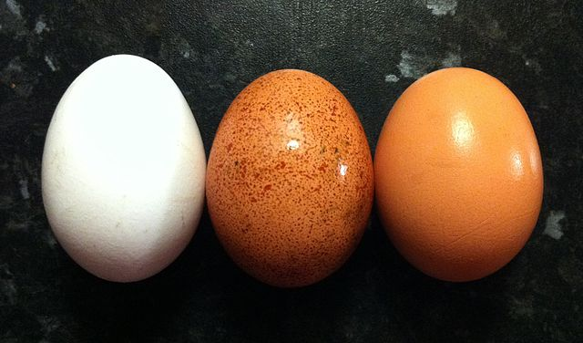
17
1
2
3
NO!
Don’t count your chickens before they hatch.
Answer
Notes:
By Timothy Titus - Own work, CC BY-SA 3.0, https://commons.wikimedia.org/w/index.php?curid=14808351
Source=[http://www.flickr.com/photos/26454069@N03/2771672568/ Battle chicken is ready for action] |Date=August 17, 2008 at 11:11 |Author=[http://www.flickr.com/people/264540

Slide 36
17
Some chicken eggs are infertile.
?
Don’t depend on something until it has happened.
?
Don’t disturb the hen when she’s sitting on eggs.
?

Slide 37
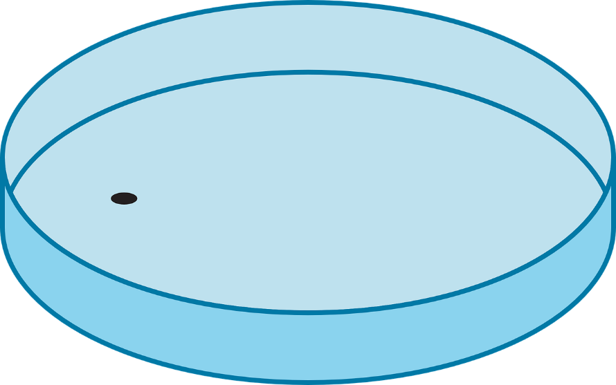
18
1°C
Revenge
Revenge is a dish best served cold.
Answer
Notes:
By Tubezlob et Vaikunda Raja (Own work) [GFDL (http://www.gnu.org/copyleft/fdl.html) or CC BY-SA 3.0 (http://creativecommons.org/licenses/by-sa/3.0)], via Wikimedia Commons

Slide 38
18
Revenge is best sometime after the event after careful planning.
?
Serve cold food to get revenge.
?
Revenge works best in winter.
?

Slide 39
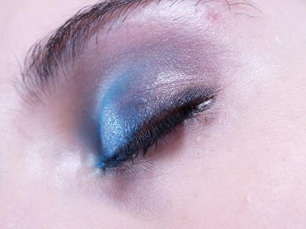
19
Answer
What the eye doesn’t see, the heart doesn’t grieve over.
Notes:
http://thisismyurl.deviantart.com/art/Macro-Eye-closed-105814671

Slide 40
19
You can’t cry with your eyes closed.
?
What you don’t know won’t upset you.
?
A good sleep helps reduce stress.
?

Slide 41
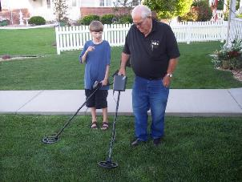
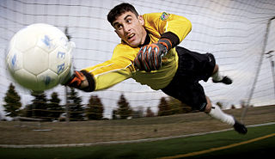
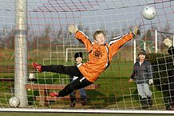
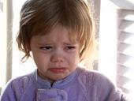
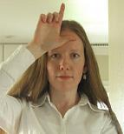
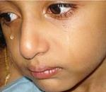
20
City 4
Town 1
Finders keepers, losers weepers.
Answer
Notes:
https://www.flickr.com/photos/sscornelius/2715868826
By Master Sgt. Lance Cheung of U.S. Air Force [Public domain], via Wikimedia Commons
By Torsten Bolten, AFpix.de - Own work (own photo), CC BY-SA 3.0, https://commons.wikimedia.org/w/index.php?curid=1433430
By Lenore Edman from Sunnyvale, CA - Loser, CC BY 2.0, https://commons.wikimedia.org/w/index.php?curid=10209351
By Crimfants - http://flickr.com/photos/crimfants/327861820/, CC BY-SA 2.0, https://commons.wikimedia.org/w/index.php?curid=2227266
By Reji Jacob - Own work, CC BY-SA 3.0, https://commons.wikimedia.org/w/index.php?curid=14972705

Slide 42
20
Losing your keeper is upsetting.
?
?
If you lose at football, get a new goalkeeper.
Something left around will be claimed by a new owner, leaving the true owner upset.
?

Slide 43
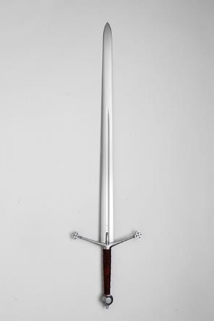
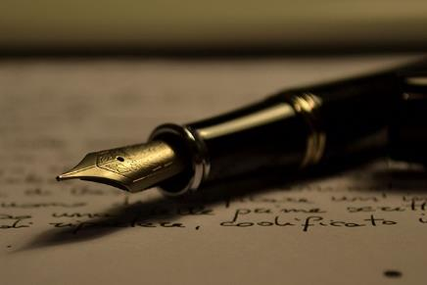
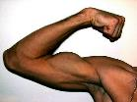
21
>
The pen is mightier than the sword.
Answer
Notes:
By Power_of_Words_by_Antonio_Litterio.jpg: Antonio Litterio derivative work: InverseHypercube (Power_of_Words_by_Antonio_Litterio.jpg) [CC BY-SA 3.0 (http://creativecommons.org/licenses/by-sa/3.0)], via Wikimedia Commons
By Søren Niedziella from Denmark (Albion_Chieftain_Medieval_Sword_05) [CC BY 2.0 (http://creativecommons.org/licenses/by/2.0)], via Wikimedia Commons
https://www.flickr.com/photos/amelism/2418449445

Slide 44
21
It is better to persuade people than try to force them to do something.
?
In close quarters, a stab from a pen is more effective than a sword.
?
?
You can do more with a pen than a sword.

Slide 45
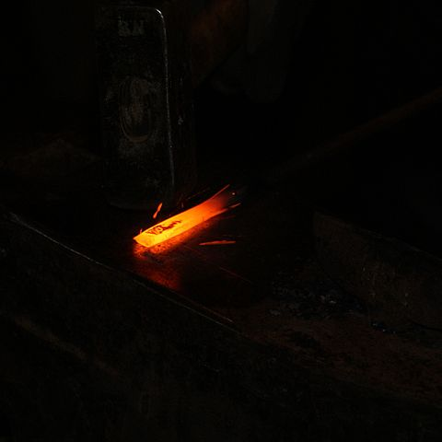
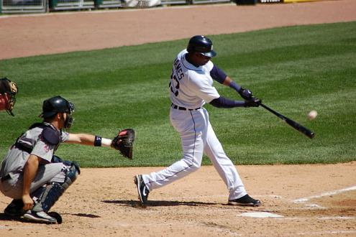
22
Strike while the iron is hot.
Answer
Notes:
By Philpottm - Own work, GFDL, https://commons.wikimedia.org/w/index.php?curid=3737879
By Hi-Res Images of Chemical Elements (http://images-of-elements.com/iron.php) [CC BY 3.0 (http://creativecommons.org/licenses/by/3.0)], via Wikimedia Commons

Slide 46
22
You can strike best when you are warmed up.
?
?
Bend the iron when it is nearly molten.
?
Don’t delay, take an opportunity when you can.

Slide 47
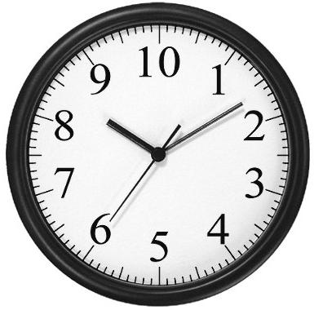
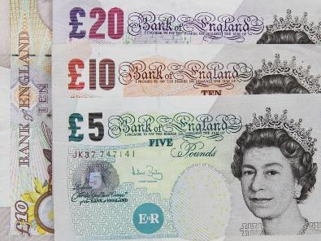
23
=
Time is money.
Answer

Slide 48
23
Clocks are expensive.
?
It can be costly to waste time so hurry up.
?
?
You get paid by the hour.

Slide 49
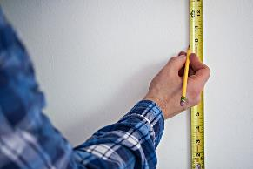
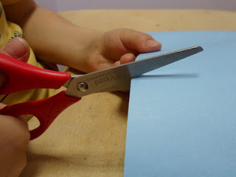
24
1
1
2
Measure twice, cut once.
Answer
Notes:
http://filodelcar.blogspot.co.uk/2015_10_01_archive.html
https://www.flickr.com/photos/personalcreations/16333093811

Slide 50
24
Think carefully before making some decisions, they can’t easily be changed.
?
It takes twice as long to measure carefully as to cut.
?
You often measure in two directions but cut in one.
?

Slide 51
25
Easy
Easy come, easy go.
Answer
Notes:
By Lenore Edman from Sunnyvale, CA (Loser) [CC BY 2.0 (http://creativecommons.org/licenses/by/2.0)], via Wikimedia Commons

Slide 52
25
An easy outward journey usually means an easy return journey.
?
?
Having lots of money makes transport easy.
?
Something gained easily is just as easily lost.

Slide 53
The End

