Slide 1
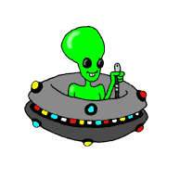
I can identify features of the science fiction genre.
Science Fiction

Slide 2
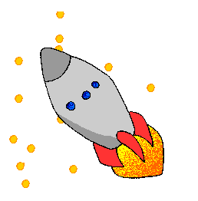
Science fiction often involves space travel.

Slide 3

Sometimes there are aliens.

Slide 4

Often there are cool machines like robots…

Slide 5
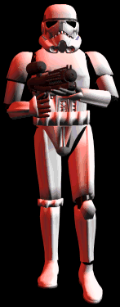

Or weapons…

Slide 6
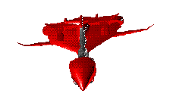
Or spaceships.

Slide 7
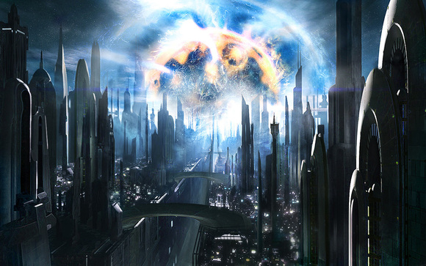
Sometimes the story is set in the future.

Slide 8
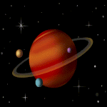
It might be set in an alien world.

Slide 9
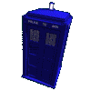
There might be time travel.

Slide 10

However, characters behave like normal humans!

