Slide 1

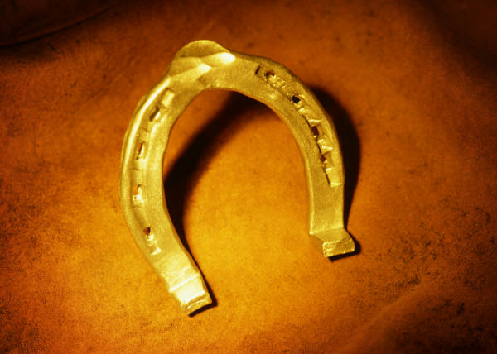
Short Writing Paper
School: Insert name here
DfE number: Insert number here
Start:
End:

Slide 2

Plan for 3 paragraphs

Slide 3

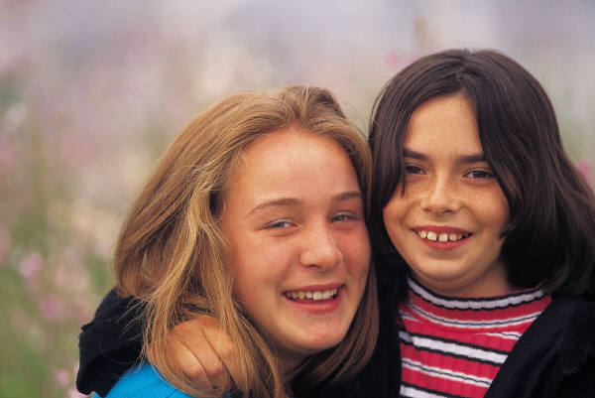
Who are you writing for?
Formal?
Informal?
Stranger?
Formal
Friend?
Chatty style

Slide 4
What is the genre?
How will you layout
the work?

Slide 5

Do you need
sub-headings?
Make them catchy!
Wicked writers using amazing alliteration!

Slide 6

Commas!!!
Mrs Webb, the class teacher of Year 6, wished her pupils good luck!
Anxiously, the children awaited their results.
You will need a pencil, pen, rubber and a ruler.

Slide 7
Adverbs!!
The waves crashed violently against my body.
The girl walked down the street cheerfully.

Slide 8


Edit! Edit! Edit!
Slow down and keep
reading your work.

Slide 9



Level 5 punctuation?
Colons?
Brackets?
Semi-colons?

Slide 10
Write in paragraphs

Slide 11
Introduction?
W? W? W? W?
Conclusion?

Slide 12
BAN
BORING
WORDS!
MAKE
IT
INTERESTING!

Slide 13
Vary your words.
Don’t repeat words.
WOW words!
Massive
Enormous
big
Immense
Huge

Slide 14
A mixture of sentence
Lengths.
Long
Short

Slide 15
Past?
Tense
Present?
Future?

Slide 16
because
Soon after
Connectives
firstly
next
therefore
consequently

Slide 17
The score for short writing is made up of two marks.
Sentences & Punctuation:
Out of a total of 4.
Is it easy to read - needs accurate punctuation!
Is it varied - different types of sentences - not repetitive
Verb tense accurate?
Effect:
Out of a total of 8.
Is it interesting to read with enough detail?
Can you imagine it or understand it precisely?
Are words and phrases chosen to add Wow/technical words?

