Slide 1

Complete the following sentences using
some
or
any

Slide 2
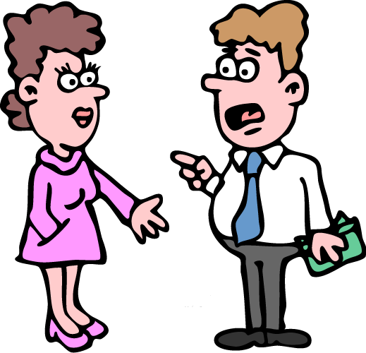
some
I’ve got ………. money.

Slide 3
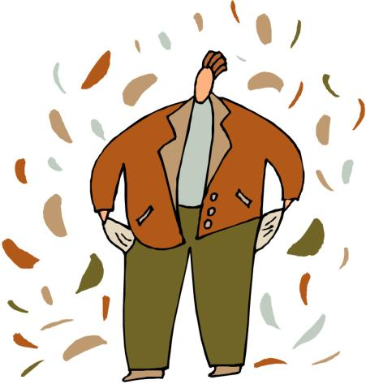
any
He hasn’t got ……. money.

Slide 4
Have Bob and Sam
got …... children?
any

Slide 5
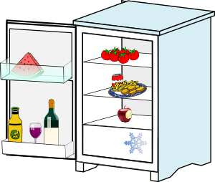
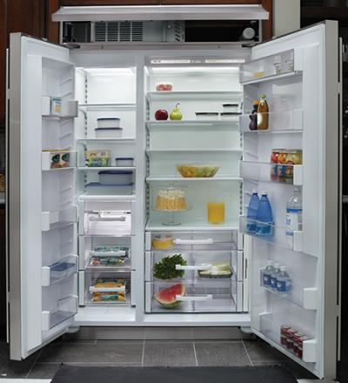
any
There isn’t ……. wine
in the fridge.

Slide 6
X
some
I’ve got ………. cheese
but I haven’t got …… bread
any

Slide 7
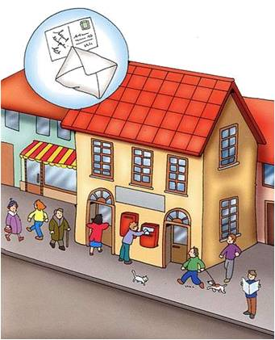
I’m going to the post office.
I need ………. stamps.
some

Slide 8
X
any
There aren’t .….. shops
in this part of town.

Slide 9
Have you got
…….. children?
any

Slide 10
some
There are ……... beautiful flowers in the garden.

Slide 11
any
Do you know ….… good
hotels in London?

Slide 12
Would you like
……….. tea?
some

Slide 13
any
Don’t buy ……… rice.
We don’t need ……..
any

Slide 14

some
I wanted to buy ………. oranges, but they didn’t have
……… in the shop.
any

Slide 15
I’m thirsty. Can I have
……… water, please?
some

