Slide 1
th

Slide 2

thumb

Slide 3
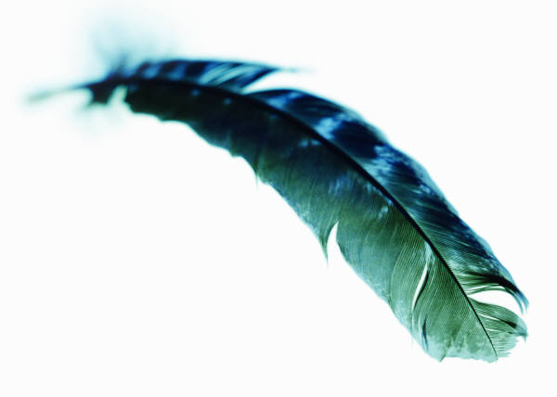
feather

Slide 4
thin

Slide 5
throw

Slide 6
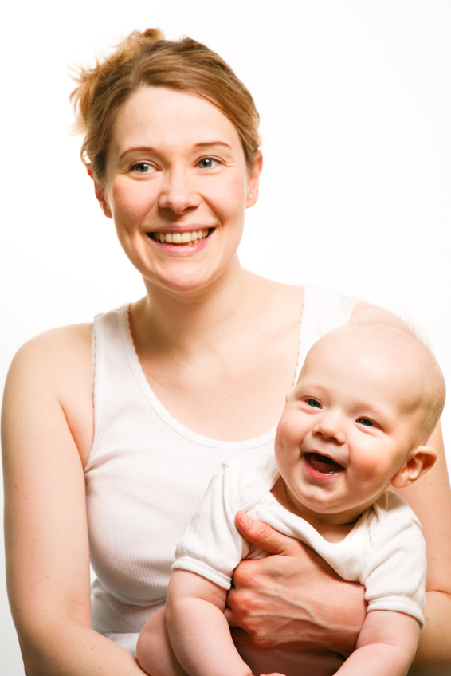
mother

Slide 7

there

Slide 8
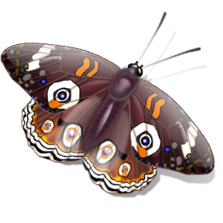
moth

Slide 9
heather

Slide 10
tenth

Slide 11
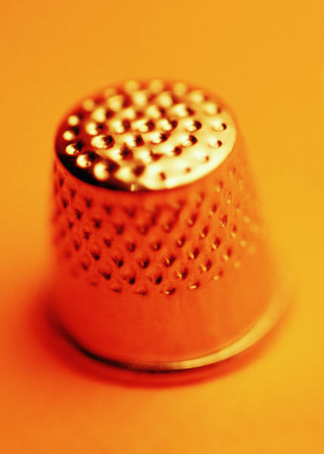
thimble

