Slide 1
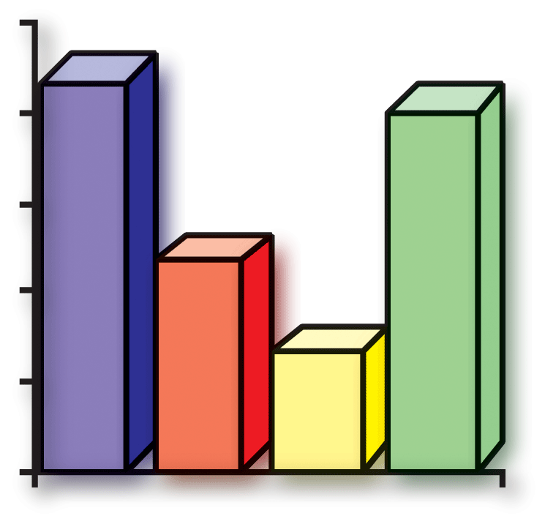
Bar Graphs

Slide 2
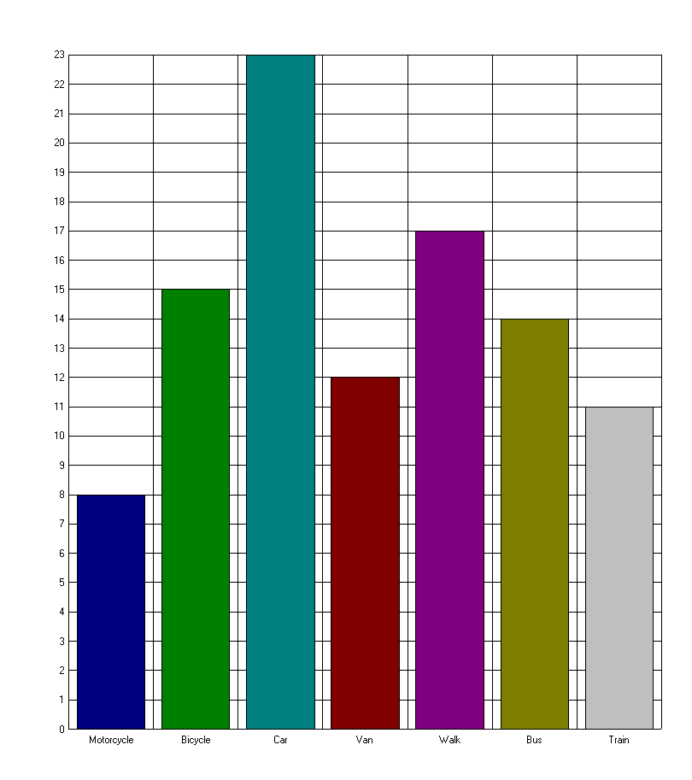
How Children Get to School
23
Number
of
Children
17
14
15
12
11
8
Method used

Slide 3
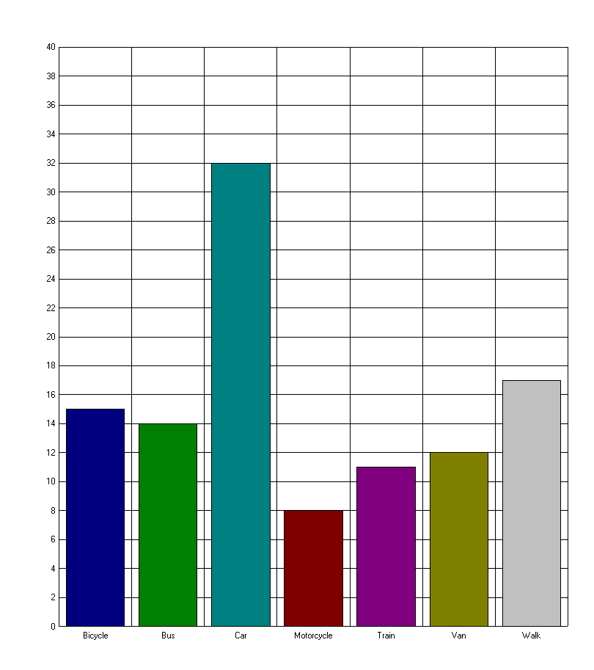
How Children Get to School
Number
of
Children
32
15
17
14
11
12
8
Method used

Slide 4
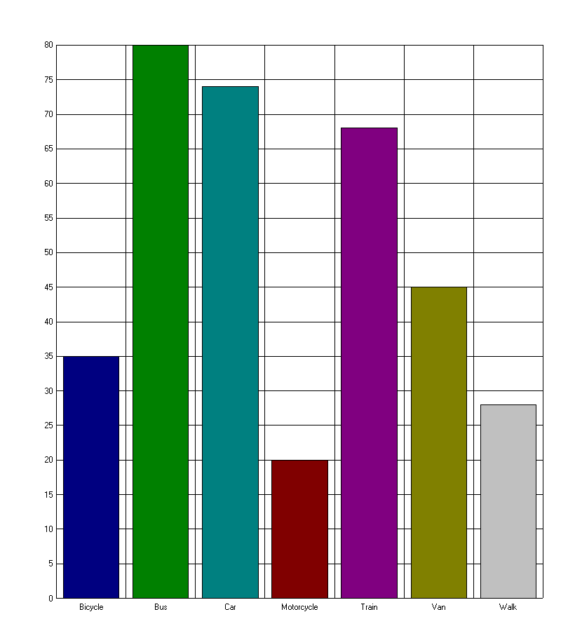
How Children Get to School
80
74
Number
of
Children
68
45
35
28
20
Method used

Slide 6
Now it’s time for our
class

