Slide 1
Dividing Whole Numbers
When dividing numbers, we can think about them in the form of grouping or sharing.
For example: 10 ÷ 2 = ?
This question can be thought of as
‘How many groups of 2 can you get from 10?’
or
‘Share 10 between 2’.

Slide 2
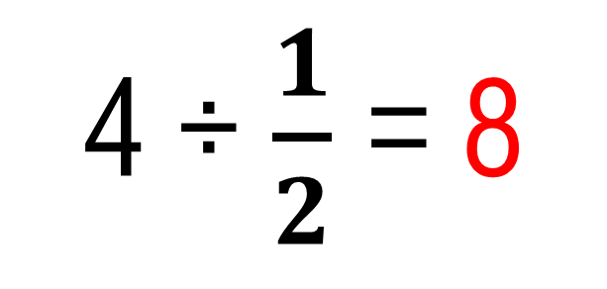
What about 4 ÷ $\frac{1}{2}$ = ?
Thinking: ‘How many $\frac{1}{2} s$can I get from 4?’
4 ÷ $\frac{1}{2}$ = 8
$$\frac{1}{2}$$
4
From the diagram you can see that 8 halves make 4.

Slide 3
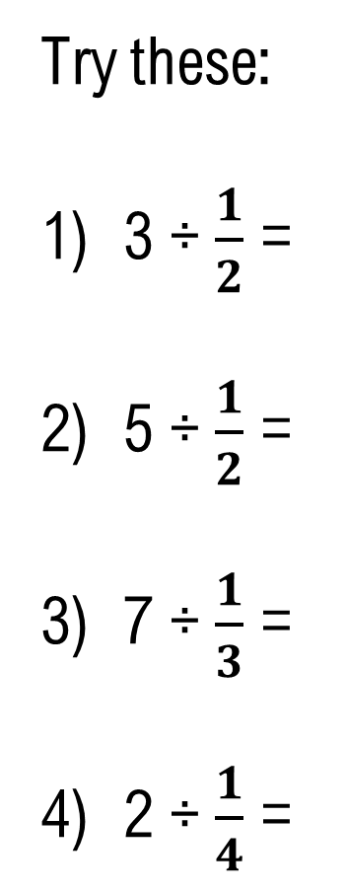
Try these:
3 ÷ $\frac{1}{2}$ =
5 ÷ $\frac{1}{2}$ =
7 ÷ $\frac{1}{3}$ =
2 ÷ $\frac{1}{4}$ =
6 halves
6
10
10 halves
21
21 thirds
8
8 quarters

Slide 4
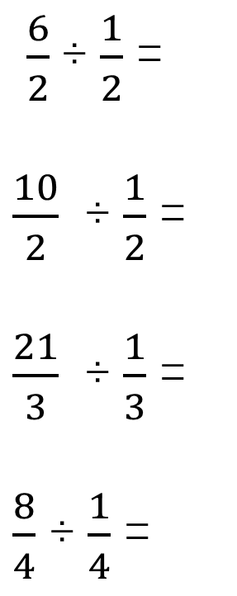
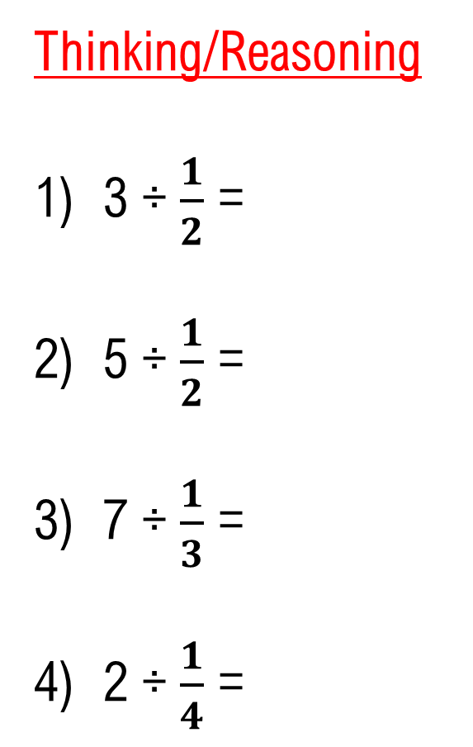
Thinking/Reasoning
3 ÷ $\frac{1}{2}$ =
5 ÷ $\frac{1}{2}$ =
7 ÷ $\frac{1}{3}$ =
2 ÷ $\frac{1}{4}$ =
$\frac{6}{2}$÷ $\frac{1}{2}$ =
$\frac{10}{2}$ ÷ $\frac{1}{2}$ =
$\frac{21}{3}$ ÷ $\frac{1}{3}$ =
$\frac{8}{4}$ ÷ $\frac{1}{4}$ =
6
6
$$\frac{6}{1}$$
$\frac{6}{1}$ = 6 ÷ 1 ( The 6 and 1 are the numerators)
10
10
$$\frac{10}{1}$$
Identify the equivalent fraction
using the same denominator.
21
21
$$\frac{21}{1}$$
8
8
$$\frac{8}{1}$$

Slide 5

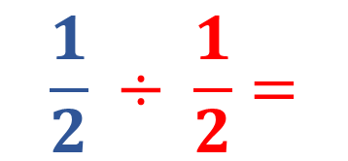
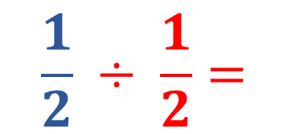
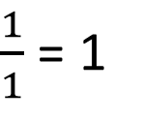
Dividing Fractions
How would you use the diagrams to answer the question:
$$\frac{1}{2} ÷ \frac{1}{2}= ?$$
$$\frac{1}{2} ÷ \frac{1}{2}=$$
1
From the diagram you can see that ONE red shaded part FITS into the blue shaded part.
Thinking:
How many $\frac{1}{2}$ s can I get from $\frac{1}{2}$ ?
$$\frac{1}{2}$$
$$\frac{1}{2}$$
One
$$\frac{1}{2} ÷ \frac{1}{2}=$$
1
because
$\frac{1}{1}$ = 1

Slide 6
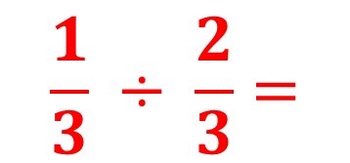
Another example:
How would you use the diagrams to answer the question: $\frac{1}{3} ÷ \frac{2}{3}$ = ?
$$\frac{1}{3} ÷ \frac{2}{3}=$$
$$\frac{1}{2}$$
From the diagram you can see that HALF the brown shaded part FITS into the yellow shaded part.
Thinking:
How many $\frac{2}{3}$ s can I get from $\frac{1}{3}$ ?
Half
$$\frac{1}{3}$$
$$\frac{2}{3}$$

Slide 7
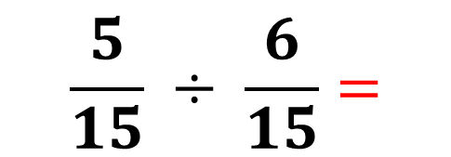
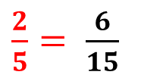
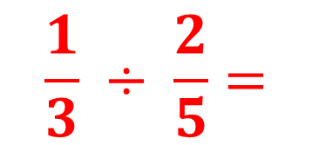
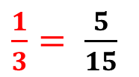
So far the denominators have been the same.
What will happen when the denominators are different?
Thinking:
How many $\frac{2}{5}$ s can I get from $\frac{1}{3}$ ?
$$\frac{1}{3} ÷ \frac{2}{5}=$$
$$\frac{5}{6}$$
Five sixths
How would you use diagrams to answer this question?
First find the equivalent fraction, using the common multiple as the denominator: $\frac{1}{3}= \frac{5}{15}$ , $\frac{2}{5}= \frac{6}{15}$
$\frac{1}{3}= \frac{5}{15}$
$\frac{2}{5}= \frac{6}{15}$
So,
$$\frac{5}{15} ÷ \frac{6}{15}=$$
$$\frac{5}{6}$$

Slide 8
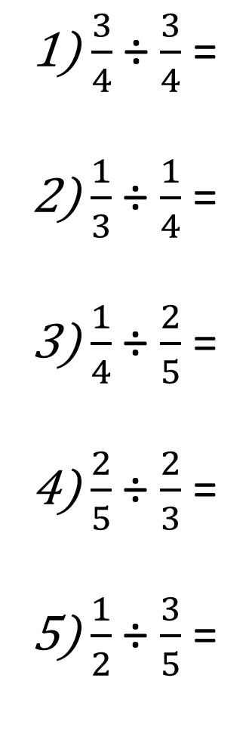
Independent activity
Use diagrams/equivalence to answer these:
1) $\frac{3}{4}$ ÷ $\frac{3}{4}$ =
2) $\frac{1}{3}$ ÷ $\frac{1}{4}$ =
3) $\frac{1}{4}$ ÷ $\frac{2}{5}$ =
4) $\frac{2}{5}$ ÷ $\frac{2}{3}$ =
5) $\frac{1}{2}$ ÷ $\frac{3}{5}$ =
1
$$\frac{3}{3}$$
$$\frac{4}{3}$$
$$\frac{5}{8}$$
$$\frac{3}{5}$$
$$\frac{6}{10}$$
$$\frac{5}{6}$$

Slide 9

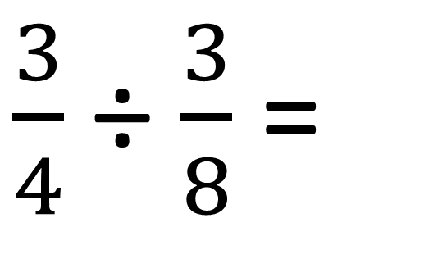
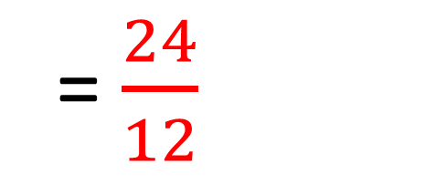
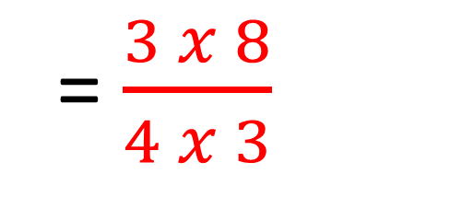
What is the rule for dividing fractions?
$\frac{3}{4}$ ÷ $\frac{3}{8}$ =
$\frac{3}{4}$
$\frac{8}{3}$
x
Keep the first fraction (the dividend);
2. Change the ÷ to X;
= $\frac{3 x 8}{4 x 3}$
Turn the second fraction (the divisor)
upside down (invert it).
= $\frac{24}{12}$
4. Apply rules of multiplying fractions.
Do you get the same answer using the diagrammatic method? Show how.
= $2$

Slide 10
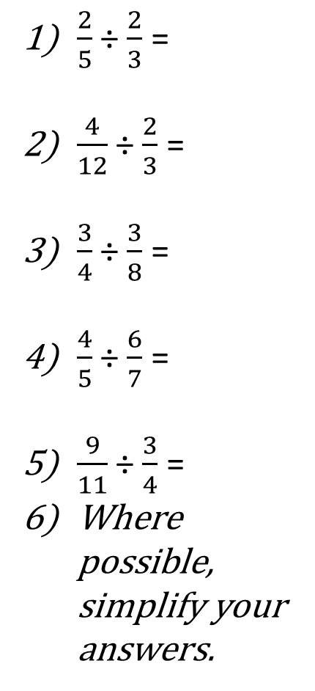

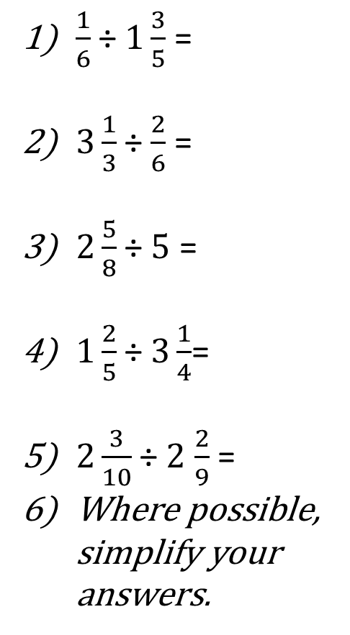
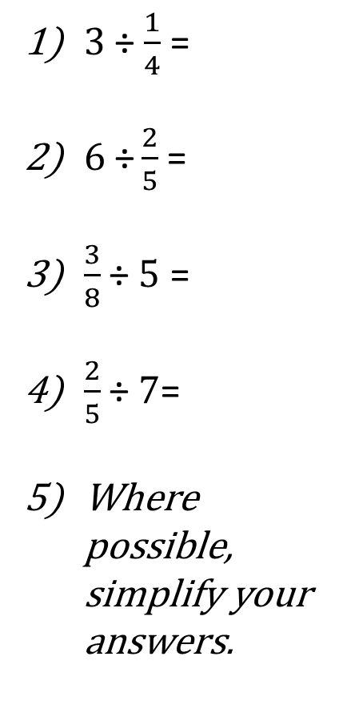
Try these questions. (Answer using diagrams/written method)
Challenge 5:
True or False
Show your working to explain your choice of answer.
Challenge 1:
Challenge 2:
Challenge 3:
Challenge 4:
$\frac{1}{2}$ ÷ $\frac{5}{7}$ =
$\frac{1}{3}$ ÷ $\frac{2}{5}$ =
$\frac{1}{4}$ ÷ $\frac{2}{6}$ =
$\frac{1}{5}$ ÷ $\frac{6}{9}$ =
$\frac{1}{10}$ ÷ $\frac{3}{12}$ =
6) Where possible, simplify your answers.
$\frac{2}{5}$ ÷ $\frac{2}{3}$ =
$\frac{4}{12}$ ÷ $\frac{2}{3}$ =
$\frac{3}{4}$ ÷ $\frac{3}{8}$ =
$\frac{4}{5}$ ÷ $\frac{6}{7}$ =
$\frac{9}{11}$ ÷ $\frac{3}{4}$ =
Where possible, simplify your answers.
$3$ ÷ $\frac{1}{4}$ =
$6 \text{÷}\frac{2}{5}$ =
$\frac{3}{8}$ ÷ $5$ =
$\frac{2}{5}$ ÷ $7$=
Where possible, simplify your answers.
$\frac{1}{6}$ ÷ $1\frac{3}{5}$ =
$3\frac{1}{3}$ ÷ $\frac{2}{6}$ =
$2\frac{5}{8}$ ÷ $5$ =
$1\frac{2}{5}$ ÷$3\frac{1}{4}$=
$2\frac{3}{10}$ ÷ $2$ $\frac{2}{9}$ =
Where possible, simplify your answers.
$\frac{1}{3}$ ÷ $\frac{2}{6}$ = $\frac{2}{9}$
$\frac{5}{8}$ ÷ $\frac{2}{5}$= $\frac{9}{16}$
$\frac{9}{6}$ ÷ $\frac{3}{5}$ = 2 $\frac{3}{6}$
$2\frac{2}{3}$ ÷$\frac{2}{3}$= 4
$1\frac{3}{5}$ ÷ $2$ $\frac{2}{5}$ = 3 $\frac{1}{4}$

Slide 11





Solutions
Challenge 1:
Challenge 2:
Challenge 3:
Challenge 4:
Challenge 5:
$\frac{1}{2}$ ÷ $\frac{5}{7}$ = $\frac{7}{10}$
$\frac{1}{3}$ ÷ $\frac{2}{5}$ = $\frac{5}{6}$
$\frac{1}{4}$ ÷ $\frac{2}{6}$ = $\frac{6}{8}$
$\frac{1}{5}$ ÷ $\frac{6}{9}$ = $\frac{9}{30}$
$\frac{1}{10}$ ÷ $\frac{3}{12}$ = $\frac{12}{30}$
$\frac{2}{5}$ ÷ $\frac{2}{3}$ = $\frac{6}{10}$
$\frac{4}{12}$ ÷ $\frac{2}{3}$ = $\frac{12}{24}$
$\frac{3}{4}$ ÷ $\frac{3}{8}$ = $\frac{24}{12}$
$\frac{4}{5}$ ÷ $\frac{6}{7}$ = $\frac{28}{30}$
$\frac{9}{11}$ ÷ $\frac{3}{4}$ = $\frac{36}{33}$
$3$ ÷ $\frac{1}{4}$ = 12
$6 \text{÷}\frac{2}{5}$ = $\frac{30}{2}$
$\frac{3}{8}$ ÷ $5$ = $\frac{3}{40}$
$\frac{2}{5}$ ÷ $7$= $\frac{2}{35}$
$\frac{1}{6}$ ÷ $1\frac{3}{5}$ = $\frac{5}{48}$
$3\frac{1}{3}$ ÷ $\frac{2}{6}$ = $\frac{60}{6}$
$2\frac{5}{8}$ ÷ $5$ = $\frac{21}{40}$
$1\frac{2}{5}$ ÷$3\frac{1}{4}$= $\frac{28}{65}$
$2\frac{3}{10}$ ÷ $2$ $\frac{2}{9}$ = $\frac{207}{200}$
$\frac{1}{3}$ ÷ $\frac{2}{6}$ = $\frac{2}{9}$ False
$\frac{5}{8}$ ÷ $\frac{2}{5}$= $\frac{9}{16}$ False
$\frac{9}{6}$ ÷ $\frac{3}{5}$ = 2 $\frac{3}{6}$ True
$2\frac{2}{3}$ ÷$\frac{2}{3}$= 4 True
$1\frac{3}{5}$ ÷ $2$ $\frac{2}{5}$ = 3 $\frac{1}{4}$ False
All answers marked in red can be simplified.

Slide 12
Plenary
Is this statement True or False? Why?
$\frac{2}{3}$ ÷ $\frac{2}{5}$ = $\frac{2}{5}$ ÷ $\frac{2}{3}$

