Slide 1
Rich Donnell
Word Problems
(Addition and Subtraction)

Slide 2
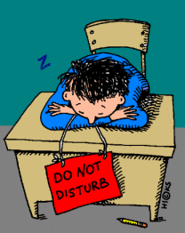
Bobby had 6 pennies on his desk. Three pennies fell on the floor. How many pennies are still on his desk?
3
6 – 3 = ___

Slide 3
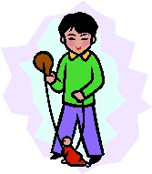
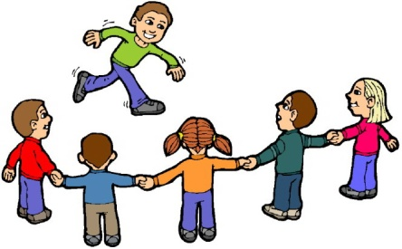
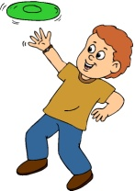
There were 8 children playing outside. Two of them ran inside the school. How many children are still playing outside?
6
8 – 2 =___

Slide 4
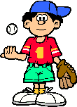
Seven people were playing baseball. Two more came to play. How many are playing baseball now?
9
7 + 2 = ___

Slide 5
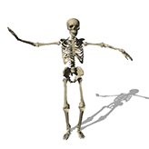
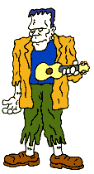
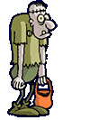
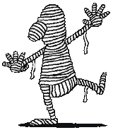
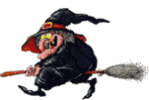
There were 7 people outside at Halloween. One had to go home. How many will still be outside?
6
7 – 1 = ___

Slide 6
There were 7 spaceships hovering. Three more spaceships joined them. How many spaceships in all?
10
7 + 3 = ___

Slide 7
There were 5 birds on a branch, and 4 birds on the ground. How many birds are there in all?
9
5 + 4 =___

Slide 8
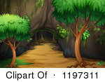
There were 10 panda bears playing at the zoo. Two of the pandas went into the cave. How many pandas are still playing?
8
10 – 2 = ___

Slide 9
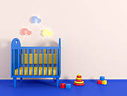
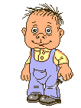
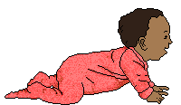
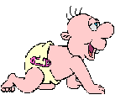
My mom had 5 babies in the room with her. Three more babies crawled into the room. How many babies are there altogether?
8
5 + 3 = ___

Slide 10
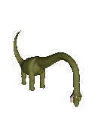
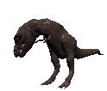
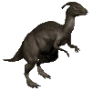
There were 7 dinosaurs in the valley. When the volcano's erupted, 4 of them ran away. How many are still in the valley?
3
7 – 4 = __

Slide 11
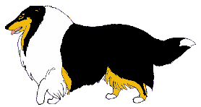
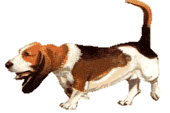
There were 7 dogs playing in the park. Two more dogs came to play. How many dogs are there altogether in the park?
9
7 + 2 = ___

Slide 12
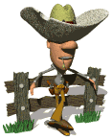
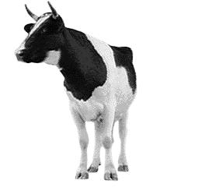
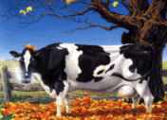
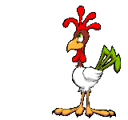
Farmer Fred was watching 9 animals in his field. Two horses ran away. How many animals are in the field now?
7
9 – 2 = ___

Slide 13
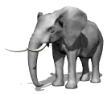
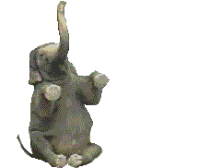
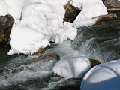
There were 6 elephants by the river. Five rhinos came to get a drink. How many animals in all?
11
6 + 5 = ___

Slide 14
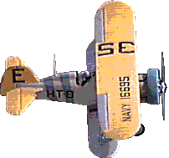
Welcome to Indezine -- my name is Geetesh Bajaj. Awarded as a PowerPoint MVP from Microsoft for over a decade, I train others in business presenting and PowerPoint skills. I also consult large companies on their presenting strategies, and write books. You can contact me through the feedback section.
Like This Page
Like This Site
There were 9 planes flying in the sky. Three planes flew back to the airport. How many planes are still flying?
6
9 – 3 = __

Slide 15
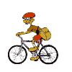
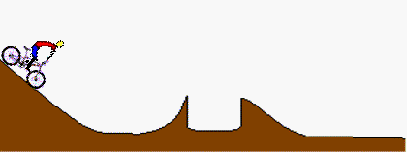
There were 6 people riding their bikes at the park. Three more bike riders joined them . How many riders in all?
9
6 + 3 = ___

Slide 16
There was 2 policeman directing traffic, and 1 on a motorcycle. How many policemen in all?
3
2 + 1 = __

Slide 17
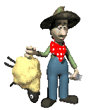
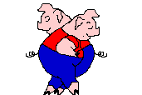
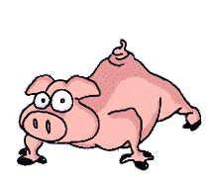
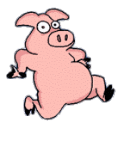
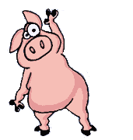
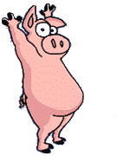
Farmer Fred went out to his pig pen to count his pigs. He saw 4 pigs exercising, and 2 pigs dancing. How many pigs were there all together?
6
4 + 2 = __

Slide 18
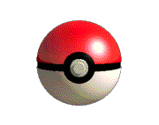
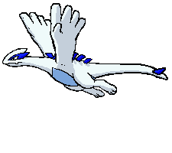
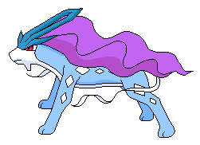
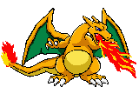
I saw 10 Pokemon, and 4 of them flew away. How many Pokemon are left?
6
10 – 4 = __

Slide 19
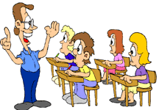
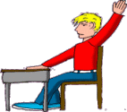
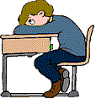
Mr. Donnell had 11 students in his class. Two boys had to go to the office. How many children are still in class?
9
11 – 2 = ___

