Slide 1
The story of the five plants.
(The story of seed dispersal)

Slide 2
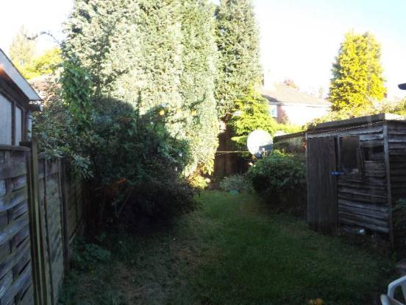
In a small dark garden in Selly Oak, Birmingham, there lived five plants.

Slide 3
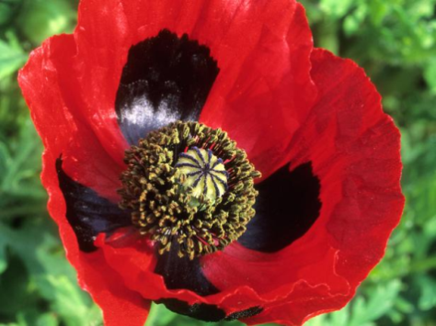
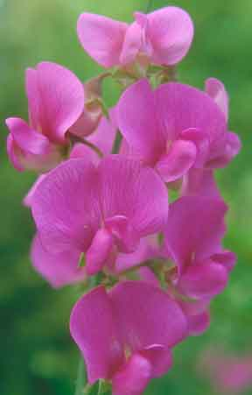
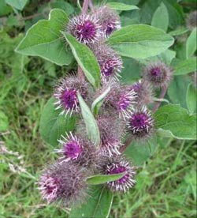
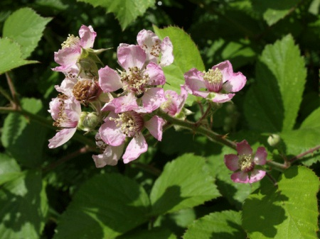
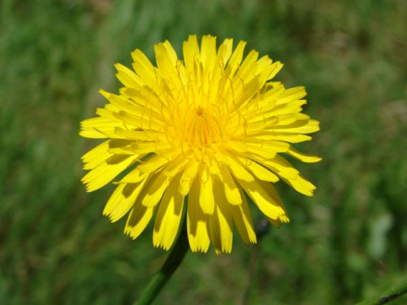
Poppy, was tall, elegant and thoughtful. Sweet Pea, was a climber with soft, delicate petals and Burdock was a bit spikey, but had a gentle heart. Bramble was an explorer, always sending out shoots into new ground, and Dandelion was bright and cheerful, seeing the best in everything. They lived in the small, overcrowded garden, overlooked by a wise old sycamore tree. She was so tall, she could see over the garden fence, into the neat, well tended gardens beyond and across to the park on the other side of the road.

Slide 4
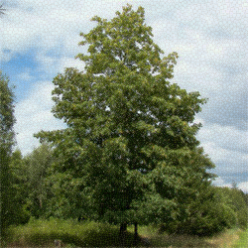
The plants had always lived happily in the garden. Every year the ground was fertilised, the gardener watered them in dry weather and chopped back the bigger shrubs when they started to takeover the garden. But, last year the gardener had died and the students who had moved in didn’t care about the garden. Nobody pruned the shrubs, fertilised the ground or watered in dry weather. The plants were simply left to fend for them selves.

Slide 5
“It’s my children I worry about,”grumbled Poppy one day. “How will they survive in this over-crowded garden? If only we could move. But we have roots here, we can’t leave.” “It will be hard for them ,” agreed Burdock, there just is not enough space any more and the ground has become so dry!” “Don’t you worry ,” smiled the wise old sycamore. “They will thrive!” But she didn’t say how.

Slide 6
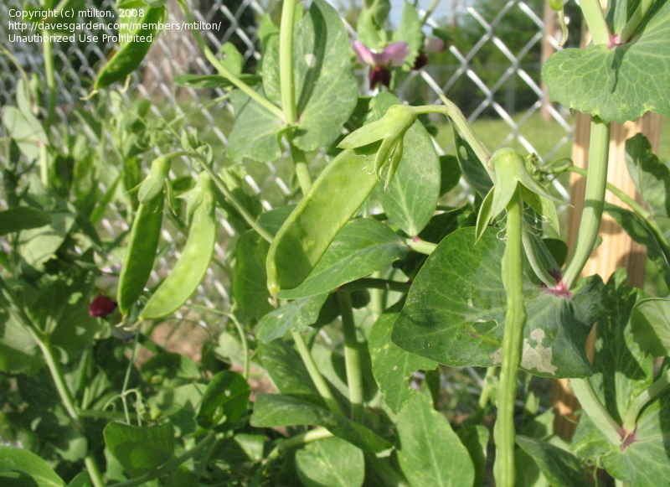
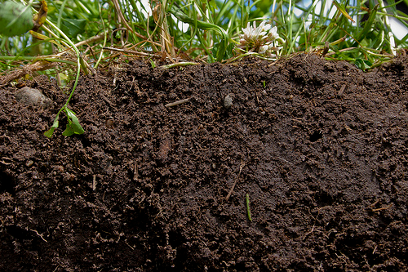
The next morning, as the wind blew gently through the garden, Poppy heard the sound of a gentle ‘pop’. She looked across to Sweet Pea. “Your seed pods are exploding Sweet Pea!” she cried, “Oh, you poor thing, your children will be gone forever,” And, as she stared in disbelief, she saw the tiny little seeds flying through the fence. What she didn’t see, but the sycamore did, was that the seeds landed in the rich, well watered soil of Mr Singh’s garden, next door. Next spring they would germinate and grow into beautiful, delicate plants, just like their mother.

Slide 7
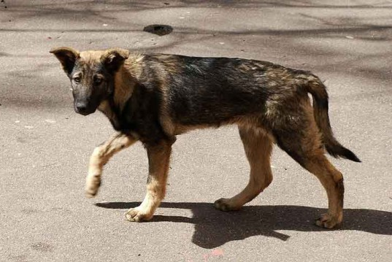
Just then, a stray dog, wandered into the garden. It cocked it’s leg, as dogs, do against poor old Burdock. “Ugh!” squealed Burdock. “ This is so humiliating. Can things can get any worse?” But then, as the dog ran off, she noticed, stuck to her fur, were three of her precious seeds, clinging on for dear life. Later that day, when the dog re-joined it’s master in the park, the burs brushed off and fell into soil amongst a clump of trees, ready to sprout again the following year.

Slide 8
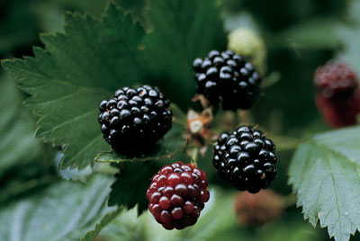
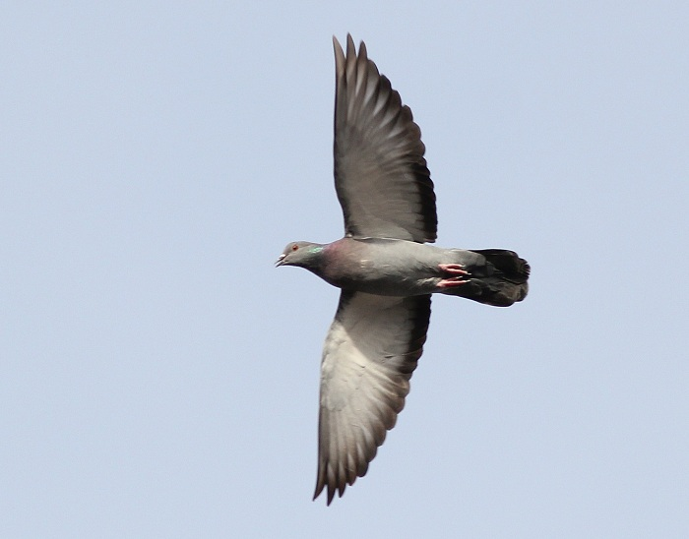
The garden was always full of birds at this time of year and Bramble knew that soon her glossy black fruit would provide a feast for the robins and blackbirds that made their home there. As she thought about this a pigeon landed on her branches and started stripping the barely ripe fruit from the stem. The seeds, encased in the ripe fruit , passed into the bird’s stomach. The pigeon didn’t stay long and soon it was off, flying over the fence into the next garden. Before long, it’s droppings fell into the soil, and with it Bramble’s precious seeds. They too would germinate and grow and have a better life in a garden with plenty of space that was loved and well cared for.

Slide 9
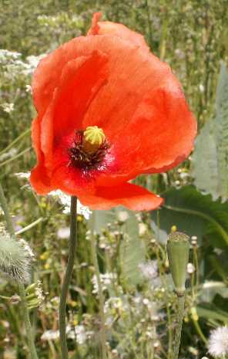
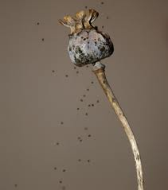
The wind was blowing quite strongly now and Poppy was shaking to and fro with the force of it. As she shook, her seeds were blown out of their holder and into an empty patch of soil away from the overgrown shrubs that were choking the plants.

Slide 10
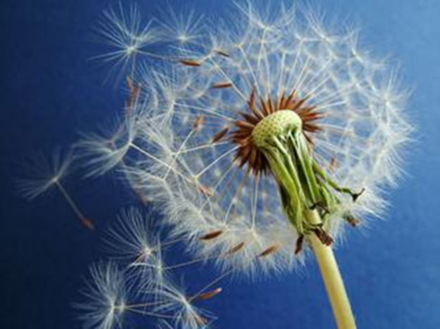
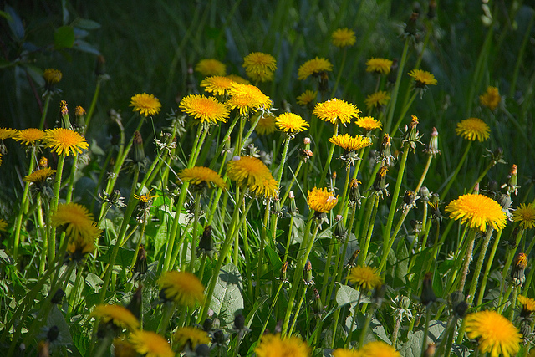
Dandelion, smiled as she saw the seeds land. “They will be very happy there ,” she whispered to Poppy. And with that, a puff of wind picked up all her own seeds and carried them away, far, far away, to a small, empty patch of land by the canal that flowed through Selly Oak on its way to the city.. There, they germinated , put down roots and grew, ready to produce, bright, new sunshiny flowers and seeds the following year.

Slide 11
Well, thought the sycamore, all the seeds have gone now. They will all be better off in their new homes. Their mothers need not have worried. Plants will always find new homes when they need to, even if they can’t move themselves!

