Slide 1
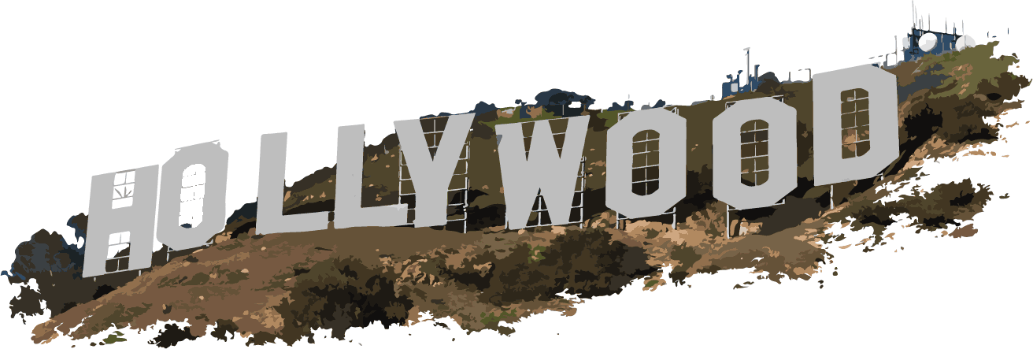
Heights

Slide 2
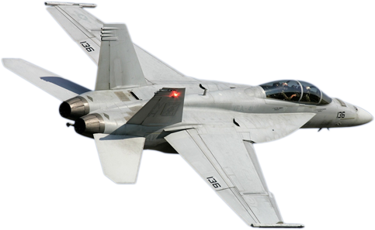
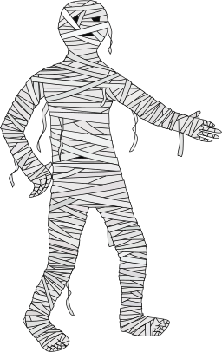
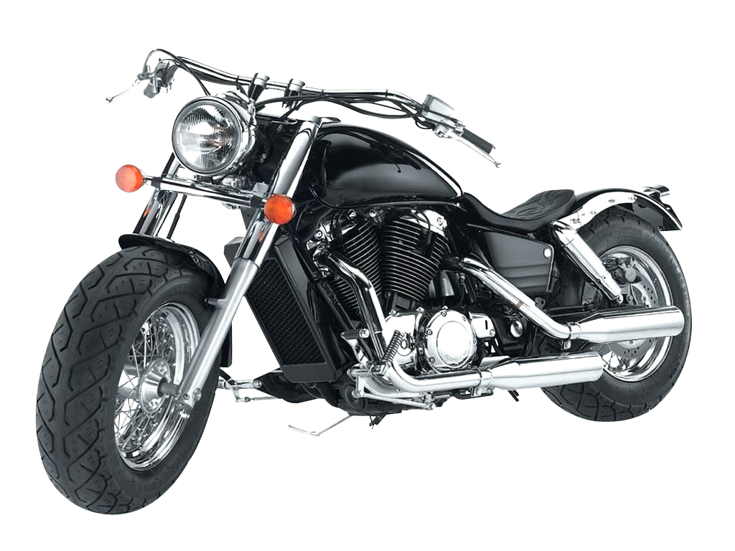
Heights
6' 2" | 1.88m
6' 1" | 1.85m
6' | 1.83m
5' 11" | 1.8m
5' 10" | 1.78m
5' 9" | 1.75m
5' 8" | 1.73m
5' 7" | 1.70m
5' 6" | 1.68m
5' 5" | 1.65m
5' 4" | 1.63m
5' 3" | 1.60m
1.7m

Slide 3
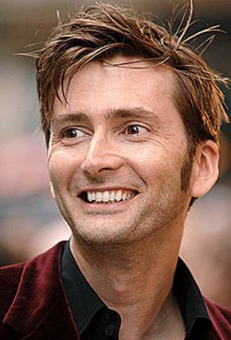
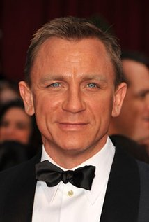
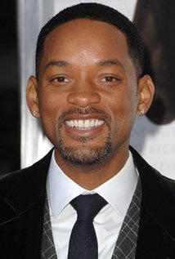
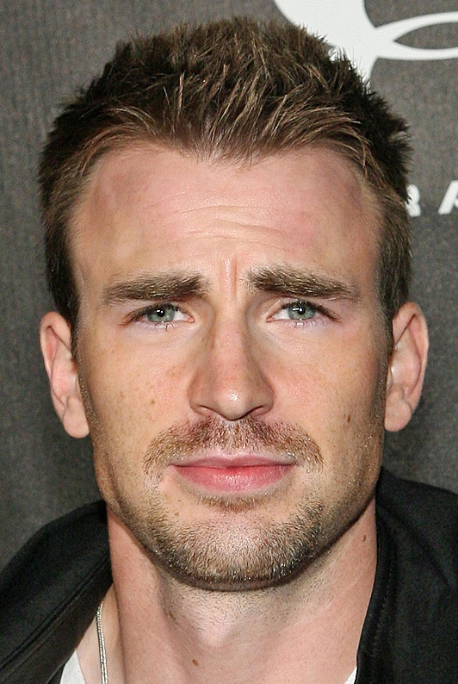
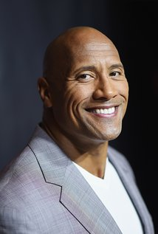
Heights
David Tennant
Daniel Craig
Will Smith
Chris Evans
Dwayne Johnson
1.85m
1.78m
1.88m
1.83m
1.96m

Slide 4
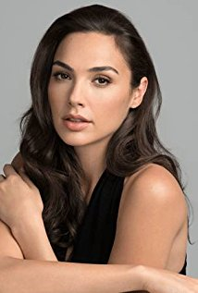
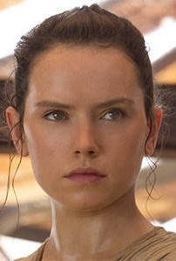
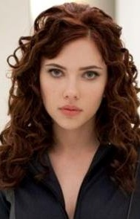
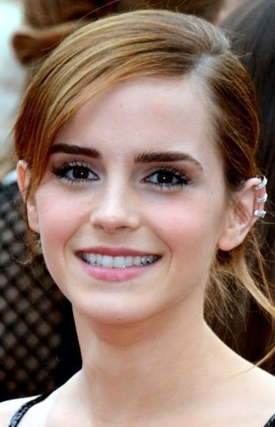
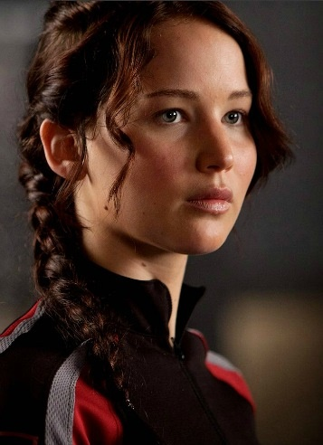
Heights
Jennifer Lawrence
Gal Gadot
Daisy Ridley
Scarlett Johansson
Emma Watson
1.75m
1.78m
1.7m
1.6m
1.65m

Slide 5
Place these actors in order of height. Smallest to tallest.
Johnny Depp – 1.78m
Elijah Wood – 1.68m
Robert Downey Jr – 1.74m
Daniel Radcliffe – 1.65m
Chris Pratt – 1.88m
Extension: Calculate the range (of height) for each group of actors.
Heights

Slide 6
Place these actors in order of height. Smallest to tallest.
Idris Elba – 1.9m
Samuel L Jackson – 189cm
Warwick Davis – 1.07m
Tom Hiddleston – 1.88m
Jack Black – 1.68m
Extension: Calculate the range (of height) for each group of actors.
Heights

Slide 7
Place these actors in order of height. Smallest to tallest.
Beyoncé Knowles – 169cm
Dwayne Johnson – 1.96m
Will Smith – 1.88m
Gwyneth Paltrow – 5’ 9”
Gwendoline Christie – 1.91m
Arnold Schwarzenegger – 6’ 2”
Gal Gadot – 1.78m
Vin Diesel – 1.82m
Leslie Jones – 6’
Tom Cruise – 1.7m
6' 2" | 1.88m
6' 1" | 1.85m
6' | 1.83m
5' 11" | 1.8m
5' 10" | 1.78m
5' 9" | 1.75m
5' 8" | 1.73m
5' 7" | 1.70m
5' 6" | 1.68m
5' 5" | 1.65m
5' 4" | 1.63m
5' 3" | 1.60m
Extension: Calculate the range (of height) for each group of actors.
Heights

