Slide 1
50 Homophone Puzzles
What are homophones?
Two or more words you pronounce the same.
They have different meanings.
They have different spellings.

Slide 2
Each slide gives first a written clue.
This is followed by picture clues (some with sound) and then finally by the homophones.
When is the earliest you can guess the words?
Can you spell the homophones on your white board before they are revealed?
In most cases there are two homophones. Where there are more, the number is shown in brackets at the end of the written clue.

Slide 3
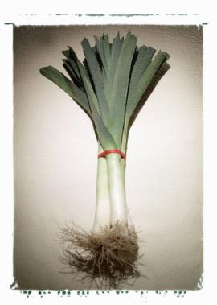
Is this vegetable letting out water?
leek
leak

Slide 4
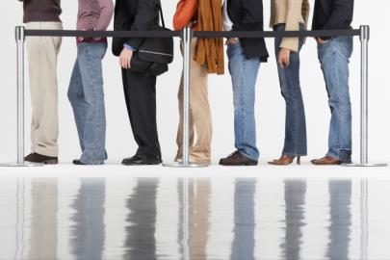
A long line of people to hit the snooker ball.
queue
cue

Slide 5
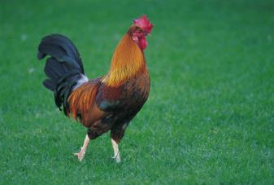
This bird doesn’t play by the rules at football.
fowl
foul

Slide 6
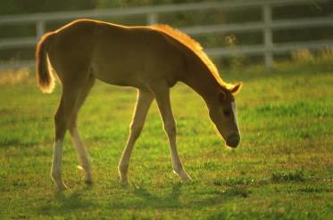
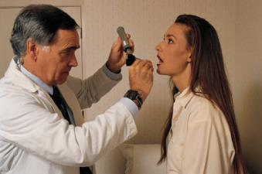
An animal which makes your voice worn out.
horse
hoarse

Slide 7

This tree or sheep is not me. (3)
yew
ewe
you

Slide 8
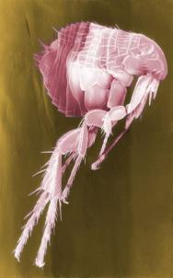
An insect that escapes.
flea
flee

Slide 9
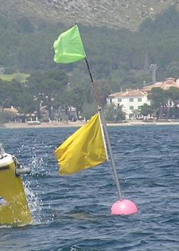
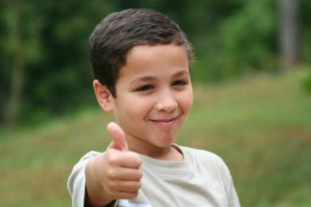
A lad who sits on top of the water.
boy
buoy

Slide 10

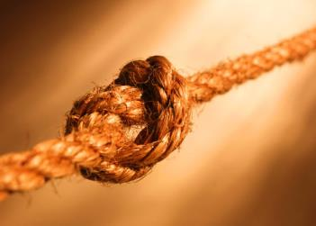
Do ____ tie this.
not
knot

Slide 11
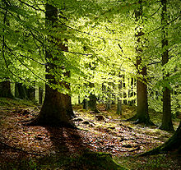
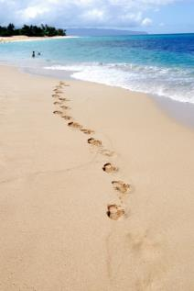
A tree beside the sea.
beech
beach

Slide 12
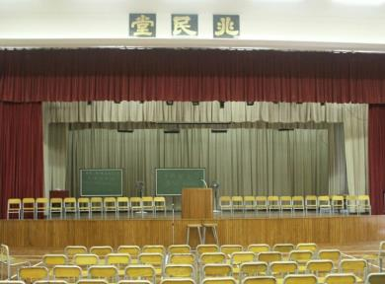
Keep pulling the large room.
haul
hall

Slide 13
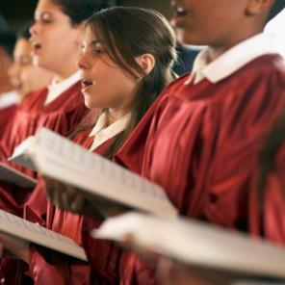
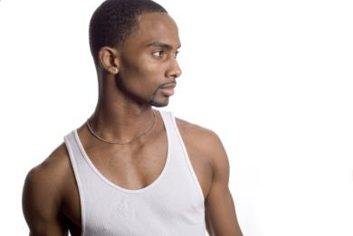
A male song in church.
him
hymn

Slide 14
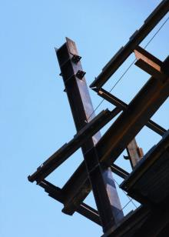
Nick the magnetic iron-rich alloy
steal
steel

Slide 15

The individual did not lose or draw.
one
won

Slide 16
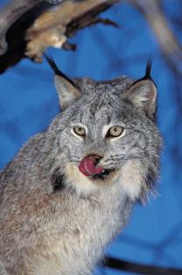
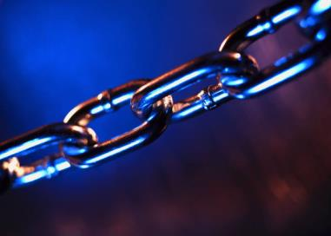
The cat that joins.
lynx
links

Slide 17
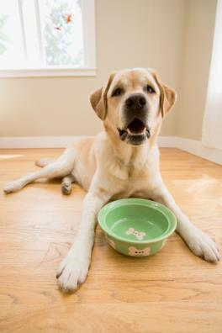
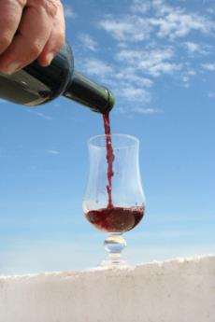

A drink that moans like a dog.
wine
whine

Slide 18
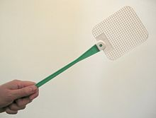
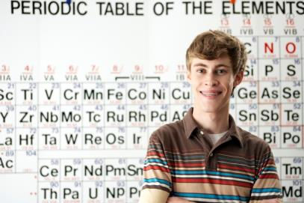
Hit the one who loves learning.
swat
swot

Slide 19
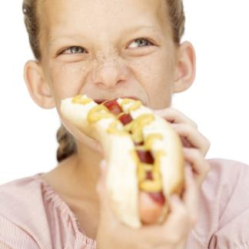
Gobbled up the number.
ate
eight

Slide 20
The paper and pens don’t move.
stationery
stationary

Slide 21
Cold but spicy
chilly
chilli

Slide 22
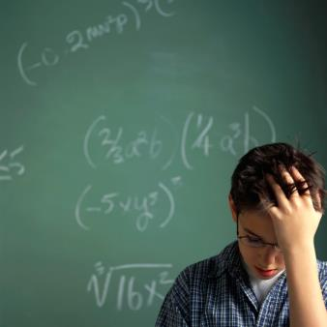
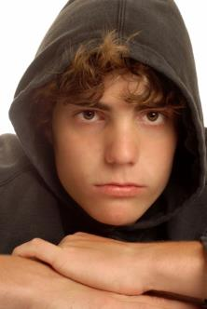
White or black but not excited.
board
bored

Slide 23
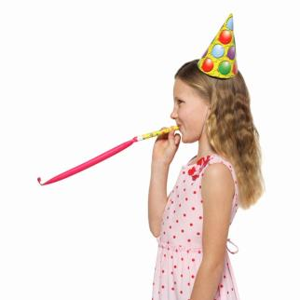

Not silent is permitted.
aloud
allowed

Slide 24
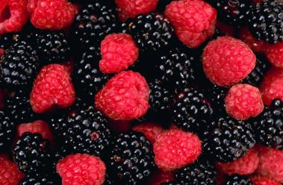
Puts the fruit under the ground.
buries
berries

Slide 25
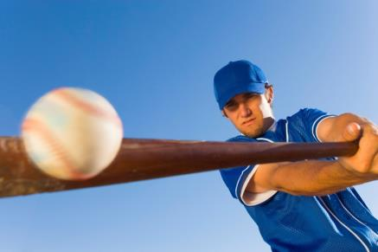
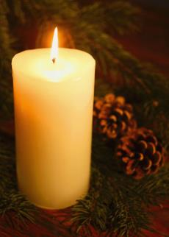
Hits this to make a candle.
whacks
wax

Slide 26
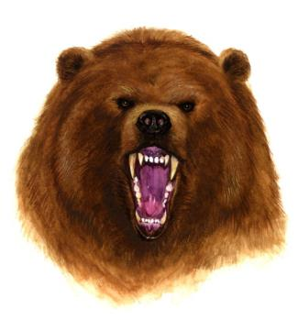
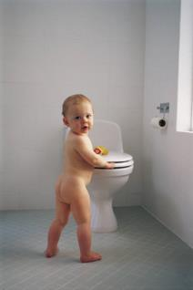
A naked animal.
bare
bear

Slide 27
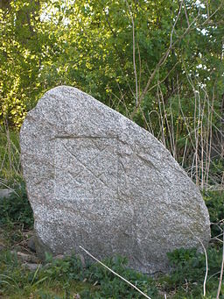
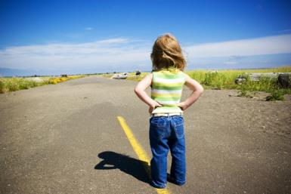
A large rock which is more brave.
boulder
bolder

Slide 28
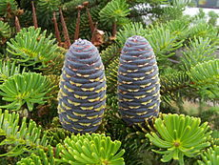
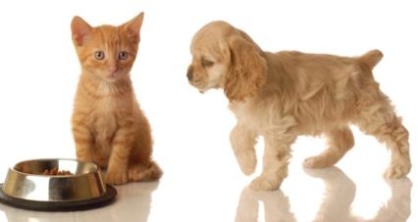
A tree with a warm coat on.
fir
fur

Slide 29
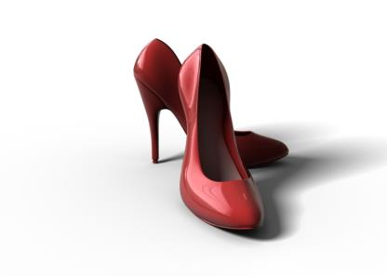
They’re high but it gets better.
heels
heals

Slide 30
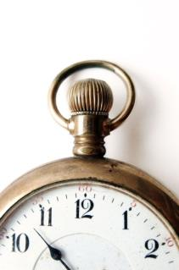
Sixty minutes belongs to us.
Me – my
Her – her
Him- his
Us - ?
Them -their
hour
our

Slide 31

The letters are not female.
mail
male

Slide 32
Does it get smaller as you learn your ____?
lessen
lesson

Slide 33
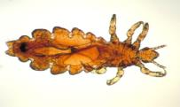
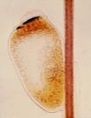
Do this to make a jumper for the egg of a head louse.
knit
nit

Slide 34
Not even one female monk.
none
nun

Slide 35
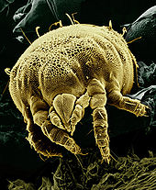
This small spider like animal could have strength.
mite
might

Slide 36
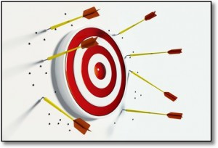
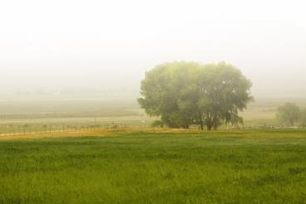
Did not hit in the thin fog.
missed
mist

Slide 37
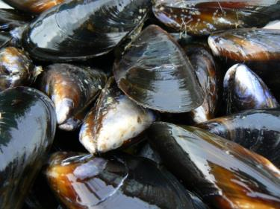
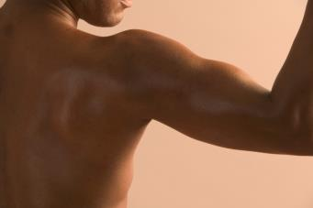
The shellfish with strength.
mussels
muscles

Slide 38
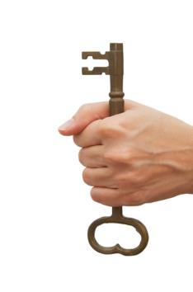
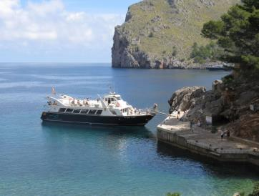
Turn this in the lock – where ships dock.
key
quay

Slide 39

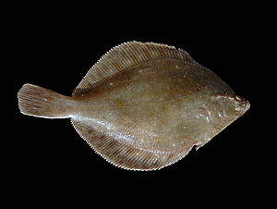
Where to put the flat fish?
place
plaice

Slide 40
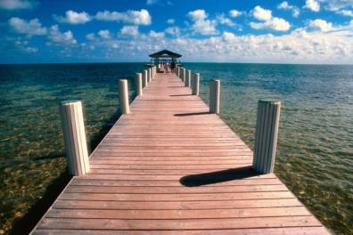
Look intently at the walkway out over the sea. Don’t give in to the pressure!
peer
pier

Slide 41
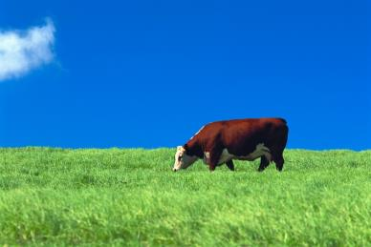
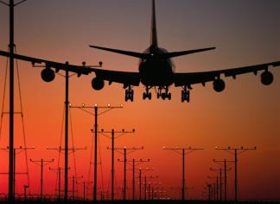
It’s very ordinary and flat, this flying machine.
plain
plane

Slide 42
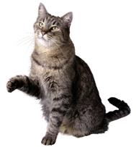


Having little money, tip from the jug, using a cat’s hand to cover the small hole in the skin. (4)
pore
pour
poor
paw

Slide 43


Not left but correct- form words with pen or pencil.
right
write

Slide 44


Fire a gun as you slide down it.
shoot
chute

Slide 45
Kill Santa’s transport.
slay
sleigh

Slide 46


Closing up the top of the room.
sealing
ceiling

Slide 47


Someone selling in an underground room.
seller
cellar

Slide 48


The colour the wind ___.
blue
blew

Slide 49

Does this sweet farmer’s crop grow to a rhythm?
beet
beat

Slide 50


No cheers for the drink.
boos
booze

Slide 51

Bend at the waist to respect the tree branch.
bow
bough

Slide 52

Overcomes the horse chestnut tree fruits.
conquers
conkers

