Slide 1
50 More Homonym Puzzles
What are homonyms?
Homonyms are spelt the same.
They are pronounced the same.
They have different meanings.

Slide 2
Each slide gives first a written clue.
This is followed by picture clues (some with sound) and then finally by the homonyms.
When is the earliest you can guess the words?
Can you spell the homonym on your white board before it is revealed?

Slide 3
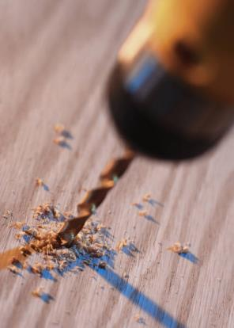
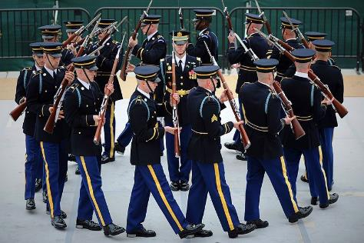
Make a hole as you march around in order.
1
drill

Slide 4
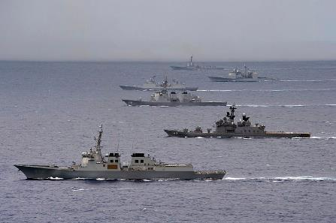
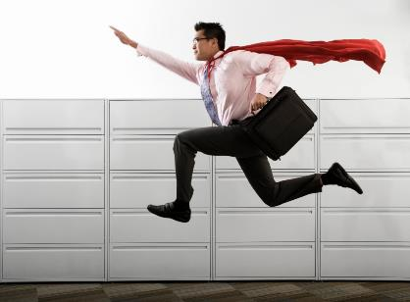
The group of ships is fast.
2
fleet

Slide 5
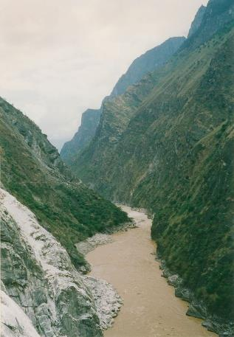
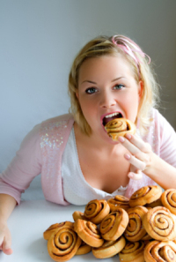
Eat far too much in the narrow valley.
3
gorge

Slide 6
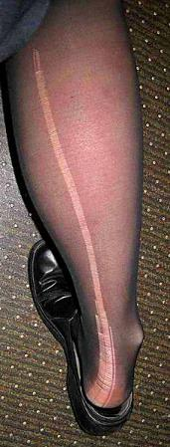

Does this help you climb up tights?
4
ladder

Slide 7
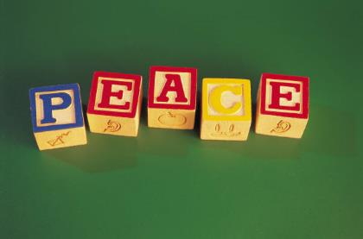
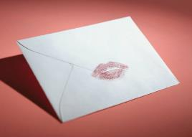
Post these in the alphabet.
5
letters

Slide 8

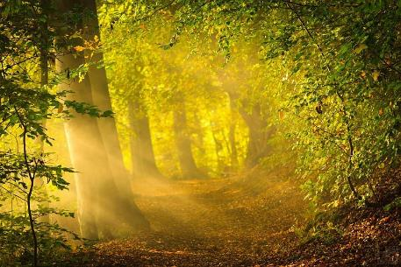
Not heavy when darkness has gone.
6
light

Slide 9
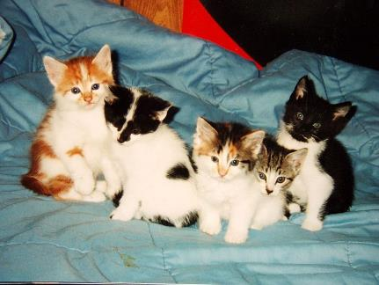
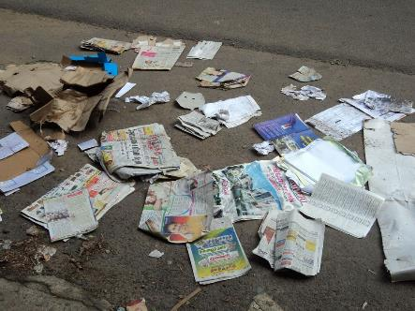
A group of kittens is rubbish.
7
litter

Slide 10
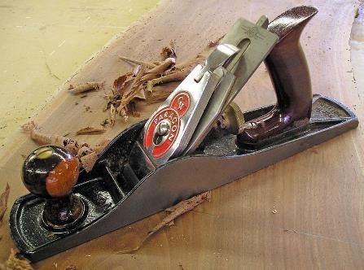
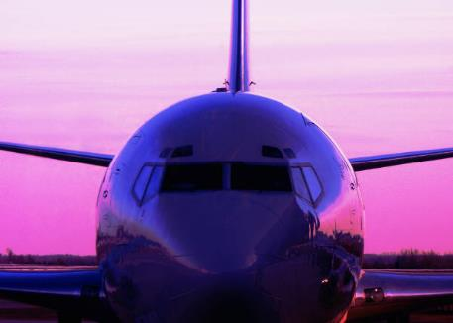
Smooth the wood as you fly this.
8
plane

Slide 11
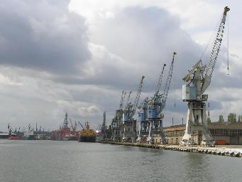

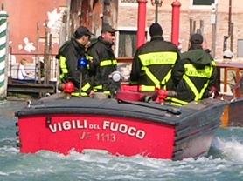
A place a ship visits for a drink on the left.
9
port

Slide 12
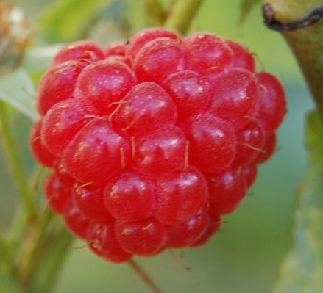
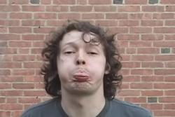

A fruit you blow.
10
raspberry

Slide 13
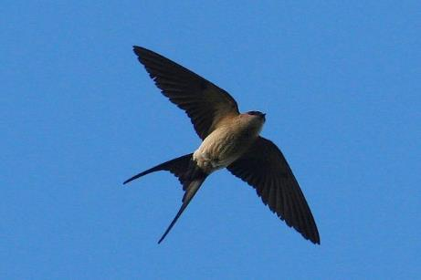
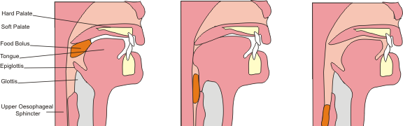
The bird flies from the mouth to the stomach.
11
swallow

Slide 14
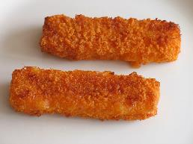
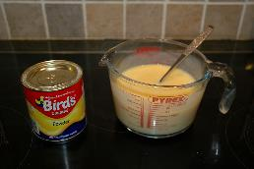
This number is disgusting.
12
144
gross

Slide 15

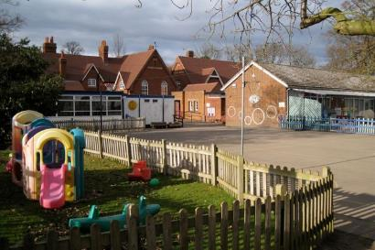
3 foot is a good place to play in.
13
yard

Slide 16
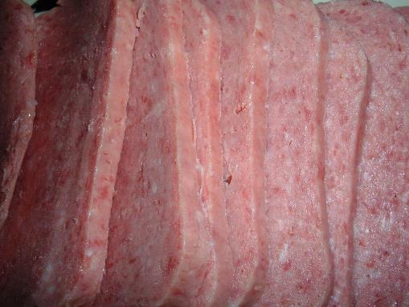
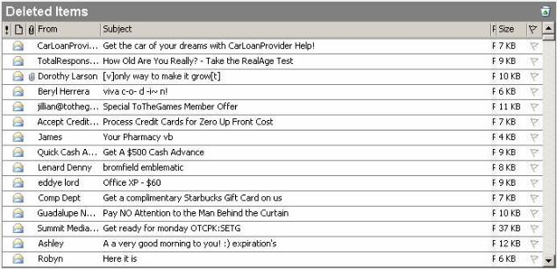
Unwanted email is sliced meat.
14
spam

Slide 17
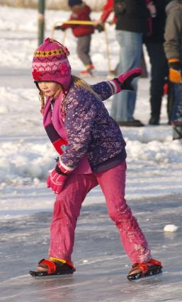
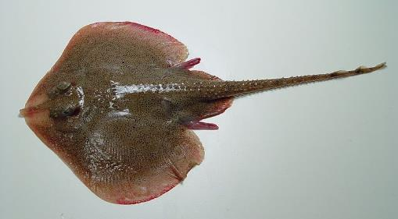
Move on the ice with the flat fish.
15
skate

Slide 18
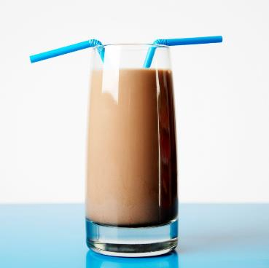
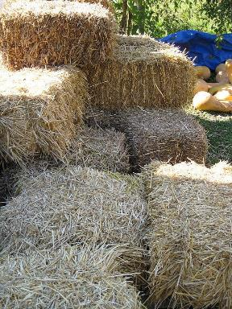
Suck up your drink through the dried stems.
16
straw

Slide 19
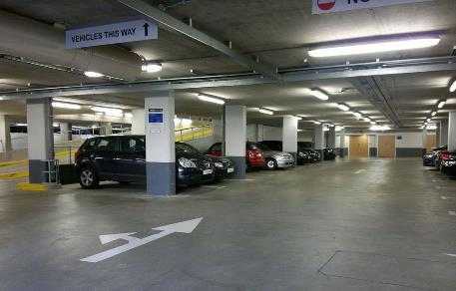
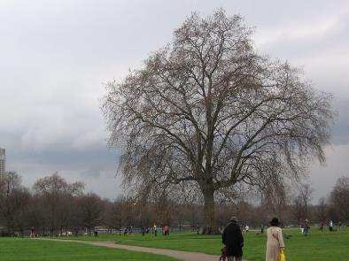
Stop your car on the grass by the trees.
17
park

Slide 20
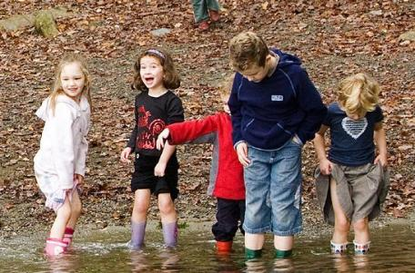
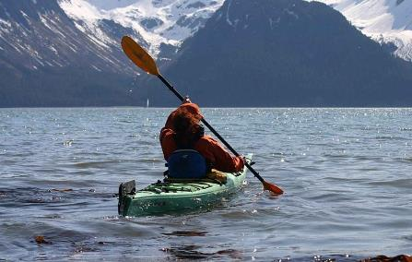
Dip your feet in the water as you move the canoe.
18
paddle

Slide 21
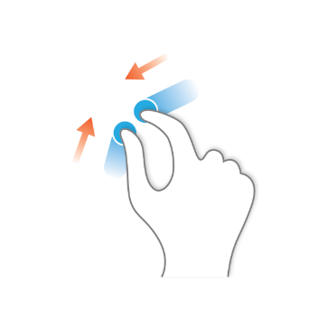
Nip between thumb and forefinger to steal.
19
pinch

Slide 22
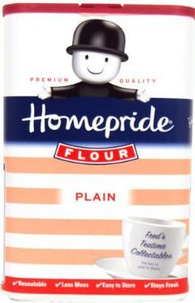
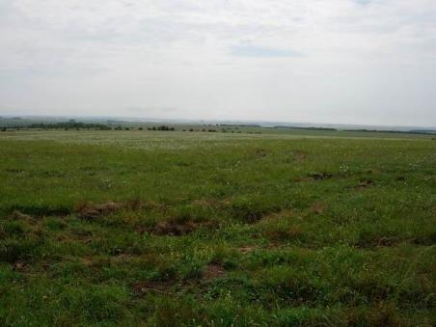
It’s ordinary- this flat area of land.
20
plain

Slide 23
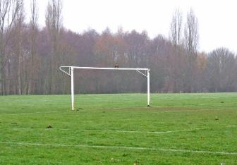
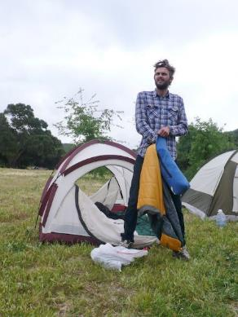
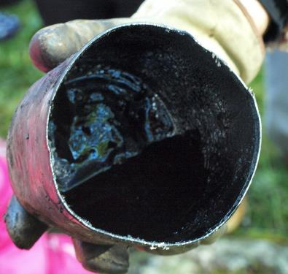
A black substance to play sport or you can __ your tent.
21
pitch

Slide 24
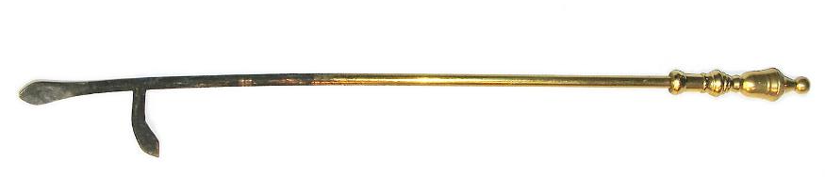
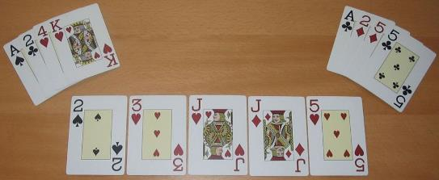
Stir the fire with this while playing cards.
22
poker

Slide 25
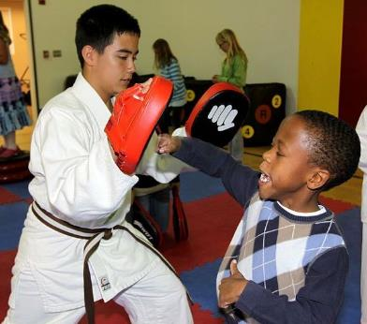
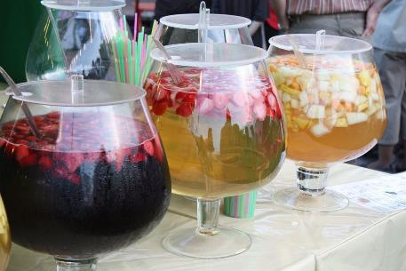
Hit with the fist as you drink this.
23
punch

Slide 26
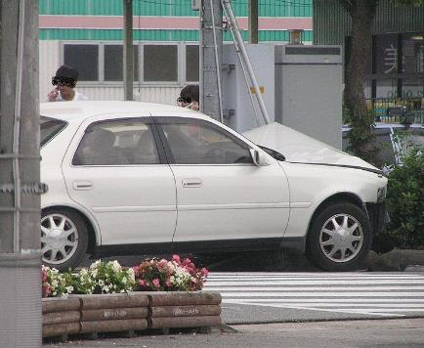
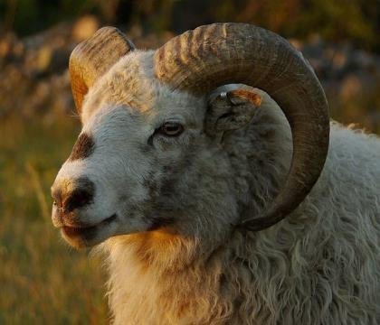
Crash into the male sheep.
24
ram

Slide 27
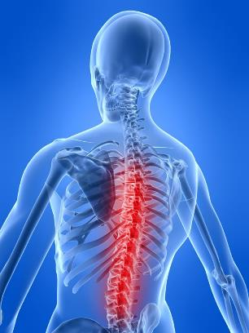
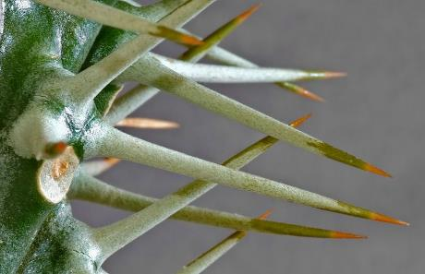
A sharp point gives you backbone.
25
spine

Slide 28
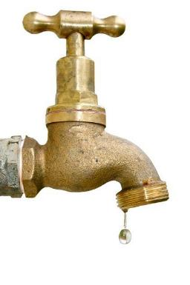
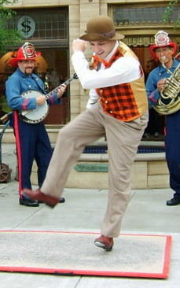
A light hit to turn on the water as you dance noisily.
26
tap

Slide 29
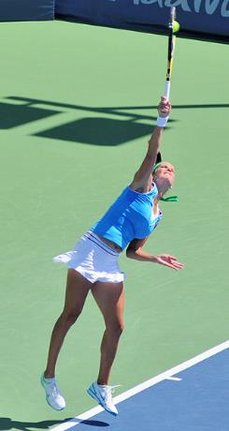

Start the tennis point by giving the food.
27
serve

Slide 30


The flower went up from the end of a watering can.
28
rose

Slide 31
90° is not wrong or left.
29
right

Slide 32


Turn the key in this to move up the canal.
30
lock

Slide 33

This desert is not wise.
31
1st April
fool

Slide 34


Put this heavy shoe in the back of the car.
32
boot

Slide 35


The junior girl guides taste of chocolate.
33
brownies

Slide 36


The metal policeman.
34
copper

Slide 37


It’s quick, not eating food.
35
fast

Slide 38


Cut back the dried plum.
36
prune

Slide 39



Drink or eat this while playing the game.
37
squash

Slide 40

The back of a ship is not friendly.
38
stern

Slide 41


Eat the grilled bread to celebrate.
39
toast

Slide 42


Hit the mollusc without a shell.
40
slug

Slide 43


The fruit preserve stops the cars moving.
41
jam

Slide 44


Strike this to start the romance or game.
42
match

Slide 45

Choose this tool.
43
pick

Slide 46


Don’t float when you wash your hands in this.
44
sink

Slide 47


This bird is good at lifting.
45
crane

Slide 48


Hit the ball into the pocket as you cook in this.
46
pot

Slide 49

Is this felt by a group of lions?
47
pride

Slide 50


This shows the way to write your name.
48
sign

Slide 51

Does this weapon hold fish or gas?
49
tank

Slide 52

Average but unkind.
50
5,10,14,21,25
5+10+14+21+25=75
75÷5=15
mean

Slide 53
The end
Give yourselves a quiet clap!

