Slide 1

At the pet shop

Slide 2
Rabbits/expensive/mice
€ 8
€ 38
Rabbits are more expensive
than mice.

Slide 3
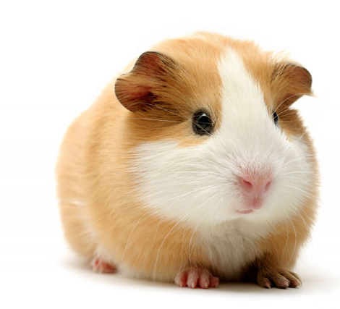
hamsters/not/expensive/guinea pigs
€ 11
€ 20
Hamsters are not
as expensive as guinea pigs.

Slide 4
parrots/expensive/iguanas
€ 150
€ 450
Parrots are more
expensive than iguanas.

Slide 5
dogs/expensive/cats
€ 75
€ 75
Dogs are
as expensive as cats.

Slide 6
dogs/not/expensive/parrots
€ 75
€ 450
Dogs are not
as expensive as parrots.

Slide 7
frogs/cheap/snakes
€ 5
€ 125
Frogs are
cheaper than snakes.

Slide 8
fish/not/expensive/rats
€ 15
€ 1
Fish are not as expensive as rats.

Slide 9
iguanas/cheap/parrots
€ 150
€ 450
Iguanas are cheaper
than parrots.

Slide 10
frogs/not/expensive/cats
€ 5
€ 75
Frogs are not as expensive as cats.

Slide 11
Mice/cheap/rabbits
€ 8
€ 38
Mice are cheaper than rabbits.

Slide 12
hamsters/not/expensive/rats
€ 15
€ 11
Hamsters are not
as expensive as rats.

Slide 13
guinea pigs/expensive/hamsters
€ 20
€ 11
Guinea pigs are more expensive than hamsters.

Slide 14
Mice/not/expensive/rabbits
€ 8
€ 38
Mice are not as expensive
as rabbits.

Slide 15
fish/cheap/rats
€ 15
€ 1
Fish are cheaper than rats.

Slide 16
hamsters/cheap/rats
€ 15
€ 11
Hamsters are cheaper than rats.

