Slide 1
Idioms 3

Slide 2
Each idiom has two slides.
In the first slide you get a picture clue – can you guess the idiom?
In the second slide three possible meanings are given – can you guess the correct one?
Authors of photos are attributed in the notes of the relevant slide.

Slide 3
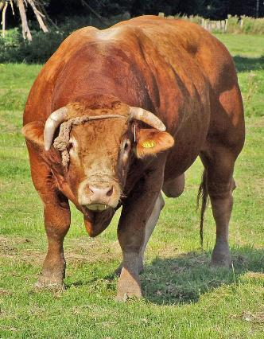
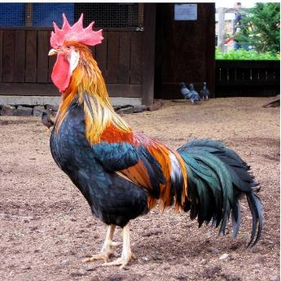
51
₊
A cock and bull story.
Answer
Notes:
"Brown Leghorn rooster in Australia" by Fernando de Sousa from Melbourne, Australia - Standing Tall. Licensed under CC BY-SA 2.0 via Wikimedia Commons - https://commons.wikimedia.org/wiki/File:Brown_Leghorn_rooster_in_Australia.jpg#/media/File:Brown_Leghorn_rooster_in_Australia.jpg "Bull Oostvaardersplassen 2" by No machine readable author provided. Rex assumed (based on copyright claims). - No machine readable source provided. Own work assumed (based on copyright claims).. Licensed under CC BY-SA 3.0 via Wikimedia Commons - https://commons.wikimedia.org/wiki/File:Bull_Oostvaardersplassen_2.JPG#/media/File:Bull_Oostvaardersplassen_2.JPG

Slide 4
51
A fable.
?
?
An unbelievable story.
An farmyard tale.
?
His explanation of what happened at the party sounds like a real cock and bull story.

Slide 5
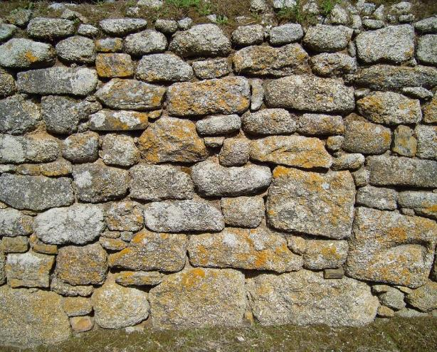
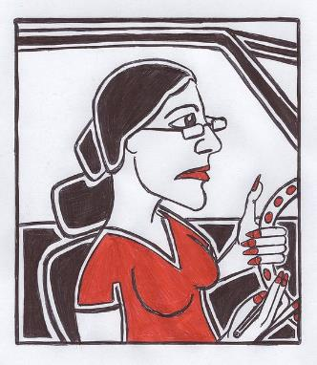
52
Me
Drive me up the wall.
Answer

Slide 6
52
Annoy me immensely.
?
Involve me in a car crash.
?
?
Use a lift.
Rover keeps chasing other dogs – it’s driving me up the wall.

Slide 7
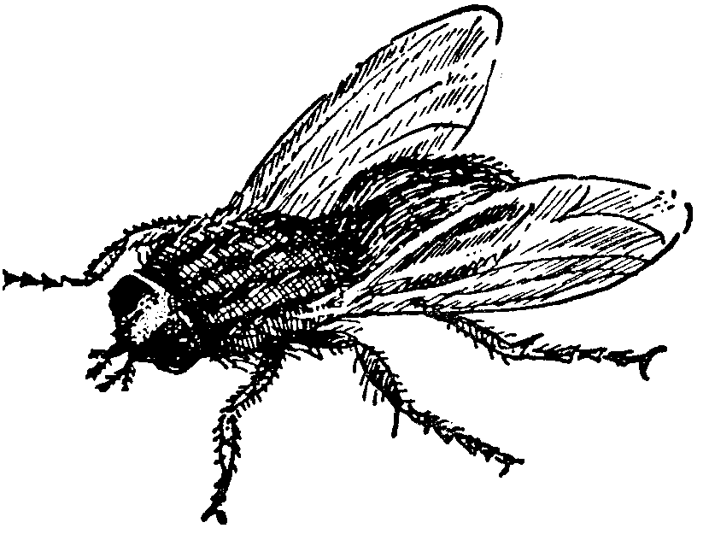
53
Dropping like flies.
Answer

Slide 8
53
Falling through the air.
?
?
Falling over making a buzzing sound.
?
Large numbers of people falling ill or leaving.
Since the flu started after Christmas, they’ve been dropping like flies.

Slide 9
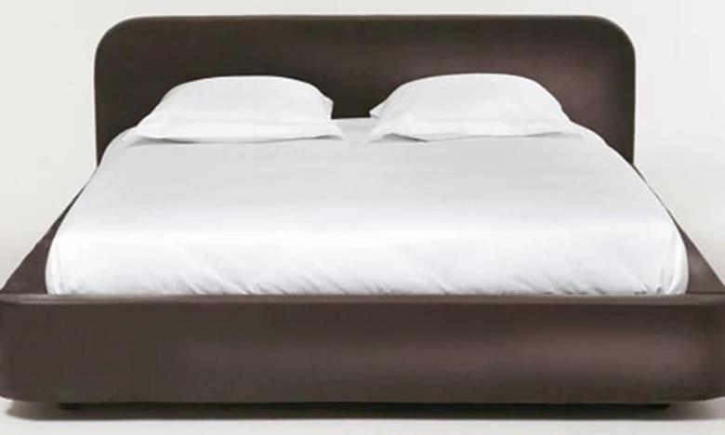
54
Get out of bed on the wrong side.
Answer

Slide 10
54
Climb over your partner to get out of bed.
?
Start the day in a bad mood.
?
Read a book together.
?
He was very argumentative – he must have got out of bed on the wrong side.

Slide 11
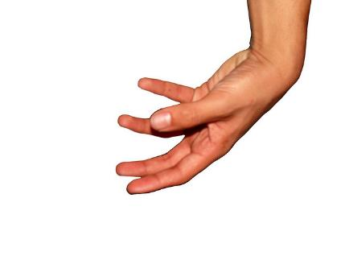
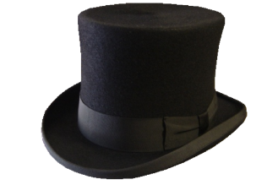
55
At the drop of a hat.
Answer

Slide 12
55
Without delay – at once.
?
When your head gets cold.
?
As a sign of respect.
?
“I’m not busy – I could come and help you at the drop of a hat.”

Slide 13
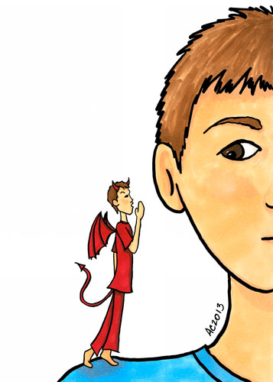
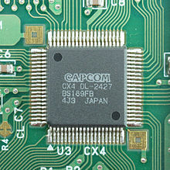
56
A chip on your shoulder.
Answer

Slide 14
56
?
Bone damage to your shoulder.
A bright idea heading for your ear.
?
?
A grudge which makes you angry.
Ever since Gareth was left out of the football team, he’s had a chip on his shoulder.

Slide 15
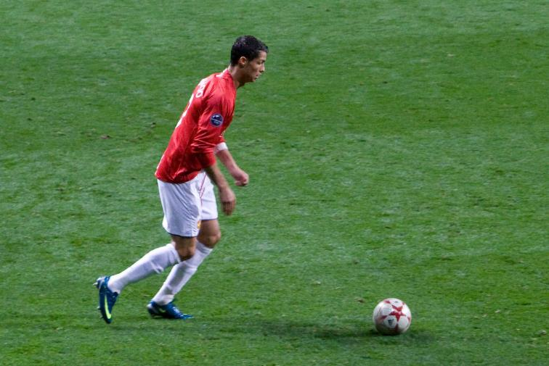
57
Kick the bucket.
Answer

Slide 16
57
?
Wash the floor.
Die.
?
Knock over a container holding liquid.
?
“I hope I won’t kick the bucket for at least another 30 years!”

Slide 17
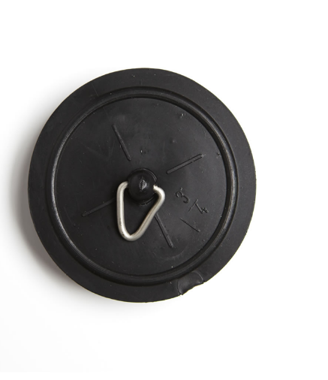
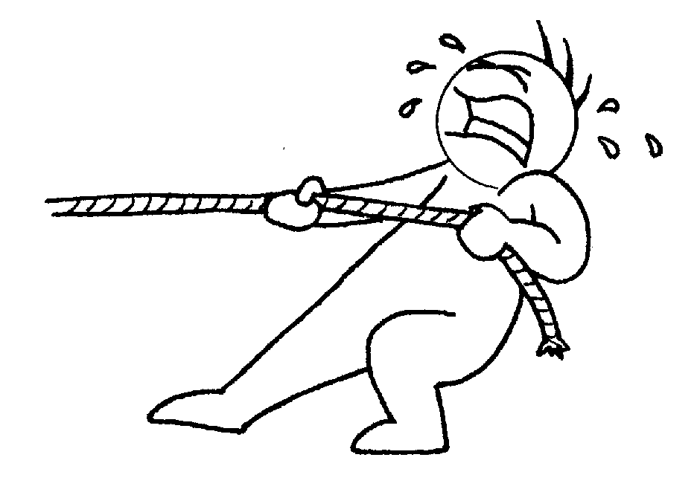
58
Pull the plug.
Answer

Slide 18
58
End something.
?
Let the bath water out.
?
?
Stop electricity flowing.
Nobody turned up for craft club so Miss Jenkins pulled the plug on it.

Slide 19
59
Cut a long story short.
Answer

Slide 20
59
Miss out the last few chapters.
?
?
Give a summary.
Read a shorter book.
?
To cut a long story short: they fell in love and got married.

Slide 21
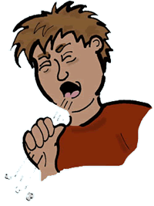
60
Cough up.
Answer

Slide 22
60
Pay up.
?
Cough without your hand over your mouth.
?
Cough in a high pitch.
?
“I didn’t get pocket money last Saturday – it’s time Dad coughed up!”

Slide 23
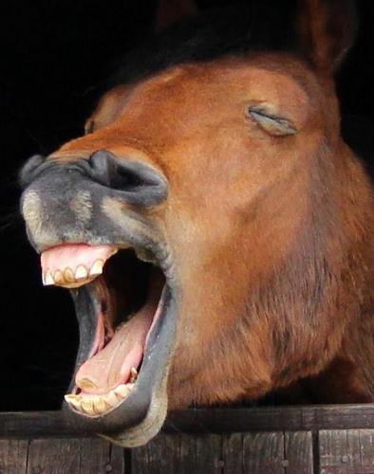
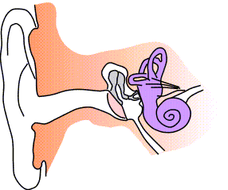
61
Hear it from the horse’s mouth.
Answer
Notes:
Photo by Tony Parkin CC license – flipped vertically.
"Ear-anatomy-notext-small" by Iain at the English language Wikipedia. Licensed under CC BY-SA 3.0 via Wikimedia Commons - https://commons.wikimedia.org/wiki/File:Ear-anatomy-notext-small.png#/media/File:Ear-anatomy-notext-small.png

Slide 24
61
Hear a tip about a horse race.
?
Hear from the person with authority.
?
Hear an animal sound and see the animal which is making it.
?
“I’ve heard it from the horse’s mouth – the head teacher said that exams have been cancelled.”

Slide 25
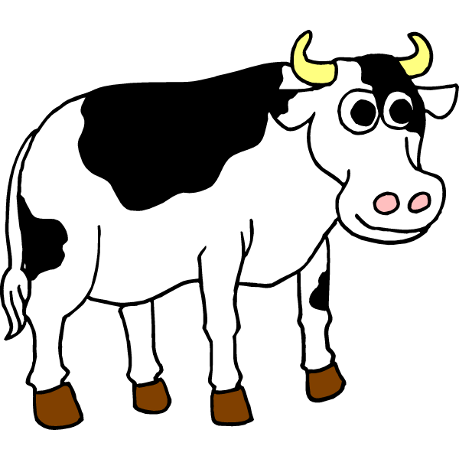
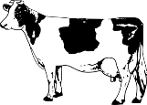
62
Till the cows come home.
Answer

Slide 26
62
Until the fields are empty.
?
?
Until it rains.
?
For a long time.
“The last train has left – if you carry on waiting, you will be here till the cows come home.”

Slide 27
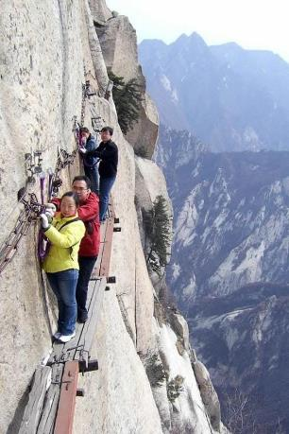
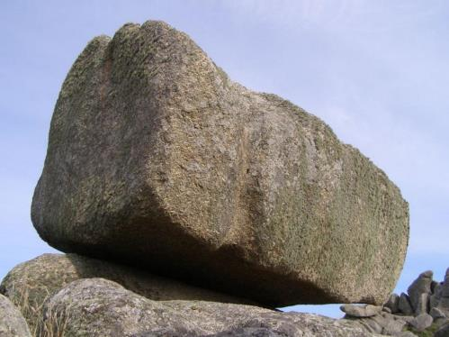
63
Be between a rock and a hard place.
Answer

Slide 28
63
Be stuck between two unpleasant choices.
?
Get stuck when climbing.
?
Suck a stick of rock while sitting on a rock.
?
James was stuck between a rock and a hard place: he could either spend all day accompanying his sister clothes shopping or he could go to a flower arranging day.

Slide 29
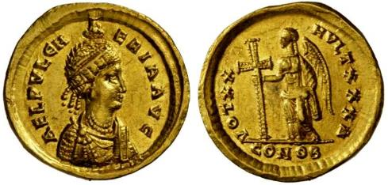
64
Can’t make heads or tails of it.
Answer

Slide 30
64
Can’t find a coin without heads or tails.
?
Can’t call a tossed coin correctly.
?
Cannot understand something at all.
?
“The instruction book is written in Russian – I can’t make heads or tails of it!”

Slide 31
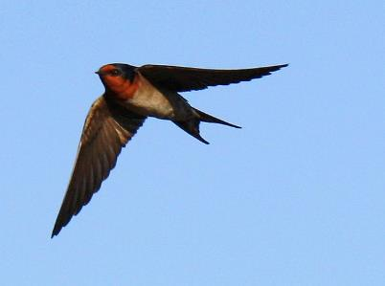
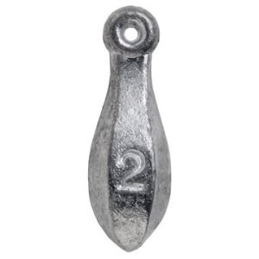
65
+
Swallow it hook, line and sinker.
Answer

Slide 32
65
Be completely taken in by it.
?
Catch a bird with a hook.
?
Eat a fish you have caught.
?
When I tried the old ‘Your car’s on fire’ joke on Mum, she swallowed it hook, line and sinker.

Slide 33
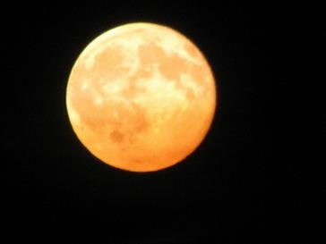
66
Once in a blue moon.
Answer

Slide 34
66
Once upon time.
?
When there is a full moon in winter.
?
?
Not very often at all.
He’s near the bottom of the league so he only wins once in a blue moon.

Slide 35
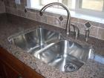
Everything
67
Things I am taking
Everything but the kitchen sink.
Answer

Slide 36
67
Everything except cleaning materials.
?
A lot more than you need.
?
A few basic kitchen essentials.
?
Their car was overloaded as they set out for the camping trip – they had everything but the kitchen sink.

Slide 37
Everything
68
Everything is coming up roses.
Answer

Slide 38
68
The garden is full of roses.
?
Everything is turning out really well.
?
Everything smells wonderful.
?
“Since we moved to Miss’s class, everything has been coming up roses.”

Slide 39
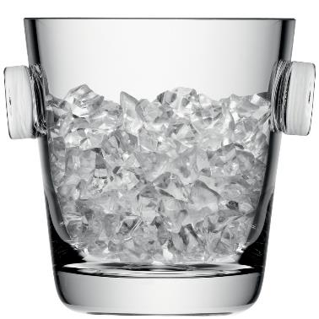
69
Cool it.
Answer

Slide 40
69
Calm down and don’t lose your temper.
?
Make your clothes more fashionable.
?
Put it in the freezer for a while.
?
As the argument progressed, Sam got redder and redder until Amy told him to cool it.

Slide 41
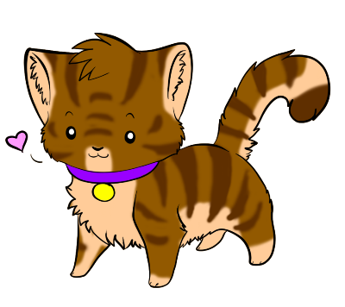
70
Curiosity killed the cat.
Answer

Slide 42
70
Keep control of your cat.
?
Avoid using too many question marks.
?
?
Don’t investigate things which don’t concern you.
“I wouldn’t go poking around in that dark alley at midnight – remember curiosity killed the cat.”

Slide 43
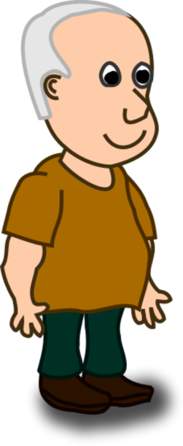
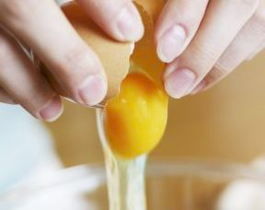
71
Cracking him up.
Answer

Slide 44
71
?
Make him laugh uncontrollably.
Prepare an omelette for him.
?
?
Break his heart.
The cockroach joke really cracks him up.

Slide 45
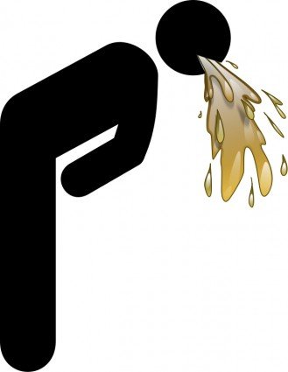
72
Be as sick as a dog.
Answer

Slide 46
72
Catch an animal disease.
?
?
Vomit over your pet.
Be very ill.
?
After he’d eaten the maggots, he was as sick as a dog.

Slide 47
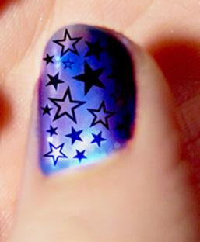
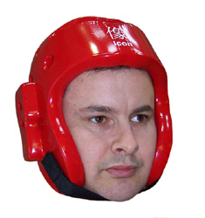
73
Hit the nail on the head.
Answer
Notes:
"Hologram nail art" by Courtney Rhodes - http://www.flickr.com/photos/pumpkincat210/6236365596/. Licensed under CC BY 2.0 via Wikimedia Commons - https://commons.wikimedia.org/wiki/File:Hologram_nail_art.jpg#/media/File:Hologram_nail_art.jpg

Slide 48
73
Hammer home your point of view.
?
Describe a problem or situation really well.
?
Miss your thumb with the hammer.
?
You hit the nail on the head when you said that there weren’t enough vegetables in school dinners.

Slide 49
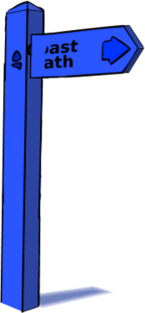
49
Wrong
Rub someone up the wrong way.
Answer

Slide 50
74
?
Irritate someone.
Try to erase the memory of someone.
?
Stroke someone too roughly.
?
The way he thinks he’s always right rubs me up the wrong way.

Slide 51
75
I’m all ears.
Answer

Slide 52
75
My hearing aid is turned up to maximum.
?
?
My ears are too big for the rest of my body.
?
I’m listening intently.
“Do tell me more – I’m all ears.”

Slide 53
The End
Also available: Idioms 1, Idioms 2 & Idioms 4.

