Slide 1
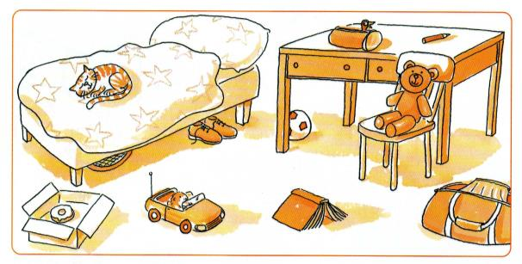
PLACE
PREPOSITIONS
in
under
in
The bird is ____ the pencil case.
on

Slide 2
PLACE
PREPOSITIONS
in
under
The cat is _____ the bed.
on
on

Slide 3
PLACE
PREPOSITIONS
in
under
The football is ______ the desk.
on
under

Slide 4
PLACE
PREPOSITIONS
in
under
The shoes are ______ the bed.
on
under

Slide 5
PLACE
PREPOSITIONS
in
under
The doughnut is ____ the box.
on
in

Slide 6
PLACE
PREPOSITIONS
in
under
The teddy bear is ____ the chair.
on
on

Slide 7
PLACE
PREPOSITIONS
in
under
on
The bag is ____ the floor.
on

Slide 8
PLACE
PREPOSITIONS
in
under
The hamster is ____ the car.
in
on

Slide 9
PLACE
PREPOSITIONS
in
under
The tennis racket is ______ the bed.
on
under

Slide 10
PLACE
PREPOSITIONS
in
under
The book is ____ the floor.
on
on

Slide 11
PLACE
PREPOSITIONS
in
under
The pen is ____ the desk.
on
on

