Slide 1
Tudor food

Slide 2

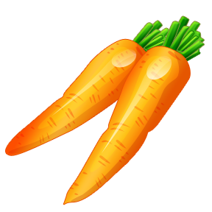
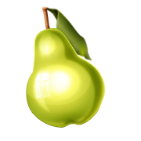
Beliefs about food
The Tudors had a very different beliefs about food than we do today.
Fruit was always cooked, as it was thought that raw fruit and vegetables were bad for you!
People didn’t eat meat on Friday due to religious beliefs about ‘Good Friday’. Therefore they would eat fish on Fridays.

Slide 3
Rich and Poor
Rich and poor Tudors ate very different food from each other.
Poor people would eat a lot of pottage (a vegetable stew.) They wouldn’t be able to afford much meat.
The rich would eat lots of meat, but only a few vegetables.
They would also eat spices and sugar which the poor couldn’t afford.

Slide 4
Vegetables
Vegetables which grew underground, (such as carrots and parsnips), were only considered fit for the poor.
Only vegetables such as onions, garlic and leeks (which grew above the ground) were eaten by the King and other rich people!

Slide 5
Meat
Meat was very important to the Tudor diet. Rich Tudors ate 1 to 2 kilos of meat per day! This is 10 times as much as people eat nowadays!
Tudor meat included venison, beef, pork, veal, goat, lamb, rabbit, hare, mutton, swans, and herons.
They also ate seabirds such as puffins!

Slide 6
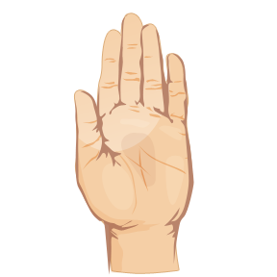
Poaching
Only lords and nobles of Tudor England were allowed to hunt deer, boar, hares and rabbits!
The punishment for poaching (illegal hunting) in Tudor England could result in death or having one’s hands cut off.

Slide 7

Bread
The king and rich people ate white bread.
Poorer people would eat rye, or wholemeal bread
Baking was dangerous in Tudor times, as ovens were heated by fire. If the fire spread, the whole house could burn down!

Slide 8

Dairy foods
Dairy foods (such as milk, butter and cheese) were considered as food for the poor.
The rich only used milk and butter for cooking.

Slide 9
Drinks
Tudors would generally drink weak beer as it was cleaner than water. They might drink up to 6 pints a day!
The rich would drink beer, or wine, imported from France.

Slide 10
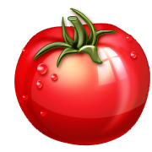
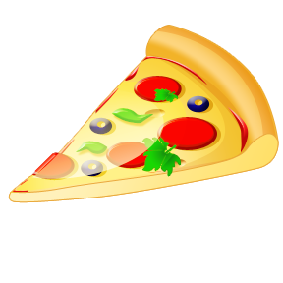
Food that Tudors didn’t eat
Not all the food that we eat today was available to the Tudors.
Such food as potatoes, tomatoes, sweetcorn, cocoa and pineapples were only discovered in the Americas during Tudor times.
So, Henry VIII wouldn’t have been able to have eaten chips, pizza, nor chocolate!

Slide 11
Storing food
Storing food in Tudor times was not as easy as it is for us today. They didn’t have refrigerators, nor freezers. Therefore food would go off quite quickly.
Meat was kept from going off by keeping it in barrels of salt water, or by rubbing it with salt. The salt stopped it from going off so quickly. It would also keep longer, if it was hung to dry.

Slide 12
Serving food
In early Tudor times, food was served on a four day old piece of bread called a ‘trencher’. This stale piece of bread would be thrown away after the meal was eaten. When food was cooked in pies, likewise, the food inside the pie was eaten, but the pastry would be thrown away.
In later times, the rich ate off plates. The Plates were made from metal; pewter or silver.
Silver plates were washed in hot water, whilst cheaper pewter plates were cleaned by being scoured with sand.

Slide 13
Your task
Henry VIII is having an important visitor, King Francis I of France, coming to dine at Hampton Court Palace, and King Henry needs you to draw up a menu for the banquet that he is giving. What food will you serve?
Success Criteria
What drinks will you serve?
What sort of meats would you serve for the main course?
Which part of the animal would you serve? Trotters? Tongue? Ears? Wings? Rump? Shoulder?
How would it be cooked? Roasted? Boiled? Baked? Stewed?
What would you serve with the meats?
What desserts would you serve?

