Slide 1
Racing Car Game
Using the keys to control a sprite.
To use loops to repeat a command.
To use an if statement.
To use the sense block ‘touching colour’ to control the game.

Slide 2
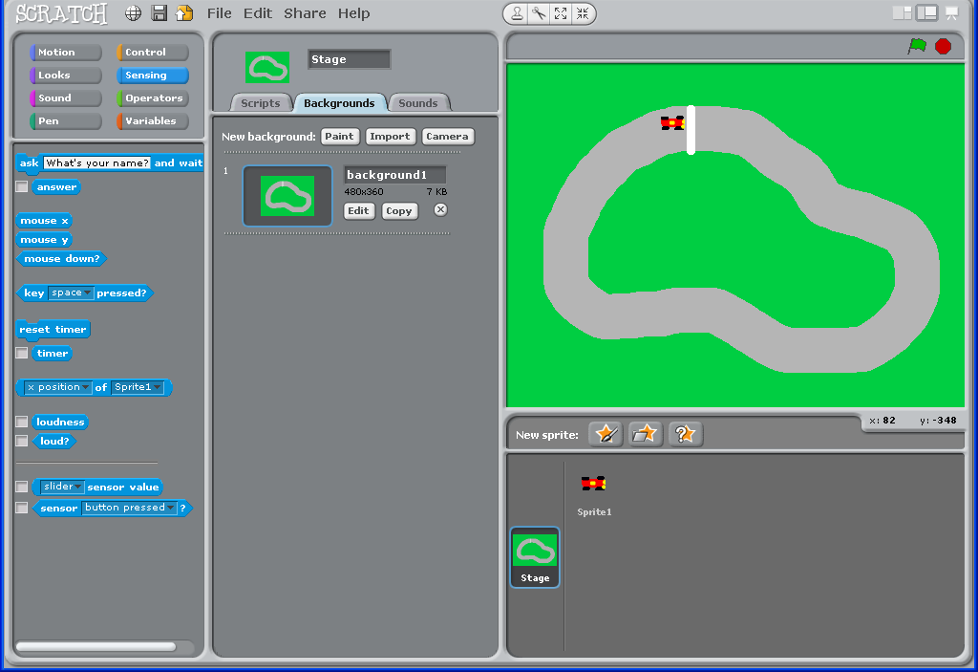
Go to Stage.
Paint a race track background like this one.
Add a finishing line in white.

Slide 3
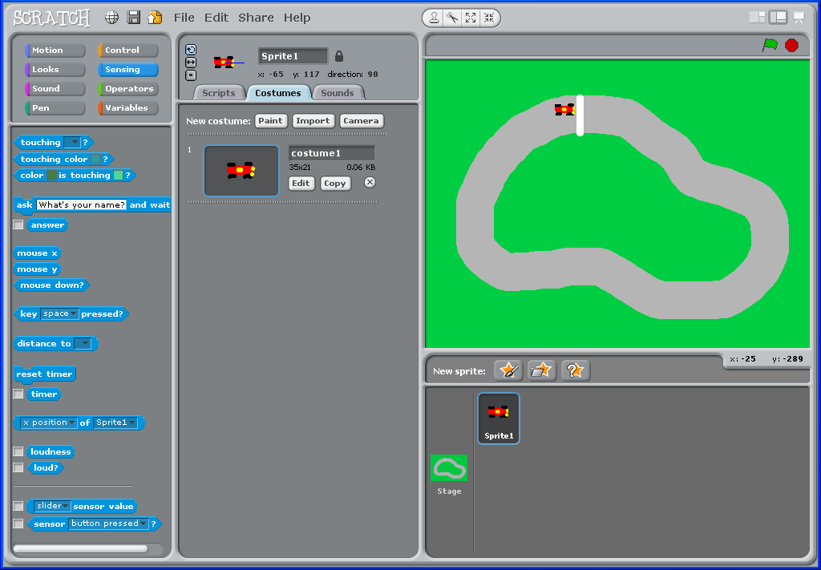
Delete Scratch.
Select Paint Sprite.
Paint a simple racing car shape.

Slide 4
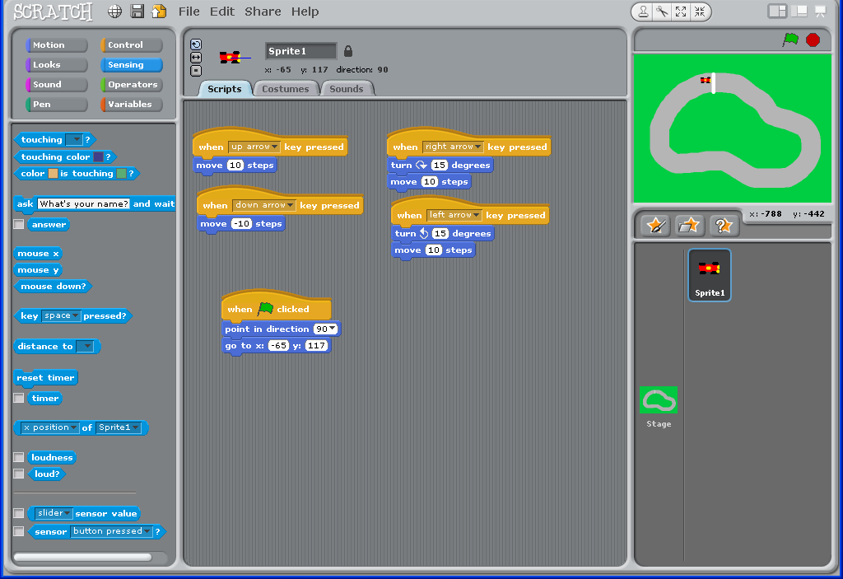
Build these controls to move your car and place it at the starting line.

Slide 5
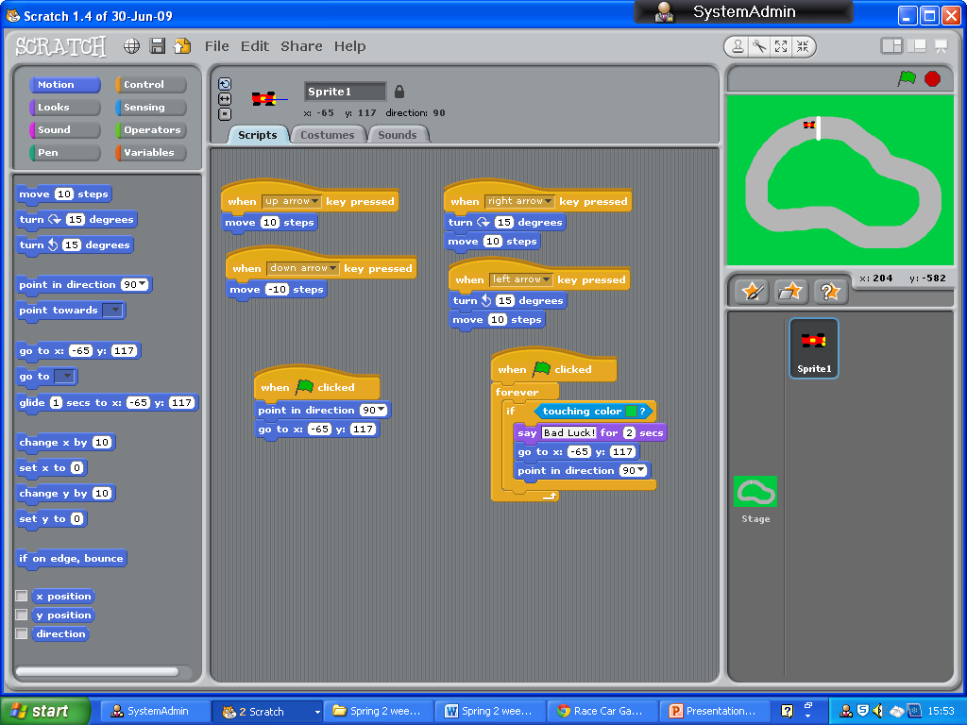
Watch how the teacher shows you how to add the colour of the grass to ‘touching colour’.
This instruction
Puts you back to the start if you go on the grass!

Slide 6
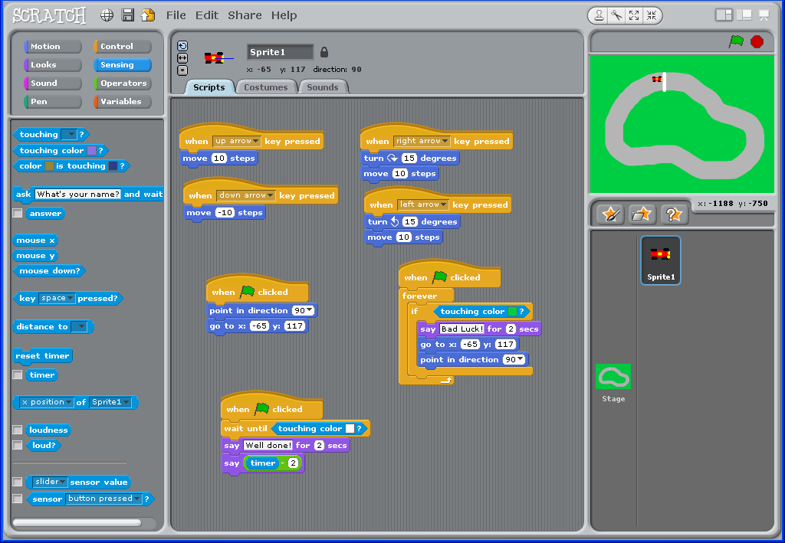
This instruction tells you that you have won if you touch the finishing line.

Slide 7
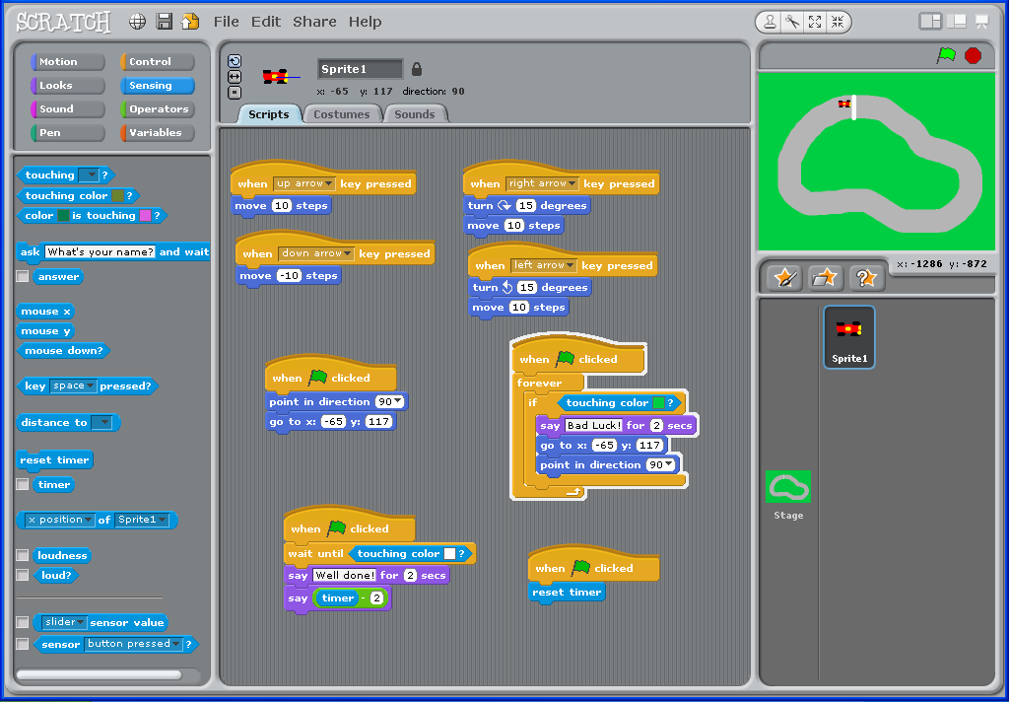
This resets the timer.

Slide 8
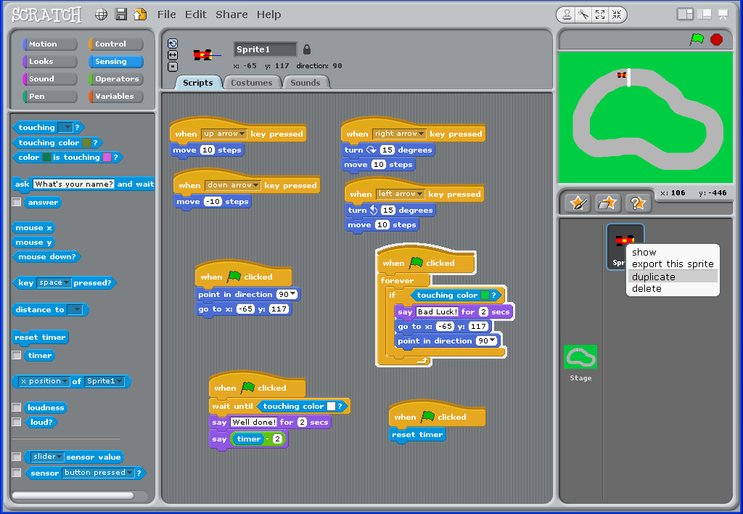
To make another car DUPLICATE Sprite 1.

Slide 9
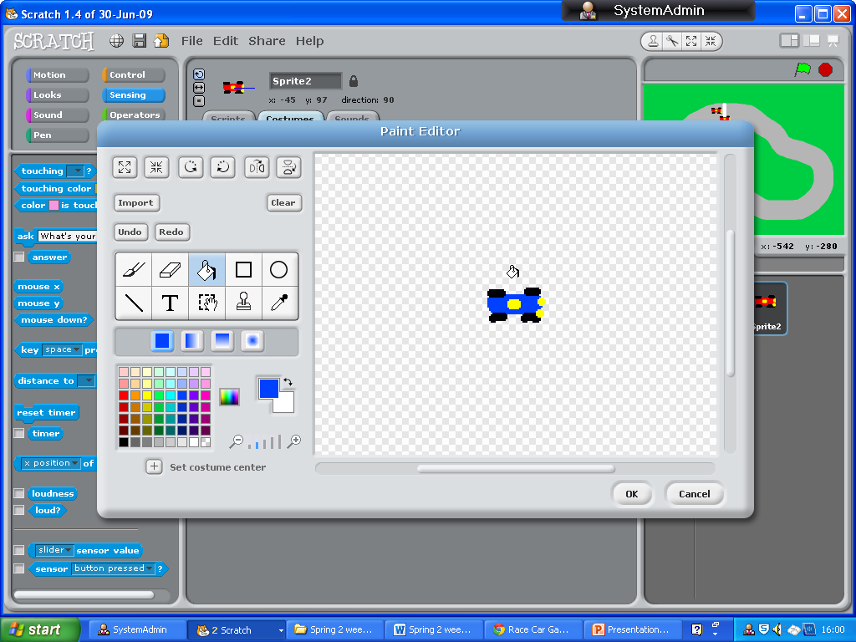
Click on Costumes.
Select EDIT.
Use the Fill Tool to turn the car blue.

Slide 10
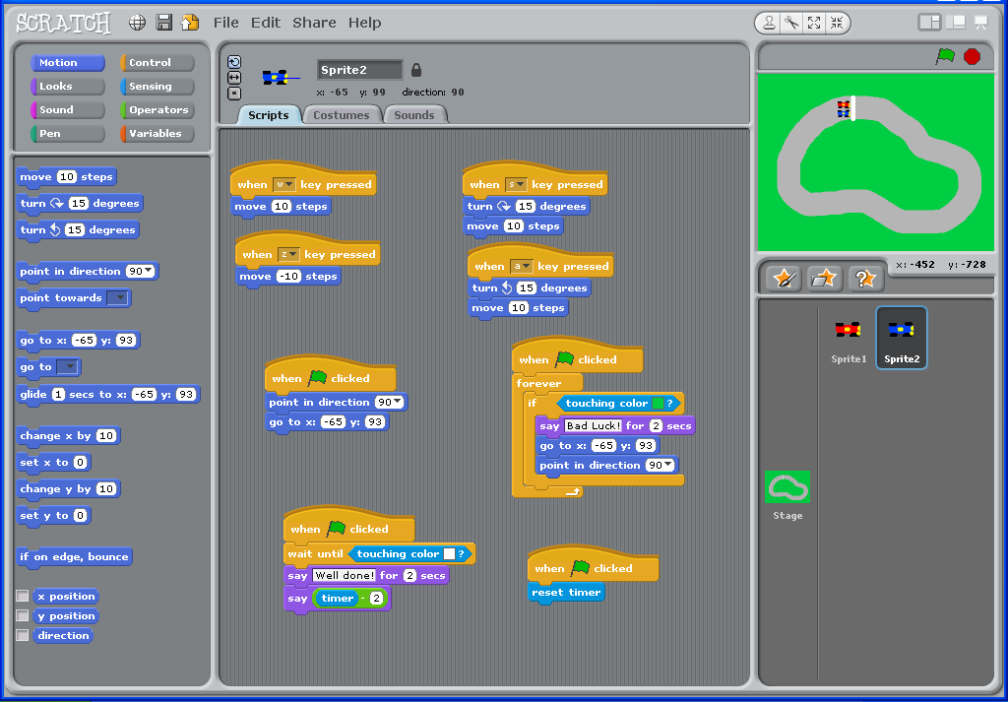
Change the keys controlling the blue car.
Change the ‘go to’ coordinates to match the blue car.
Now play your game

