Slide 1
British Space Service
Astronaut Test Paper 1
(Trip to Mars)

Slide 2
Scenario
You are to plan a mission to Mars. You will be given a list of items you will need to take and you must calculate the total weight of those items.
You will be required to fuel your ship with the correct amount of fuel.
In addition you will need to prove you can read your instruments accurately and decide on the correct course of action as a result of what your instruments show.
A mission will be described to you and you will need to read the instructions carefully and decide what you would do in the situation.
Good luck with the test
Albert Minch
Albert Minch
Head of Recruitment
British Space Service

Slide 3
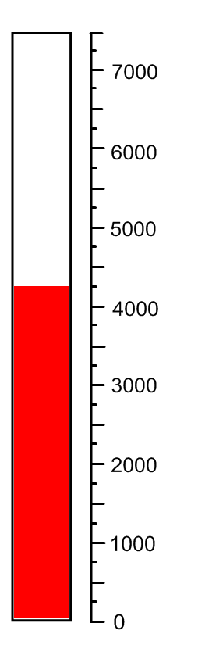
Your first task will be to fuel your craft with the correct amount of fuel. The current level of fuel is shown below:-
Your craft requires 6750 tonnes of fuel to make the trip to Mars and back.
How much more fuel should the ship be fuelled with. Remember if you take too much fuel your craft will be too heavy to lift off safely and will crash.
Show how you have worked out how much more fuel to put in your craft.
_________________________________________________________________________________________________________________________________________________________________________________________

Slide 4
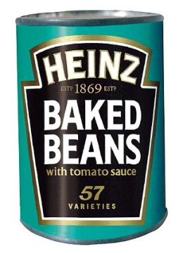
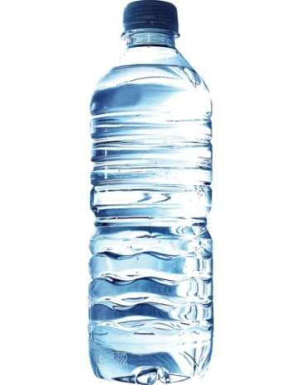
Being a British mission we have little money to spend on food. Following much research it has been discovered that an astronaut can survive on a diet of baked beans alone. In order to make the trip you will need to take 375 cans of beans.
As part of the test you are required to weigh a tin of beans and calculate the total weight of 375 cans.
Show your working below.
_________________________________________________________________________________________________________________________________________________________________________________________
You will also need water on your trip, our scientists have been hard at it calculating how much water you will need to survive the trip. After much effort they have decided that you will need 546 bottles.
As part of the test you are required to weigh the water and calculate the total weight of 546 bottles.
Show your working below.
_________________________________________________________________________________________________________________________________________________________________________________________

Slide 5
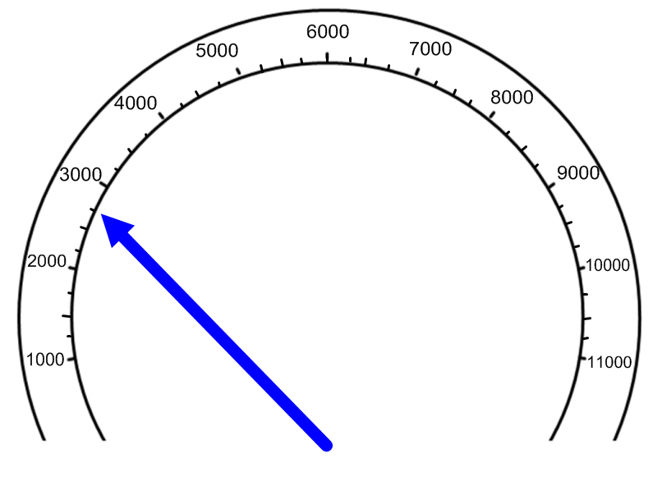
Mission Test
In order to lift off the launch pad you will need to generate 3500 tonnes per metre of thrust. Below is the thrustometer which shows the thrust level. Read the dial and record what the thrustometer shows thrusts levels as.
tonnes per metre
Thrust
__________
How much more thrust do you need to have to reach lift off, show your working.
_________________________________________________________________________________________________________________________________________________________________________________________

Slide 6
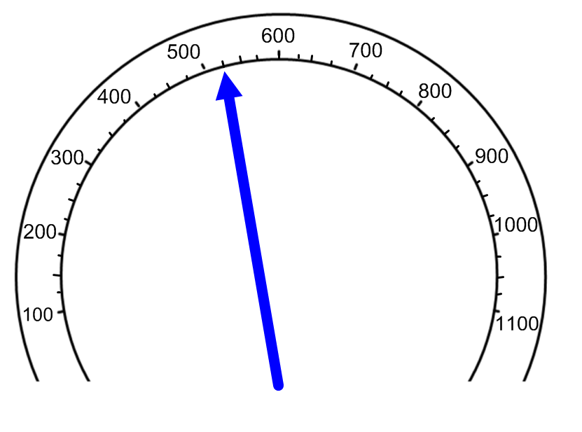
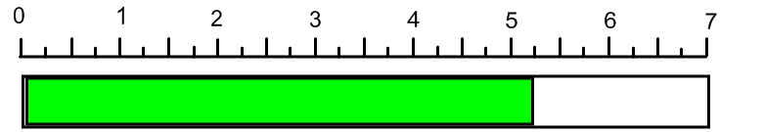
To escape earths gravity you need to reach a speed of 810 mph. Below is your speedometer. Read the current speed from the speedometer and record it.
Speed
__________
mph
How much faster will you need to be going to successfully escape earth’s gravity?
_______________________________________________________________________________________________________________
As you escape the earths atmosphere you will be hit by radiation, this has to stay at a safe level. The level is 3.75 rad. How much over the safe level is your ship if the level is shown below?
_______________________________________________________________________________________________________________

Slide 7
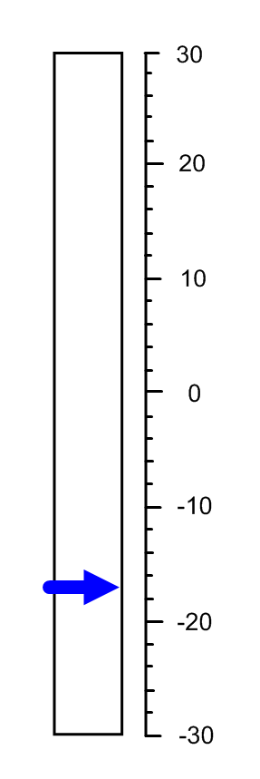
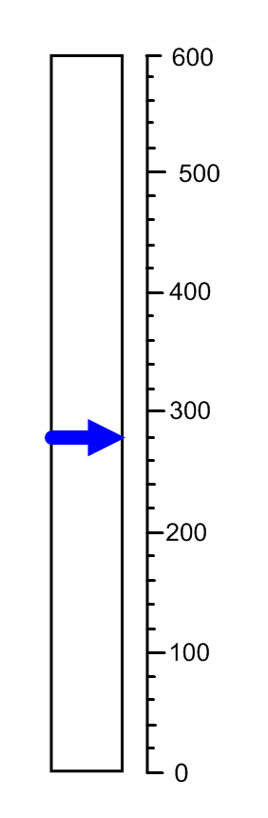
The temperature of the ships hull needs to be carefully watched if it falls below - 15 the ship will fall apart! Check the thermometer below are you still safe?
What is the reading? _________
Are you safe still? _________
As you enter Mars’ atmosphere the temperature of the hull cannot reach more than 450 C . The thermometer below shows the temperature, are you safe?
What is the current temperature? ______
How much can the temperature rise before it reaches 450c (show your working)
____________________________________________________________________________________________________________________________________________________

Slide 8
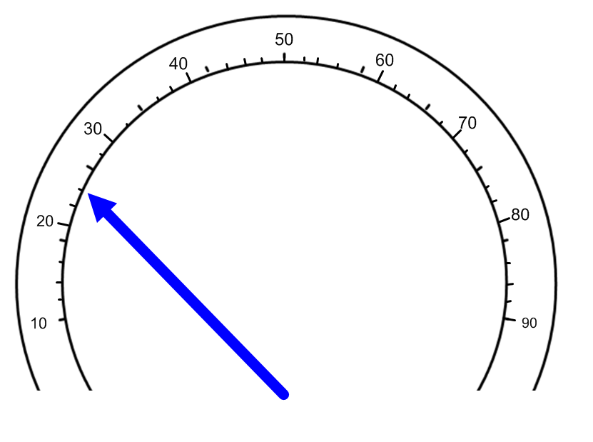
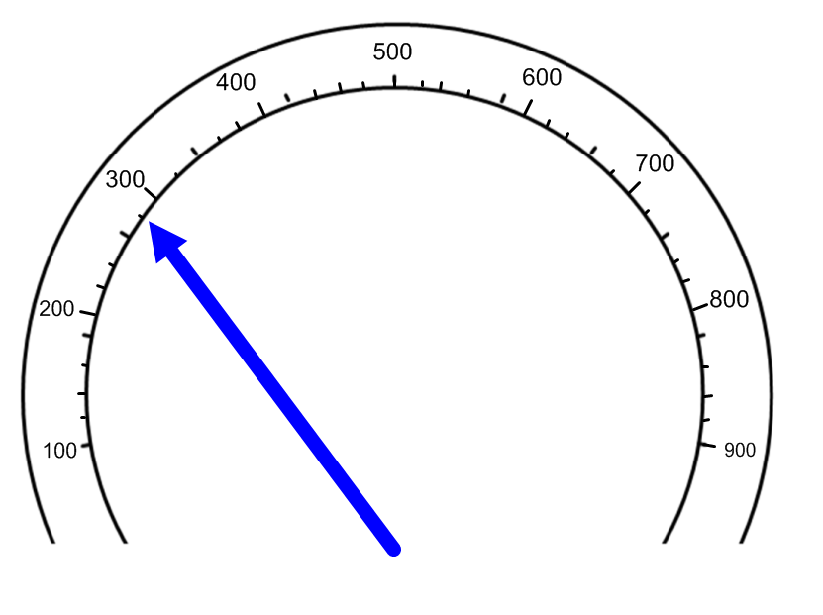
Whilst on Mars you need to fix your ships electrics. You use an ameter which measure amps. You need to have at least 43 amps for your ships electrics to work properly. How many amps do you have if the reading below is correct.
What is the reading at the moment? ________
How many more amps do you need? (show your working)
________________________________________________________________________________________________________________________
During your stay on Mars you must collect 355 kilograms of rocks. The meter below shows how much you have collected. How much have you collected so far? ___________
How much more do you need to collect?(Show your working)
________________________________________________________________________________________________________________________________________________________

