Slide 1
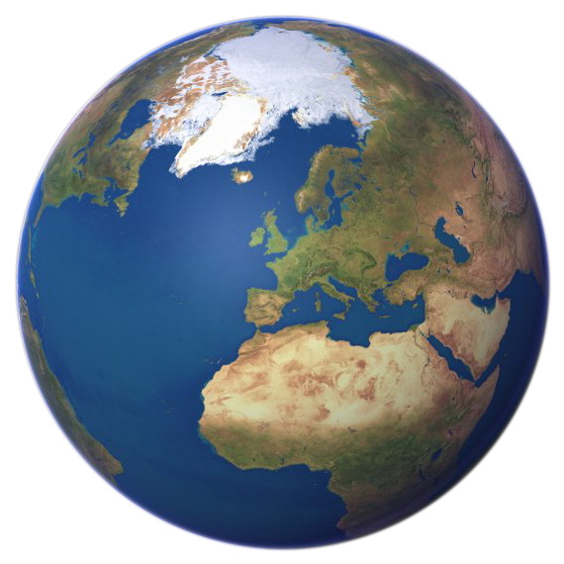
Where in the world is our agent?
An investigation involving estimation, formula and addition.

Slide 2
Top government agents have produced a secret code. Can you study the code and explain the formula?

Slide 3
Secret country code breaker
a | b | c | d | e | f | g | h | i | j | k | l | m
1 | 2 | 3 | 4 | 5 | 6 | 7 | 8 | 9 | 10 | 11 | 12 | 13
n | o | p | q | r | s | t | u | v | w | x | y | z
14 | 15 | 16 | 17 | 18 | 19 | 20 | 21 | 22 | 23 | 24 | 25 | 26

Slide 4
Each letter has a value which is equal to the position it has in the alphabet.
A is the first letter = 1
B is second = 2
Z is last, so = 26

Slide 5
Where in the world is this?
6 18 1 14 3 5

Slide 6
Can you add up the numbers to give the country a quick code number?
6 + 18 + 1 + 14 + 3 + 5=

Slide 7
How do you add up?
6 + 18 + 1 + 14 + 3 + 5=
Along the line?
Tens first then units?
Units then tens?
Big to small?

Slide 8
How do you add?
+ 18 + 1 + 14 + 3 + 5 =
6+14 18+1 3+5
19 8
47
20
20
7

Slide 9
Where in the world?
6 18 1 14 3 5
47
F r a n c e

Slide 10
France is worth 47…..
Can you predict which country has the most points?
Latvia
England
Greece

Slide 11
Why did you think this?
Latvia
England
Greece

Slide 12
Can you work out the number codes for
Latvia
England
Greece

Slide 13
Can you work out the number codes for
Latvia
12 1 20 22 9 1 = 65
England
Greece

Slide 14
Can you work out the number codes for
Latvia
12 1 20 22 9 1 = 65
England
5 14 7 12 1 14 4 = 57
Greece

Slide 15
Can you work out the number codes for
Latvia
12 1 20 22 9 1 = 65
England
5 14 7 12 1 14 4 = 57
Greece
7 18 5 5 3 5 = 43

Slide 16

Our agent has just sent a message saying that he needs to be rescued from a country. Code 100
He needs to be flown to a country with the smallest value code. You have 10 minutes to rescue him .
Good Luck.

Slide 17
Where is code 100?
Wales Denmark New Zealand
Turkey Holland Zimbabwe
India Australia Italy
America Venezuela Canada
Egypt Germany Japan
and where shall we take him to hide? (the smallest total)

Slide 18
The code was too easy to break.
I have designed a new code using a formula of numbers for letters but I have lost my code breaker. All I have are the names of 6 countries and their codes but they are muddled.
Can you sort them out and work out the formula of the new code?

Slide 19
New code breaker
a | b | c | d | e | f | g | h | i | j | k | l | m
n | o | p | q | r | s | t | u | v | w | x | y | z

Slide 20
Code mix up…
England
New Zealand
Holland
Zimbabwe
Australia
Egypt
27,9 ,45, 53,9,1,23,1,27,7
9,13,51,31,39
15, 29, 23,23, 1,27,7
53, 17, 25, 3,1,3, 45, 9
1,41,37,38,35,1,23,17,1
9,13,51,31,39

Slide 21
Code mix up…
England
New Zealand
Holland
Zimbabwe
Australia
Egypt
27,9 ,45, 53,9,1,23,1,27,7
9,13,51,31,39
15, 29, 23,23, 1,27,7
53, 17, 25, 3,1,3, 45, 9
1,41,37,38,35,1,23,17,1
9,13,51,31,39

Slide 22
Can you work out the formula for the new code and explain it ?
New code is ‘double old code’ –1.
Old code New code
C= 3 C = 3x2 – 1

Slide 23
New code breaker
a | b | c | d | e | f | g | h | i | j | k | l | m
1 | 3 | 5 | 7 | 9 | 11 | 13 | 15 | 17 | 19 | 21 | 23 | 25
n | o | p | q | r | s | t | u | v | w | x | y | z
27 | 29 | 31 | 33 | 35 | 37 | 39 | 41 | 43 | 45 | 47 | 51 | 53

Slide 24
Where is code 100 answers.
Wales Denmark New Zealand
Turkey 100 Holland Zimbabwe
India Australia Italy
America Venezuela Canada 24
Egypt Germany Japan
and where shall we take him to hide? (the smallest total)

