Slide 1
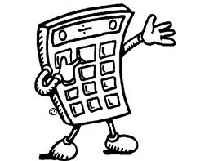
Mental Maths Warm Up WALT: I can state what fraction and percentage of a shape is shaded
Example:
Calculate how many squares altogether (2 x 5 = 10)
Count how many are shaded (7)
Represent this as a fraction (⁷/₁₀)
Convert into percentage (70%)
Top Tip! Use your calculator to find percentages from fractions!!
E.g. ⁷/₉ → (7 ÷ 9) x 100 → 77.8%

Slide 2
WALT: I can state what fraction and percentage of a shape is shaded
A.
D.
B.
E.
C.
Now, create your own shape in the back of your book. Find out its shaded area in fraction and percentage.

Slide 3
WALT: I can state what fraction and percentage of a shape is shaded
A.
D.
⁸/₁₆ = ½
= 50%
¹¹/₂₅ = 44%
B.
⁹/₂₅ = 36%
E.
³⁴/₆₃ = 54%
C.
¹⁴/₂₄ = 58.3%

