Slide 1
Who Dunnit?
Use the information given to find out who was the murderer.

Slide 2

Breaking News!
Yesterday, the mayor of Gressinton was murdered, and police are appealing for information, as the murderer has not yet been found. They put forward this statement:
“Mayor John Fresburg was a much loved member of the Gressindale community, and shall be much missed. If you have any information, please contact us. Thank you.”
But however much the police say he will be missed, some members of the community disagree. It is possible that one of these less favourable members of the small village could have committed the crime out of revenge for the way he governed.
So far, however, the police have no obvious leads, so if you have any information that could help out with the case, please contact D.I. Hart with the phone number: 0187 332 7620

Slide 3
How it’s done…
You may have noticed some spelling mistakes in the letter.
Well, every wrong letter makes up the answer.
Example: Mh nami is Laura = Hi
Can you figure it out now?

Slide 4
Hidden Message…
How it’s done…
Knowing that you, Frederick Mills (a special detective) are staying in town at the moment on holiday, the police sent you a letter, the content of which is coded.
Good luck in solving it.
COME SOON WE NEED YOUR HELP

Slide 5
D.I. Hart
You do as the coded letter asks, and visit D.I. Hart at the police office.
He is secretly impressed with your work, and asks you to analyse the crime scene.
You arrive at the scene of the crime. What do you notice about the place that is strange?
D.I. Hart asks you to write out a report describing the crime & scene. Good Luck.

Slide 6
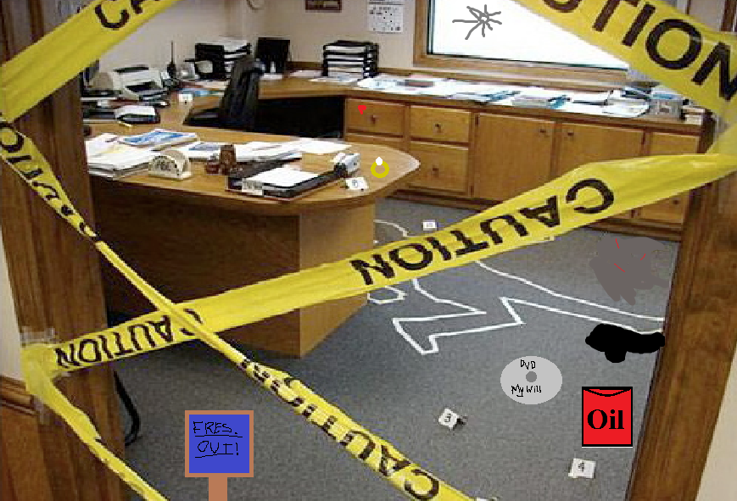
Here is the crime scene…
What do you notice?

Slide 7
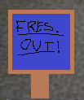





C.S.I…
You find the following:
A sign reading ‘Fres. Out!’
An oil can with a pool of oil
A DVD reading ‘My Will’
A wedding/engagement ring
A spot of blood
A shot hole through the window
And a spot on the carpet that has red strips (maybe of blood) on it.

Slide 8
Interviews
Well done! When you get back to the station, D.I. Hart sends you to the interview room, without telling you your task.
You go to the room to find another officer finishing the interviews.
She gives you a map and the interview sheets and asks you to mark where each person states they were on the night of the crime. Good luck!

Slide 9

Mark on the map where each person was.

Slide 10
The Weapon
You should have enough information from the crime scene, interviews and story to know that the weapon was… what?
It was a gun! Or so you may think…

Slide 11
The Weapon (continued)
When doctors looked over the body, they found a gunshot, but they didn’t think it was what killed him.
Look at the image. Why did they think it wasn’t the gun that killed him?
What did they think it was?

Slide 12
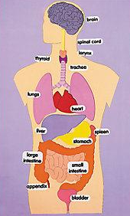


What was the murder weapon?
Here is another wound…
This was the cause of his death, not the gun
The sign hit him right at the front of his head, making him virtually dead (brain dead) and the killer, seeing him still breathing, shot him, afterwards.
Here is the gun shot wound
The reason it wasn’t the gun that killed him was that the bullet narrowly avoided the lungs and heart.
It was… the ‘Fres. out’ sign!
The crime scene will help…

Slide 13
Evidence...
We haven’t yet taken a closer look at our evidence.
Why are these there?
D.I. Hart has left the station, so you decide to let yourself look at the evidence.
Who may have left these things here?

Slide 14
Fresburg Out!
Who would have most wanted Fresburg to be ‘out’ (not mayor)?
GILBERT POLLO
RODERICK
MS LILA

Slide 15

My Will…
Why would Fresburg be writing his will?
Who was involved in his will and testament?
What is on the DVD?
Who wanted his money?
SOLICITOR
HARRIS
GILBERT
MS LILA

Slide 16
The Ring
Who was he married to?
MS LILA

Slide 17

Who is telling the truth?
So, which suspect(s) are telling lies?
Look at the interviews and map and think about who could be telling fibs…
Have you got it down to your killer yet?

Slide 18
So… Whodunit?
It’s time! D.I. Hart expects an answer from you, and soon, so have another look over your evidence and decide… WHODUNIT?
It was…
MS PENELOPE LILA!

Slide 19
Let’s look back…
Did you figure out who it was?
Why was it Penelope?
Did you enjoy this activity?

Slide 20

Writing Task
Write a conclusion to the case, stating:
the murderer,
motive,
how they murdered him,
the victim,
date of murder (make it up),
final statement,
whether they pled guilty or not,
their sentence (e.g. 20 yrs in jail)
a picture of Penelope in jail clothing (stripy black and white).

Slide 21

Homework
Make your own ‘whodunit’ mystery. It doesn’t have to be as long as the one you’ve just done, just try to be creative. Draw pictures, make factfiles, whatever you want!
Due in: ______________

