Slide 1
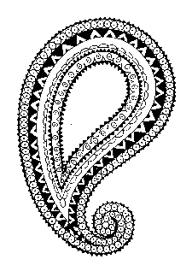
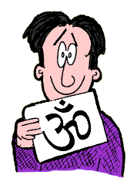
Hinduism
Wednesday 7th November 2012
Term 2 Week 1

Slide 2


To know the Hindu story and meaning of Raksha Bandhan
Recall some of the key points in the story of Raksha Bandhan
Know that Raksha Bandhan is a Hindu festival for brothers & sisters
Know what the string bracelet made for brothers represents

Slide 3
Raksha Bandhan
*Festival for brothers and sisters*
good things about having brothers and sisters are...
☹ not so good things are...

Slide 4
Celebrate
Would you want to celebrate having good brothers and sisters?
Why?

Slide 5
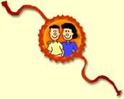
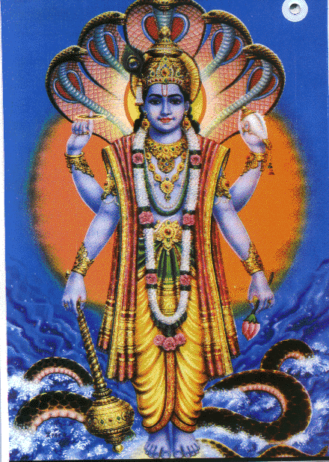
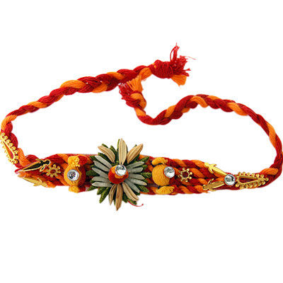
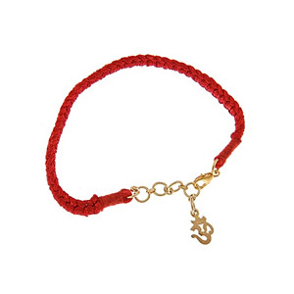
Vishnu
Gave thread to the wife of the god Indra. This brought luck to Indra who defeated the wicked King Bali.
To remember this, sisters gave brothers a bracelet made of string, which they keep on for a week.
The bracelets represent love and care for their siblings – they want to protect them.

Slide 6
Hindu girls give their brothers a bracelet made of string. They wear it for a whole week and promise to look after their sister.
How might a brother look after their sister?

Slide 7
Make your own bracelet
Make bracelet
Take a picture of it
Draw a picture of your bracelet
Write about it

Slide 8
AFL
Recall some of the key points in the story of Raksha Bandhan
Know that Raksha Bandhan is a Hindu festival for brothers & sisters
Know what the string bracelet made for brothers represents

